Slide 1

CONUNDRUMS IN THE DIAGNOSIS OF TCMR
Professor Parmjeet Randhawa, M.D.,
Division of Transplantation
Department of Pathology
University of Pittsburgh
Notes:
50 mins could be readily achieved in the final version of muh talk---Banff updates for tes grand round
Dec 12 Tuesday: 12:45 pm to 1: 30 pm and is back to the same date?
Thank you Geetika for that very nice introduction; If my father was here today, he would swell up with pride. As for my mother, she would be wondering how I transformed myself from her--Pamma-Nikamma---to the person you have just described.
My thanks also to the organizing committee and the isrtp leadership for giving me an opportunity to visit Nadiad, and enjoy what this region has to offer.
Clinical trials 6s, 6 mins timed
.
.

Slide 2
DISCLOSURES
Consultancy: Takeda Pharma inc &Allovir Inc. (Viralym-M trial)
Editorial Board: Clinical Transplantation
Board of Director: Renal Pathology Society
Notes:
These are my disclosures, none of which are relevant for today’s talk

Slide 3
Outline of Talk
Impact of TCMR in kidney transplantation
Evolution of the category Borderline Change
Disagreements in molecular vs histologic diagnosis of Acute TCMR
Entity of mixed Acute TCMR-ABMR
Significance of V-lesions (= intimal arteritis)
Concept of chronic active TCMR
Notes:
Here is an outline of my talk. The areas I am going to cover are

Slide 4
Current Burden of TCMR in UPMC Tx Program
sTCMR in 29.1% --& cl-TCMR in 16.6% ---PBx 3m 12m
A-ABMR 4.6%, low risk , White, Caucasian, Non-sensitized
Virtually all ABMR biopsies have BL or higher TCMR
21% sT & 34% cT develop dn DSA < 1y (transient 75%, 46%)
12/13 (92%) patients dnDSA < 2y have SC-i in Pbx
Notes:
I will begin with this slide intended to give you an overview of the current burden of TCMR in kidney transplantation-----------
This data is the result of work done by my colleagues Rajil Mehta, Bill Hoffman and Arvind Cherukuri.--------It has been shown that subclinical-TCMR is seen in 29.1% & clinical l-TCMR in 16.6% of all PBxs performed at 3 or 12 m post-tx
By comparison, our incidence of ACTIVE/ACUTE ANTIBODY mediated rejection is 4.6% …we are talking of a very low risk population, consisting primarily of White, …Caucasian, …Non-sensitized patients. ……….Virtually all our biopsies with ANTIBODY mediated rejection have BL or higher TCMR
21% of subclinical & 34% clinical tcmr patients develop dn DSA within 1 yr of follow up (transient 75%, 46%)
Notably 12/13 or (92%) of patients with denovo DSAs that developed within 24m...had Subclinical inflammation in their protocol biopsies (sci includes subclinical i1t0, subclinical BL, and subclinical TCMR biopsies)
Xxxxxxxxxxxxxxxxxxx
(although these DSAs are transient in 75% & 46% of patients respectively of the subclinical and clinical TCMR ps )Hoffman: I could not readily find relative TCMR incidence at 3m and 12 m
TCMR arteritis:15% graft loss at 6 yrs (2% controls)
ABMR arteritis: rate of graft loss is 60%
- T-cells present in intima in all cases
- 2/3 i+t sum score >3 (mixed Ab-TCMR)
Mehta et al AJT 2018: 18: 1710: in a study that focused on sci 12/13 =92% denovo DSA by 24 m occurred in patients who had a biopsy with sci (1/13 in patient with no sci)(sci defined as i1, subclinical BL and subclinical 1A) (serum creatinine at 24m was higher 1.6 versus 1.4, chronicity score was higher 2.4 versus 1.9, lower GFR 48 versus 43); denovo DSA was higher 12/129 VERSUS 1/71) (No donor biopsy; no demonstrable effect graft loss)(378 patients January 2013 to nov 2014)
Hoffman et al. TX 2019 103 1457 allows rate calculations using PBX: sTCMR 56/192= 29.1%, clinical TCMR 32/192 = 16.6%; ABMR is 4.6% (and can be doubled or tripled to compensate for less than rigorous case by case analysis, as opposed to just tallying the check marked boxes in pathology reports)(yes some of the incidence reflects our aggressive BL calls and the inclusion of IFTA inflammation, but it is biologically valid, as shown by our own BL data and IFTA data from many groups)
Cherukuri et al; Kid int 2019 96 202 reports 36.7% TCMR in first year (53% is subclinical) = not all that different from Hoffman where in 29.1 + 16.6 adds up to 45.7%; the fact that detection of DSA preceded or coincided with biopsy only reflects the non-availability of ELISPOT type assays monitor T-cell alloimmunity in the same way that we can monitor antibodies. Figure s6: Prevalence of impending graft loss similar in TCMR->DSA and in DSA->TCMR groups
Xiaomu pure TCMR 7.9% = somewhat under-estimates extent of problem because of insistence on very stringent criteria for DSA timing within 30 days and C4d testing (but is still close to about 10% incidence of Rajil subclinical inflammation but not close to Hoffman or Cherukuri subclinical and clinical rejection )
Chemouny/Anglicheau’s group: Transplantation 2015 99 965: 21% of TCMR patients had dnDSA develop mean of 5.1 +/- 3.9 m later; he quotes 10% at 1 year in references 8, 10 and ~15% at 2 yrs in references 8 10 13
Wehmeier/Schaub Transplantation Direct 2017 3 e 136: Basel; 2009-2014: 251 biopsies from pre-transplant DSA negative patients (81% were protocol biopsies: 538:125 for a total of 663 including 163 pre-transplant DSA POSITIVE pts
Hari lecture notes: you can double ABMR incidence from 4% and it will still be comparable to TCMR estimates (unsensitized, Caucasian population, cross match negative population)
Rajil defines subclinical I as I+t>0 & shows more ifta but does not translate each biopsy to a Banff diagnosis, and serum creatinine is averaged (confounded by outliers)
Aravind says DSA meaningful only if there is TCMR or non-compliance—but does not analyze C4d or translate each biopsy into an ABMR category (claims 1 yr TCMR 36.7% with 53% subclinical (not BL); DSA preceded or was concomitant with TCMR in 80% (no surprise since No T-cell elispots done)
(note our immunosuppression protocol consists of thymoglobulin induction, Tacrolimus monotherapy, steroid free, with most patients being low risk, Caucasian, non-sensitized, cross match neg) (xiaomu 7.8% 12bl+16tcmr=28/361 = 7.8%)(I think the treated borderlines are included here)
-eGFR in patients with one episode of pure tcmr: is 18ml/min lower Than controls)
HR for graft loss for TCMR is 3.0 as per (University Minnesota without detailed antibody work up)
-

Slide 5
Data from Basel: 500 Bxs (DSA –ve PreTx)
.
 | Protocol = 407 | Indication = 93
Borderline | 34.6%. | 21. 5%
TCMR | 6.9% | 44.0 %
Suspicious for ABMR | 2.2 | 7.5
Acute/caABMR | 0.0 | 1.1
Mixed | 1.5 | 7.5
Notes:
Pittsburgh is not an outlier in terms of our incidence of TCMR: ……Here is some data from across the Atlantic in Basel, Switzerland ……where they studied 500 biopsies;
These were all DSA negative prior to transplant.
.***The right column*** shows that …amongst 93 indication biopsies collected over a 6 year period from 2009-2014, …the incidence of BL change, ..TCMR, …suspicious for ABMR ….and acute/chronic active ABMR… was 21%, 44%, 7.5% and & 1.1% respectively.
***PROTOCOL biopsies in the left column showed essentially the same distribution AS INDICATION BIOPSIES--except that there were more BL biopsies34 % vs 21%,--- and SUBSTANTIALLY fewer definitive TCMRs 6.9% VS 44%)
Xxxxxxxxxxxxxxx
It is important that the concept of BL when it was first conceived in the 90s was intended to prevent over treatment of rejection.
Pittsburgh and many other centers that perform PROTOCOL biopsies use BL change as in indicator that inflamm has not been sufficiently suppressed; Puneet says most cases will get optimization of immunosuppression (though only about 20-30% will get steroid doses depending on sensitized status, FK506 level, pathology review under the microscope)
AND certainly none of these patients will be subject to further reduction of calcineurin inhibitor dosage, as is the practice in many programs if patients continue to do well
xxxxxxxxxxxxxxxxxxxxxxxxxxxxx
It was frozen C4d and DSA was on day of biopsy
sABMR is suspicious for ABMR, a term no longer recognized by Banff but cases in this category are seen in real life, particularly if DSA is not available, and C4d on a small tissue fragment taken for C4d is negative. (yes small frozen fragment could explain why 71% of biopsies in suspicious category were C4d negative)
The reason for low calls for definitve ABMR was missing DSA and 71% were C4d negative: but these are captured in the suspicious for ABMR category
Mixed categnory included BL
Note how BL and susp categories exceed definitive diagnosis, and HENCE THE NEED FOR properly validated and MORE USEFUL RISK STRATIFICATION TOOLS

Slide 6
National Data on ABMR (USA)
ACUTE ABMR:
USA: 1-10% in different programs (~25k KTx yrly)
Incidence in patients who are DSA+ at Tx is 25-40%
CHRONIC:
Abs blamed for loss of up to 64% of grafts
Contributory rather than sole cause of graft injury in these cases (antibody assisted rejection)
Notes:
FOR COMPARISON: Here is some national data on ANTIBODY mediated rejection-----For ACUTE ABMR, the Incidence is estimated to be 1-10% in different programs----The annual # of kidney transplants in the USA in the year 2019 was ~ 23,400.
-Incidence in DSA positive patients can be as high as 25-40%--- but only SEVERAL HINDERED such transplants are done annually, so the magnitude of THAT problem is relatively small.
With respect to Chronic ABMR; antibodies, abs blamed for loss of up to 64% of grafts ---In my opinion antibodies are a contributory rather than sole cause of graft injury in these cases------(it will be biologically more correct to call them antibody assisted rejections).
Xxxxxxxx
Incidence of acute ABMR in patients who are DSA+ at Tx is 25-40% of only about 300 Ktx done annually
23400 likely includes living donors; Washington Post article via Google (also 14,000 type numbers are the wait listed numbers)
2020 review of epidemiology led to the following insights:
1-10% figure is from Chehade and Pascual; Transplantation 2016: 100: 264
(shire slides below say 10% of ABMR were hyperacute/accelerated so the rest must have been acute)
FDA Public Workshop Transplantation 2018: 102: e257: 14,000 patients in USA are on wait listed as highly sensitized (PRA 80-100%); denovo DSA develops in 15-25% within 5 years (though some centers report upto 20% in first year, depending on sensitization, methodology, cut offs) ; 2% per year in adherent patients;
non-adherence is a primary cause of dnDSA with one study showing prevalence of 90% in clinical dnDSA versus 24% for subclinical dnDSA and 5% for patients with no dnDSA and functioning grafts)
Reference 42: at time of dnDSA detection, 20% biopsies meet Banff criterion acute TCMR, 25% acute/active ABMR, 7.5% chronic active ABMR; one year later acute/active ABMR up to 52.9%, chronic active to 38.2% while acute TCMR remain unchanged (I think mixed TCMR is being ignored)
Chemouny/Anglicheau’s group: Transplantation 2015 99 965: 21% of TCMR patients had dnDSA develop mean of 5.1 +/- 3.9 m later
Senev/ Naesens: Am J Transplant 2019 19 3100: PreDSA: 52% resolve but 54% still develop ABMR (not statistically different from 41% ABMR if DSA persists) and OR for graft loss still 12.5 (though lower than 45% if DSA persists); histology in both groups similar
(in one recent publication in the J Am Soc Nephrol)
- However ---------(& this is a point I will be illustrating further throughout my talk)(Very often LESIONS BEING USED TO LABELS BIOPSIES AS ABMR ARE REALLY CASES OF MIXED ANTIBODY AND T-CELL mediated injury)
xxxxxxxxxxxxxxxxxxxxxxxxxxxxxxxxxxxxxxxxxxxxx
Data if from a slide presentation given by Shire to investigators participatingin a multicenter trial of C1-esterase inhibitor in amr (Cinryze)
25000 patients on waiting lists have HLA antibodies (Dept HHS 2009) and experience prolonged wait for organ; 6000 on wait list have willing donor but DSA positive;
Desenstization helps but 10% do lose graft early due to hyperacute or aggressive acute amr

Slide 7
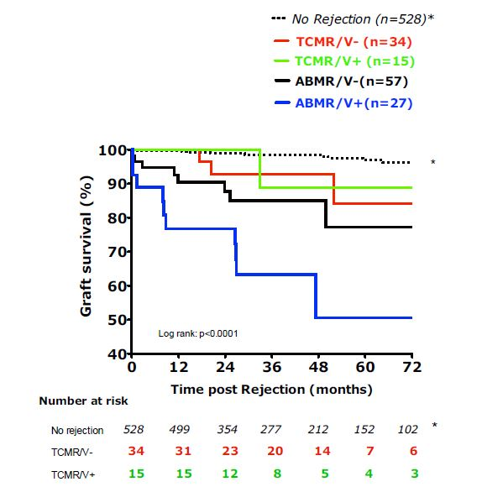
Effect of TCMR on Graft Survival
Notes:
This data from the Paris groups shows the effect of T-CELL mediated rejection on graft survival. ---PATIENTS ARE STRATIFIED BY TYPE OF REJECTION….
***Black DOTTED LINE*** : are patients with no rejection---who had an excellent graft survival of 98% at 6 yrs.
***RED***-TCMR presenting WITHOUT ARTERITIS (red line)-- or WITH ARTERITIS (***green***)-----WITH NEGATIVE C4d--- and no DSA ----had a graft loss of ~15% at 6 yrs. ---ALTHOUGH not actually so stated, very likely PERHAPS AN EQUAL… if not a greater NUMBER HAD low GFR …..or what is referred to as IMPENDING GRAFT LOSS ---and these patients were JUST HANGING IN THERE.
*** Black SOLID*** In ANTIBODY mediated rejection, without arteritis…rate of graft survival was about 80%
.. --AND ***BLUE**--with intimal arteritis it fell to about 50%.
xxxxxxxxxxxxxxxxxxxxxxxxxxxxxxxxxxxxxxxxxxxxxxxxxxxxx
Bottom border -→This PHOTOMICROGRAPH is inserted here to remind you that MOST CASES CLASSIFIED SIMPLY AS ABMR have plenty of T-cell infiltrates ….and therefore TCMR is infact participating in mediating graft injury in these biopsies .
Xxxxxxxxxxxxxxxxxxxxxxxxxxxxxxxxxxxxxxx
- T-cells present in intima in all cases
- 2/3 i+t sum score >3 (mixed Ab-TCMR)The graft survival for Arteritis with TCMR in the validation cohort (n=661)s Lancet study was ~85% at 48 m (and at 72 m);
Thus about 15% of grafts had been lost; and perhaps an equal number were chugging along although serum creatinine or gfr is not presented in this study.---so clearly TCMR remains a perceptible element in the long term survival of grafts.Note it is worse than control (but no stats presented); TCMR arteritis apparently somewhat better but probably not a real difference --[HOWEVER, in the main study cohort findings were slightly different: TCMR as a whole did 10-15% worse than no rej; TCMR v- did no worse; TCMR v+ odds ration 1.5 for graft loss but said not to be significant
Intimal arteritis with ABMR had a significantly; worse graft survival of about 50% at 4 yrs; PERHAPS IN PART BECAUSE AS A GROUP THEY DID NOT GET AGGRESSIVE STEROID OR T-cell THERAPY

Slide 8
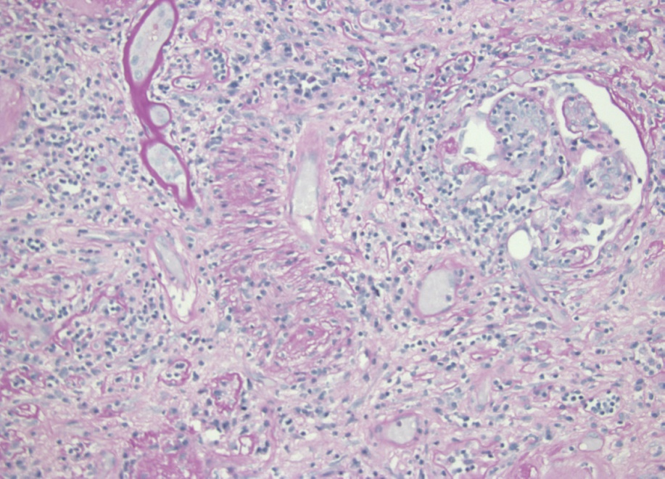
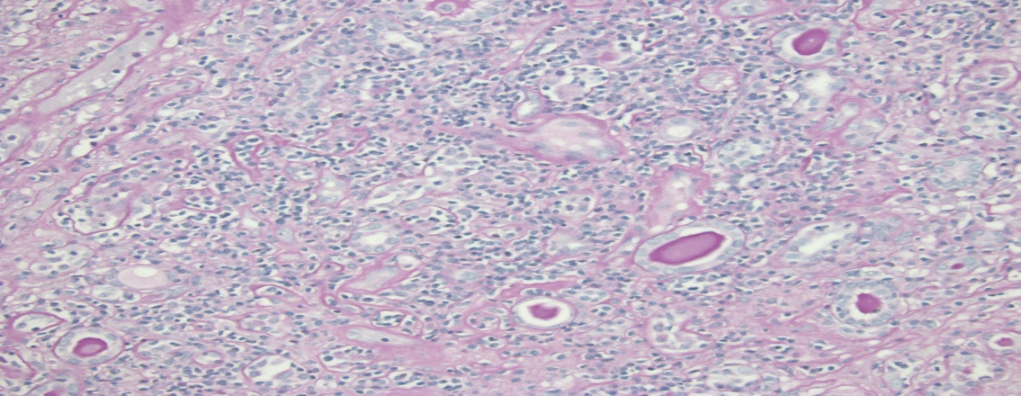
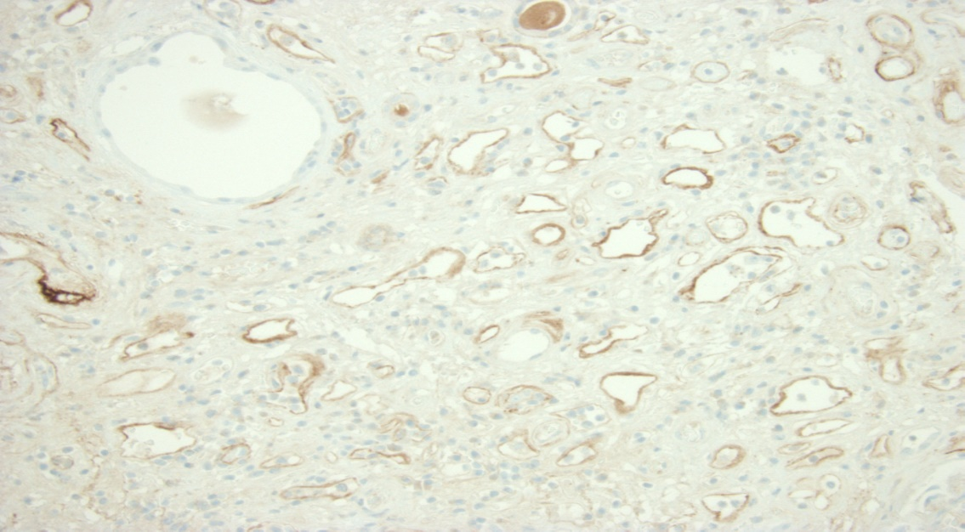
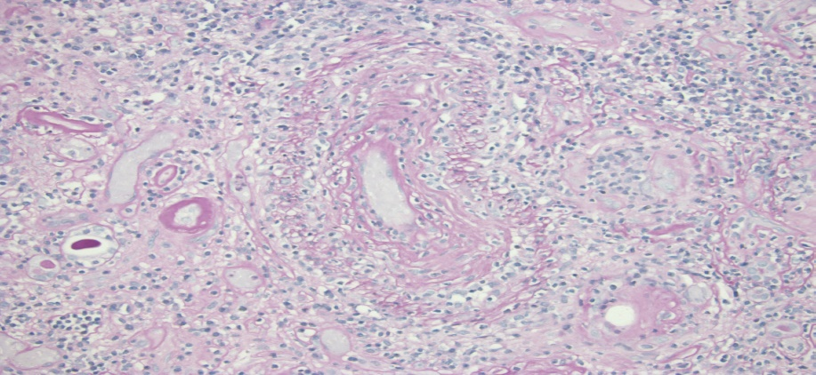
Typical Histopathology of Failed Grafts 5, 10, 20 yrs Post-transplant
.
T-cells predominant 100%; Sometimes written off as secondary
Notes:
This is what the typical histopath of failed grafts looks like, ---whether graft failure failure occurs 5, 10 or 20 yrs post-transplant;--- I emphasize the time post-transplant ---since you can find some literature which states that TCMR disappears at about 10 years after txn.
The tissue is TYPICALLY blue DUE TO dense t-cell infiltrates ***(a)***. ---There is destructive tubulitis ***(b)***,---- intimal arteritis ***(c)*** ---and C4d is indeed positive in about 60% of the cases ***(d)***
Green bar: T-cells are the predominant cell type in 100% of such cases. ------These T-cells are sometimes written off as being secondary to antibody mediated injury--- but in our experience ….many of these patients have had multiple episodes of rejection EARLIER in their clinical course, ------and there are well documented cases where DSA was clearly shown to appear AFTER an initial T-CELL INSULT.-----ACTUALLY, I DO NOT THINK IT SHOULD MATTER …whether T-cells came first or antibody came first. -----The fact is that WHEN both are present WE SHOULD PRESUME THAT THEY ARE both contributing to injury. ----- Hence, these biopsies should be called MIXED antibody and T-cell rejection, …and, when appropriate, TREATED WITH COMBINED ANTIBODY and T-CELL DIRECTED therapies
Xxxxxxxxxxx
If push back about gene expression profiles: WELL TO ME THE LYMPHOCYTES ARE ANGRY LOOKING, WITH EVIDENCE OF BLAST TRANSFORMATION, AND PRODUCTION OF CYTOTOXIC MOLECULES LIKE PERFORIN AND GRANZYME B
xxxxxxxxxxxxxxxxxxxxxxxxxxxxxxxx
T cells are present in 100% of failed grafts, and it is reasonable to argue that many of these cases or TCMR complicated by ABMR, or antibody assisted TCMR if I may use the term.
xxxxxxxxxxxxxxxxxxxxxxxxxxxxxxx
We believe there is a significant contribution of t-cells in the tissue injury that is seen in these specimens
The panels are g3, t3-ptc3, cv3, C4d
TCMR is rare (by molecular signal dilution and classifier being non-ifta rejection circular reason)
we used microarrays and conventional methods to investigate rejection in 703 unselected biopsies taken 3 days to 35 years post-transplant from North American and European centers. Using conventional methods, we diagnosed rejection in 205 biopsy specimens (28%): 67 pure TCMR, 110 pure ABMR, and 28 mixed (89 designated borderline). Using microarrays, we diagnosed rejection in 228 biopsy specimens (32%): 76 pure TCMR, 124 pure ABMR, and 28 mixed (no borderline). Molecular assessment confirmed most conventional diagnoses (agreement was 90% for TCMR and 83% for ABMR) but revealed some errors, particularly in mixed rejection, and improved prediction of failure. ABMR was strongly associated with increased graft loss, but TCMR was not. ABMR became common in biopsy specimens obtained .1 year post-transplant and continued to appear in all subsequent intervals. TCMR was common early but progressively disappeared over time. In 108 biopsy specimens obtained 10.2–35 years post-transplant, TCMR defined by molecular and conventional features was never observed.
We conclude that the main cause of kidney transplant failure is ABMR, which can present even decades after transplantation.
In contrast, TCMR disappears by 10 years post-transplant, implying that a state of partial adaptive tolerance emerges over time in the kidney transplant population.

Slide 9
Banff Categories of TCMR
Borderline
Type IA: t2 (i2 or i3)
Type 1B: t3 (i2 or i3)
Type IIA: v1 (any i or t score)
Type II B: v2
Type III: transmural inflam/fibrinoid.
Chronic Active TCMR
Arteries not inflamed
Notes:
WITH THESE prefatory remarks ABOUT THE IMPORTANCE OF TCMR, I am going to draw your attention to the different Banff categories of tcmr
These are Borderline, Banff types 1A and 1B if the arteries are NOT inflamed, ….and types IIA, IIB or III if they are inflamed-----and then we have caTCMR
Xxxxxxxxxxxxxxxxxxxxxxxxxxxxxxxxxxxxxxxxxxxxx
Borderline: criteria higher grade not met
- i varies 0-3, t=1 most often, but t=2 or 3 if i= 0,1
If there is discussion of patholgists being able to diagnose but not grade; you can say also argue than MDX is at the same stage
. I should also note that antibodies are frequently present in ~ 75% of biopsies graded as IIa IIb or III, but intimal t-cells are seen in virtually all cases, ie 100% of biopsies.
Xxxxxxxxxxxxxxxxxxxxxxxxxxxxxxxxxxxxxxxxxxxxxxxxxxxxxxxxxxxxxxx
Here is a simplified final version of the grading of acute rejection in Banff 1997 . This is the version used in the large majority of publications on TCMR.
Cooperative Clinical Trials in Transplantation (now merged with banff); >5% cortex, 3 foci tubulitis within 10 consec fields of worst I, and
2/3 other features (edema, activated L, tubular injury)
The term BORDERLINE CHANGES SUSPICIOUS FOR ACUTE REJECTION can be LOOSELY DEFINED as a biopsy that looks like rejection in terms of inflammation and tubulitis being present but criteria for a higher grade are not satisfied
Type 1 A rejection is characterized by grade t2 tubulitis; the inflammation score is i2 or i3
Type 1 B rejection must have at t3 tubulitis (at least 2 foci if tubular disruption criterion being applied) AND inflammation score of grade i2 or i3
Type 2a rejection is defined by the presence of grade v1 intimal arteritis; accompanied by any inflammation or tubulitis score; -----------sometimes we see biopsies with intimal arteritis with little or no inflammation; such cases are referred to as ‘isolated v1 lesions’; a multicentric study organized by the banff panel is currently looking into its significance (we tend to play it safe and treat it with steroids and careful clinical monitoring)
Type 2b rejection requires the presence of grade v2 intimal arteritis
And finally Type III rejection requires transmural inflammation or fibrinoid change; this is a virtual death sentence for the graft; the graft loss rate is in the 70-100% range
xxxxxxxxxxxxxxxxxxx
Peritubular capillary C4d deposition in any of these categories makes it necessary to diagnose concurrent amr ------(v3 lesion, according to some authorities occurs only in amr, though I often see it in the context of severe tubulitis in allograft nephrectomy specimens; with IIa & IIb the inflammation is often indistinguishable from that seen in 1a and ib, therefore in my opinion most of these cases should be called mixed tcmr and amr with intimal arteritis)
xxx

Slide 10
Conundrums in the Diagnosis of TCMR
BL category
Discrepancies Histo-MDx of Acute CMR
Mixed Acute TCMR-ABMR
V-lesions (defined by intimal arteritis)
Chronic active TCMR
Notes:
I will now proceed to the theme of my talk, ….which is to discuss conundrums in the diagnosis of TCMR. …..
The areas I will cover are:----- BL Category----- Discrepancies between the histologic & Molecular diagnosis of Acute TCMR …(focusing on 1A and1B categories)--- --I will discuss the so called V-lesions- characterized by intimal arteritis,---touch upon the concept of Mixed Acute T-cell and antibody mediated rejection.…and cap off this presentation by discussing CHRONIC active TCMR
XXXXXXXXXXXXXXXXXXXXXXXXXX
Chronic mixed T-cell & antibody rejection: I did not have time to build up similarly

Slide 11
Borderline Changes Suspicious for Acute TCMR
Conceptualized as TCMR not meeting criteria of Banff 1A
t1 tubulitis: i1 t1, i2 t1, i3t1; t2 tubulitis: i1t2 t3 tubulitis: i1t3
2005 schema allowed i1t0, i2t0 but Banff 2019 reverted i1t1
- Intent was to standardize Rx of ac TCMR in clinical trials
- 2005 threshold may apply rise unexplained rise creatinine .
- For optimizing baseline immunosuppression
- Trials seeking to PREVENT development of overt TCMR
Notes:
The term BL change susp for acute TCMR→
Was initially Conceptualized to refer to TCMR which was did not meet the criteria of Banff 1A
It included biopsies with t1 tubulitis: namely those with scores of i1 t1, --i2 t1, --and i3t1; ---- Biopsies with t2 tubulitis: with a score of i1t2 ---and biopsies with t3 tubulitis that have been scored as i1t3
The 2005 Banff schema even allowed biopsies scored as i1t0 and i2t0 but Banff 2019 has reverted to the original rule of making i1 t1 as the minimum threshold
-- for the purpose of standardizing Rx of ac TCMR in clinical trials
xxxxxxxxxxxxxxxxxxxxxxxxxxxxxxxxxxxxxxxxxxxxxxxxxxxxx
you can see that these scores are extremely heterogenous & at different times 5-8 combinations of scores have been allowed
Hence the Incidence & clinical correlates of BL biopsies will be be affected by I.S., biopsy policy, inconsistency in scoring, range of lesions included in cohort, & any empiric Rx given prior to biopsy
xxxxxxxxxxxxxxxxxxxx
Original thresholds intended to prevent over-Rx ACUTE TCMR
I must note that the original diagnosis thresholds for BL were intended to prevent over treatment of ACUTE Rejection, BUT CENTERS LIKE Pittsburgh THAT PERFORM PROTOCOL BIOPSIES USE IT TO MAKE MINOR ADJUSTMENTS IN I.S. & To GUIDE WEANING
XxxxxxxxxxxxxxxxxxxxxxxxxxxxxxxxxxxxxXXXXXXXXXXXXXXXXXXXXXXXXXXXXXXXXXXXX
Visual scoring of minor degrees of inflammation is not reliable; WE NEED TO COME UP WITH RELIABLE WAY OF QUANTIFYING INFLAMMATION AND TUBULITIS TO DO meaningful studies on BL; However not tool that are upto the task are currently available;
You should confirm this but mmdx scores reflect the probability of TCMR diagnosis (and not the severity of inflammation and tubulitis; though he could argue an intuitive relationship between the two)(and you may be able to find statements that agreements with histology are highest when molecular scores are highest, which I interpret simply as MMDx® missing focal disease)
Not sure this is true: T-cell burden not longer listed in MMDX reports (2nd page of report has many scores); In any case it d it will reflect transcripts of T-cell subpopulations, and not even account for subpopulations of macrophages, antigen presenting cells and other inflammatory cells
xxxxxxxxxxxxxxxxxx
Banff 1997 required i1t1; subsequently i0 also accepted if t>0 (thereby permitting 8 permutations of i& t) but Jan’s survey indicated 67% do not use it thus, and Nankivell isolated t study had no effect outcomes (while BL >i0 did show appreciable dip in KM curve);
A Banff 2019 survey is now being used to convey a consensus that i1t1 is indeed the minimum threshold for diagnosis of BL (5 permutations still remain after removing i1t1, i0t2 and i0t3)
Percentages presentation by Hallorran molecular diagnosis are population specific and will vary with medical center and clinical context—but have remained suprsiingly constant between 2012 BL paper and the latest histo-discrepancy paper (it is mostly the same centers I guess)
Borderline: one simple definition could be that criteria higher grade TCMR are not met; i varies 0-3, t=1 most often is 1, but can have t=2 or 3 if i= 0,1

Slide 12
Clinical Correlates of BL: #1Isolated t Lesions
Most biopsies i0 t1 (rarely i0t2, i0t3)
393 = 19% of 2055 consec Bxs 107 for cause
37.4% ATI, 28.0% IFTA, 12.1% Normal/minimal
9.3% had have “active rej”, 4 “vascular”, 6 Ab
2.8% classified as caTCMR, 5.6% BKVN
1 & 5 yr graft survivals 98.8% and 92.7%
Notes:
I would like to give you some sense of the clinical correlates of BL lesions. I will start with with paper by Nakivell on isolated t-lesions
These were defined as mostly i0 t1 biopsies (though rarely i0t2, and i0t3 biopsies can also fall in this category)
393 biopsies were studied representing 19% of 2055 consecutive biopsies (years 2012-2017) and 107 were done for cause (further described below)
37.4% ATI, 28.0% IFTA, 12.1% Normal/minimal
9.3% had have “active rej”, 4 “vascular”, 6 Ab
2.8% classified as caTCMR, 5.6% BKVN
1 & 5 yr graft survivals 98.8% and 92.7%
XXXXXXXXXXXXXXXXXX
Vascular rejection probable means intimal arteritis but further details C4d, DSA not specifically given; methods only make a note of pre-transplant DSA in 28% of all biopsies in the series, and for 36.8% of ISO-T biopsies (presumably very close to day of biopsy); C4d score of all isoT biopsies was 0.16+/- 0.5 probably on FFPE since rabbit polyclonal antibody is mentioned
6 Antibody probably means ABMR without intimal arteritis

Slide 13
BL > i1t1 Threshold
146 = 7.1% of 2055 consec, Bxs, 54 for rising creat
66% Rx as AcR, 28% C.R. 68% stable, 5% worse
i improved in 73%, 39% had subsequent AcR
At 1 yr, 22% C4d staining, 32% denovo DSA, 13 % cg, 19.2% moderate to severe IF & TA
1 & 5 yr graft survivals 94.5% and 81.7%
Notes:
Here is another Nankvell paper describing the clinical correlates of BL lesions above the i1t1 threshold (Defined as i1-3 t1, i2 t1 or i3 t1)
There were 146 biopsies representing 7.1% of 2055 consec, Bxs, 54 for rising creat
66% Rx as AcR, 28% showed complete response, 68% continued to show stable creatinine while 5% got worse
i- score improved in 73% of biopsies, and, 39% had subsequent AcR in a follow up bx
At 1 yr, 22% developed +ve, C4d staining, 32% denovo DSA, 13 % progressed to cg, and19.2% showed moderate to IF & TA
1 & 5 yr graft survivals 94.5% and 81.7%
THUS BL BIOPSIES WITH HIGHER INFLAMMATION SCORES WILL DO WORSE, AS ONE MIGHT EXPECT
xxxxxxxxxxxxxxxxx
YES CONSISTENT WITH HALLORAN CALL OF 68% NOT BEING REJECTION SINCE THEY WERE STABLE

Slide 14
Response to Rx in BL Biopsies is Very Heterogeneous
Scheweitzer et al. 58% CR, 30% PR
Saad et al. 63% CR, 13% PR
Dooper et al. 24% CR
Gaber et al. 8/8 (100%) CR
Not all BL biopsies get treated
Some have already been treated before Bx
Notes:
I have included this slide to make the point that If we look at the literature the response to steroid treatment in BL biopsies is very heterogeneous
-partial response rates vary from 13-30% and complete remission rates from 24-100%
Another variable is that not all BL biopsies get treated
(Pittsburgh depends on circumstance and gut feeling after looking at the biopsy under the microscope)(protocol biopsies more likely to be ignored than those performed for rising creatinine

Slide 15
Problems with BL Calls
Difficulties in grading inflammation
Imprecise threshold between i0 & i1
Non-accounting of density of inflammation
Wide range inflammation allowed:11-100%
Notes:
There are several some problems with BL calls. These include:-----Difficulties in grading inflammation, ---Imprecise thresholds for distinguishing i0 from i1 -----lack of attention to the density of inflammation, -----And also the wide range of inflammation allowed: ---it can vary from 11 to 100%
xxxxxxxxxxxxxxxx
G and ptc are allowed and this can lead to misclassification since we now these cases can represent ABMR
Inflammation in fibrotic areas is ignored—this is an issue I will elaborate on later in the talk
xxxxxxxxxxxxxxxxxxxxx
Based on arbitrary expert cut off without prior validation; t1 to t2 change with just one more lymphocyte in just one field in entire cortex can change the diagnosis if rules followed literally (and I do not do so—and I know other pathologist who follow a gestault approach)------ OR SAY HAVING A CUT OFF IS UNAVOIDABLE EG T-cell mediated acute rejection SCORE HAS ONE TOO; I agree if not valid we should change it--------------
Scarring---Another problem with tubulitis: ci scarring versus ci3; also ct1-ct3 with ‘’mild atrophy” alone allowed, and mild not defined;---problem has become worse since 90’s--Donor selection practices, Better immunosuppression, rejection beco greater use protocol biopsies,
Difficulties in grading inflammation (not to mention sampling issues)
Imprecise thresholds for i0 versus i1 not defined; Although it is said to be more than trivial in 1991 (later >10%-)
Non-accounting of the density of inflammation: the 10% of the biopsy that is inflamed could have 1 lymphocyte per hpf or 100
And finally, the wide range of inflammation allowed: it can vary from 11 to 100% (upto 50% in 1991; 11-100% in later version)
Heterogenous entitiy----even when non-immune causes reasonably excluded----t1 could be in every hpf with i3------Scores are very broad: i3t1 to i1t1; in which the response to treatment varies widely-----

Slide 16
mRNA-P Has Potential Utility in Bxs–BL
Quantifying inflammation as a substitute or i0-3
D/D quiescent vs immunologically active infiltrate
-- Inflammatory response to IRI vs alloimmune injury
MDx can not be currently regarded as a validated test for managing these cases
CAVEATS:
Conceptual issues with use of MCs
The sampling problem
Precision of MDx measurements
Notes:
Molecular diagnosis does have potential utility in biopsies with BL change:
It could be used to quantify inflammation as a substitute histologic grades varying from 0-3
And It could help in distinguishing a quiescent versus an immunologically active infiltrate.
OR an inflammatory response to ischemia-reperfusion injury (wound healing)---- from ---alloimmunity
However, neither MMDx® nor Nanostring technology can be currently regarded as validated tests for managing these case
This is because there are 3 important 3 CAVEATS, viz:
Conceptual issues with use of MCs in this clinical setting
The sampling problem (applicable to bulk mRNA profiling)
Precision of MDx measurements
Xxxxxxxxxxxxxxxxxxxxxxxxxxxxxxxx
Quantitation will only work for biopsies with fairly uniform distribution of i and t (which is not a common scenario)
Banff 2017 mdx recommendations simply lists potential use of TCMR classifier to distinguish between TCMR and no TCMR
The only other listed use of TCMR classifier is isolated V (TCMR vs ABMR may work if that fragment has a lesion we did not see; but probably could have seen if we had decided not to send it to MMDX)

Slide 17
Conceptual Issues with Applying TCMR Classifier to BL Biopsies
Discrepancies Histo-MMDX: n = 128 p-TCMR
~ 83/128 = 56% Histo BL = NO Molecular TCMR
Not MMDx® superiority; Case of circular reasoning
TCMR classifier taught not to call BL biopsies as rejection
Performance in real world is not matching the Training Set
..
Notes:
There are also some conceptual issues in applying the TCMR classifier to BL biopsies .
Here is some data from a study that evaluated discrepancies between histologic and MMDx® in a series of 128 pTCMR biopsies
(pTCMR or probable TCMR is the molecular equivalent of BL change).
83/128 or 56% of biopsies histology called BL were called no rejection on molecular diagnosis.
THIS IS not an example of MMDx® superiority (over histology); It is a case of circular reasoning
The TCMR classifier was taught not to call BL infiltrates as not TCMR.
Obviously its performance in the real world is not matching what was observed in the training set.
THE BIGGER issue IN MY MIND IS not why 56% are being called no rejection, but why the remaining 44% are still being called TCMR.
The expected number should really be really zero if the classifier were to faithfully perform the function it was asked to perform .
Xxxxxxxxxxxxxxxx
Belongs to sampling argument
I think QUANTIFYING rejection related genes ACROSS THE WHOLE LENGTH of the biopsy core may allow development of better diagnostic tests
xxxxxxxxxxxxxxxxxxxxxxxxxxxxxxxxxxxxxxxxxxxxxxxxxxxxxxx
Figures are estimated by me using a ruler with 1mm markings (Tabular data was not organized in a way that would let me translate histology data into molecular diagnosis; it forced me to do the reverse)
18% of BL biopsies were classified as ABMR, ------5% as mixed ABMR, ------7% as TCMR ------AND ONLY 3% WERE PROBABLE TCMR WHICH IS THE MOLECULAR EQUIVALENT OF BORDERLINE;
Clinical outcome of the ABMR and TCMR cases missed by histology is NOT AVAILABLE in this study;
For Histo +, MMDX- biopsies: ATC 2022 presented some data showing no difference is graft function in the first couple of years; BASED on my experience with unrx histo TCMR, differences are going to show up in 3-5 years
This is a problem with many MMDx® discrepancies.
The calls are different from histo, but we do not really know if they are more correct
We have been making TCMR calls for 50 yrs, and decisions based on these calls have resulted in a marked increase in GS; I think for histo+ MMDX-ve cases the problem is with MMDX fragment being only 3 mm, AND the threshold of molec TCMR having been set too high, which results in false negative molecular calls
xxxxxxxxxxxxxxxxxxxxxxxxxxxxxxxxxxxxxxxxxxxxxxxxxxxxx
Not sufficient data yet to make the case that MMDx® --the NEW KID ON THE BLOCK—is more correct THAN HISTOLOGY—-------------WHICH IS A SYSTEM THAT HAS SERVED US WELL FOR ABOUT 50 YEARS
0.2 CUT OFF chosen for ABMR as it resulted in 90% specificity for diagnosis of histology-DSA ABMR (10% error built in right there) sellares ajt 2013 13 971
Transcriptomics based scores (based on microarrays or RNA-seq) are a potential solution but are technologically complex, and we still have to address if they will be accurate enough, particularly when inflammation is sparse, and most in need of quantitation.
We know that < 2 fold differences can have a high SD and rigorously designed multicenter reproducibility studies will be needed)------(we can’t just have one commercial laboratory claiming they are very reproducible & making a pitch that the whole world send biopsies to them)
They are unlikely to be reliable particularly if small 3 mm or so pieces taken from tissues with focal pathology are sent as described in some publications (20% of biopsies focal)----in this setting Nanostring and RNA-seq on FFPE are expected to perform better than technologies such as mmdx which require fresh frozen tissue
Xxxxxxxxxxxxxxxxx
Total i > 25%, I-IFTA >25% criteria will need to be re-defined and re-validated by molecular diagnosis.
Histologic caTCMR covers a wide spectrum of pathology. Examples include the following:
Total i 27 units, I-IFTA 27 units (inflammation barely above current threshold & all in scar)
Total i 50 units, I-IFTA 90 (inflammation clearly significant but again mostly in “scar”= not described with respect to severity/density)
Even in biopsies that are histologic grade 0 -----(recognizing that the several dozen lymphocytes seen here definitely generate a molecular signal and the molecular inflammation score will not be zero but a discrete number)-----that number will be on a continuous scale & that would be better than an ordinal histology grade;
However the variability associated with that measurement will need to be determined;--- experience with existing molecular methods such as PCR suggests that the same sample being measured twice would generate numbers that would differ ~2-5 fold, particularly at the lower limit of detection (J. for example in patients with low grade BK viremia, many clinicians would not regard 5-10 fold changes between two time points very meaningful).
Figure 2. Clear histology-MMDx discrepancy scenarios where MMDx would provide a useful second opinion.
Panel A shows the overall mapping of all histology diagnoses per MMDx diagnostic category in the 1679
population. Panel B shows the mapping of MMDx diagnostic sign-out comments to histology diagnoses in the
1679 population.

Slide 18
THE SAMPLING PROBLEM
Different Microscopic Areas Look Very Different in 10-20% of Biopsies
Notes:
The 2nd issue I want to discuss in the diagnosis of BL TCMR is what I will callI thesampling problem; Different biopsy regions Look Very Different in ~ 10-20% of Biopsies that I present at a clinicopath conference every week.
Sometimes they differ dramatically in the degree of inflammation, tubulitis and fibrosis ----as seen in the top panel.
At other times only one of the cores is kidney, ---while the 2nd core may be fibrocollagenous tissue, ---skeletal muscle ----or skin.
xxxxxxxxxxxxxxxxxxxxxxxxxxxxxxxxxxxxxxxxxxxxxxxxxxxxxxxxxxxxxxxxxxxxxxxx
It is obvious that randomly taking one area for histology and another one for molecular diagnosis has the potential to result in molecular FALSE NEGATIVES for rejection.
Of course the Molecular Diagnostician----who has not seen the rejecting fragments---is going to swear he has not seen a rejection signal---and is going to consider the biopsy a HISTOLOGY FALSE POSITIVE
XXXXXXXXXXXXXX
Halloran: BOTH medulla and cortex found in 26 biopsies of intercom 300 study: incidence about 9% (perhaps another 5% might have been medulla only but that is not relevant to the issue of focality)

Slide 19
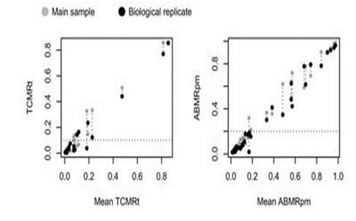
“Biologic” Reproducibility of MMDx Assays on 37 Biopsies
.
Samples not biologically distinct
Splitting 3-4 mm Bxs for TECHNICAL reproducibility does not capture variation seen in longer cores examined by LM
Notes:
(this slide is not included in the MMDx® talk)
Here’s some data on what was described as the biologic reproducibility of mmdx
Assays performed on 37 Bxs-----A 3-4 mm bx core was split into 2 pieces---& used to generate
REPRODUCIBILITY PLOTS of the MOLEC SCORES of TCMR ***(L. panel**--- & ABMR scores ***(R. panel)***
Left TCMR: You can see that some of the molecular TCMR scores vary over a 2-3 fold range particularly, PARTICULARLY for samples near the dx threshold.
Right TCMR: The same effect can be seen with the ABMR samples-----This is reminiscent of differences in histology grades of BL bxs called by pathologists—
Hence I doubt that MMdx will be able to quantify REJECTION ACTIVITY in the BL range—WITH A PRECISION SUFFICIENT FOR CLINICAL UTILITY. Indeed, I have recently reviewed a manuscript, that is not published, which confirms my suspicion.
I have 2 ADDITIONAL comments on this data: -----First these samples are really not biologically distinct as these were derived from the same patient ----the term technical reproducibility might be more appropriate.
My second comment on this study is that ---Splitting 3-4 mm Bxs does not capture variation seen in full length longer cores examined by L.M. (next slide)
XXXXXXXXXXXXXX
In this study the technical reproducibility was also measured by splitting the extracted RNAs from one sample into 2 replicate aliquots---the results were similar to those shown here
YOU SHOULD NOT CLAIM THAT THIS REPRODUCIBILITY IS AS BAD AS Banff Because the range if continuous is really from 1 to 1.0 (as opposed to ordinal Banff scores which can take only one of 4 values, 0, 1, 2 or 3
REALLY TRUE BIOL REPLICATES WOULD BE A DIFFERENT SUBJECT WITH THE SAME DIAGNOSIS, otherwise you are really measuring technical variability at a different time point in the same experiment (examples of that are indeed available & I have shown scatter of that in a different slide)
I also want to note that only 1 BL sample was studied for biologic repro, and more detailed analyses is desirable
AND secondly splitting 3-4 mm Bxs for biologic reproducibility does not capture variation seen in longer cores examined by LIGHT MICROSCOPY
Actually the BL sample would be equally reproducible if you only minced as small end of the biopsy
xxxxxxxxxxxxxxx
X-axis and y-axis abbreviation is TCMRt which must be mean TCMR transcript expression. y-axis abbreviatio ABMRpm I cannot figure out
Technical repro is splitting the RNA sample; Biol repro is splitting the biopsy core
They ran 37 Biol replicates : where tissue cores at least 4mm long were divided into two pieces1-3mm each.
Top box: The biopsy diagnosis are given here: most ie 12 were from a usually diffuse disease ABMR, ---10 were from the ‘Others or N/A category’ presumably also without regional pathology variations, ---there were 6 TCMR biopsies where it is not stated if the pathology was focally distributed or more diffuse (but the 3mm piece would not capture the variation in many biopsies).
OF NOTE only 1 SAMPLE WAS FROM BL CATEGORY WHERE REPRODUCIBILITY OF MMX WOULD BE AN ESPECIALLY DESIRABLE PROPERTY—though 3mm piece may not per se have much variation in it . NOMOA, no major abnormalities= ci<2 and no features of a disease process
This would be akin to asking 6 pathologists to look at a non-inflamed kidney and confirming that they do not believe any inflammation is present.
Left: Graph OF TECHNICAL VARIABILITY: it shows the mean of the paired TCMR scores on the x-axis, and the individual scores in the pair on the y-axis; MOST OF THE SAMPLES BEING TESTED FOR REPRODUCIBILITY OF THE TCMR SCORE DO NOT EVEN HAVE TCMR; THEN THERE IS ONE SAMPLE HERE WHERE THE PAIRED VALUES straddled the 0.1 threshold that was used to distinguish TCMR from non TCMR; in other words one member of the pair was called TCMR and the other one was called no TCMR (the denominator count of 6 is entirely from the figure and not easily found in the text)
I WOULD LIKE TO SEE A LARGER SAMPLE SET OF SAMPLES WHICH ACTUALLY HAVE TCMR To get a feel for HOW REPRODUCIBLE TECHNICAL REPLICATES REALLY ARE.
Right Graph: Shows biologic replicates evaluated for reproducibility of the TCMR molecular score and the ABMR molecular score. Again amongst samples being evaluated for TCMR score most of them do not even have TCMR, and out of the perhaps 7 or 8 samples studied 1 or 2 ie perhaps 15% do have ambiguous assignments
For ABMR score there is a much better spread of samples in the clinically meaningful range, and that is the kind of data we need for TCMR, to better evaluate, with most samples having a clear cut assignment of ABMR
Right box: Note that for BL biopsies there is NO REPRODUCIBILITY DATA COLLECTED AT ALL, AND PERSONALLY I AM SKEPTICAL THAT MOLECULAR DIAGNOSIS IS GOING TO BE USEFUL in THAT VERY HETEROGENEOUS CLINICAL SETTING– but a 3mm piece may not show the problem.
I predict that the technical (and biol) R might be better IF the case mix chosen is close to normal, but much worse if it is not
Xxxxxxxxxxxxxxxxxxxxxxxxxxx
For BL no estimates are even possible since only 1 biopsy was studied, I suspect they will be significantly worse
I could not get the number of dots in figures to match the table. HENCE I AM PRESENTING THE TECHNICAL (AND NOT BIOLOGIC REPLICATE GRAPH )
3 MM NOT BIG ENOUGH SHOW A FIGURE
If you listen to some talks, 100% perfect; look at data they themselves have published not as good; study problematic samples it will be worse
Reproducibility plots of the molecular scores of rejection (TCMR, ABMR, all rejection) and acute kidney injury (IRRAT) in the technical and biological replicates and in the cortex–medulla divided pairs. Dotted horizontal line indicates the positive/negative cutoffs for the molecular scores. The y‐axes are the scores for the two samples compared for the TCMR, ABMR, and Rejection classifiers (a number between 0 and 1.0) or the geometric mean of the expression of the AKI transcripts (IRRATs). The x‐axis is the mean of classifier or IRRAT scores. ABMR, antibody‐mediated rejection; AKI, acute kidney injury; IRRAT, acute kidney injury transcripts; TCMR, T cell–mediated rejection.

Slide 20
Left End of Biopsy
Right end of Biopsy
Each end: r= 0.99, ICC =1.0 Example of Pseudoprecision
Notes:
Here is a specific example FROM A BIOPSY THAT I SHOWED YOU IN A PRIOR SLIDE: ---If the left end of a kid biopsy is free of inflamm & the right end is inflamed.
Measuring multiple piece of tissue at this end will give a diagnosis of Normal, -----while Measuring multiple pieces of tissue at the other end might give you a diagnosis of TCMR.
Each end might give a correlation coeff of 0.99 between multiple measurements,
But quoting HIGH CORRELATION COEFFICIENTS ALONE ---- WILL BE AN EXAMPLE OF PSEUDO PRECISION;
XXXXXXXXXXXXXXXXXXXXXXXXXXXXXXXXXXXXXXXXXXX
They might even get an intra-class coefficient of 1.00 if colleagues working together perform a MMdx signout on this biopsy-------results obtained between from the 2 ends will be quite DISCREPANT, AND actual piece taken for mmdx may not give the THE CORRECT CALL. , , but the findings will not represent the range of pathology seen in the biopsy sample

Slide 21
Definitive TCMR (Biopsies above threshold for BL)
Notes:
I will now move on to a discussion of definitive TCMR,
ie biopsies above the threshold for BL change

Slide 22
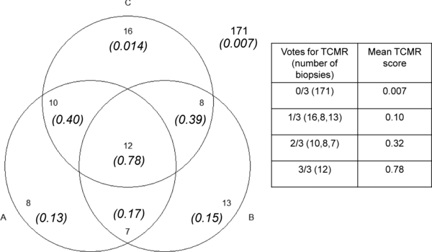
Pathologist Agreement in Dx of TCMR n=245 biopsies, Pathologists A, B, C
Reeve et al. Am J Tx 13: 645: 2013
Notes:
(slide in both talks) To begin with with I want to COMMENT ON 2 STUDIES that addressed ..the issue of Dx Agreement amongst pathologists.
IN ONE STUDY FROM THE HALLORAN LABORATORY, There were Three pathologists A, B, C, who studied a total of 245 Biopsies
Box to the right: No TCMR was called by any of the three pathologists (0/3 ) in 171 biopsies 1/3 patholgists called TCMR in16+8+13 = 37 biopsies the (the mean molecular TCMR score in these biopsies was barely abnormal at 0.1), 2/3 patholgists agreed on a call of TCMR in 10+8+7 = 25 biopsies (the mean molecular TCMR score in these biopsies was 0.32,
3/3 patholgists agreed on a call of TCMR in 12 biopsies (the mean molecular TCMR score in these biopsies was 0.76
xxxxxxxxxxxxxxxxxxxxxxxxxxxxxxxxxxxxxxxxxxxx
Total TCMR = 75 going by at least one pathologist making that call (171=no T-cell mediated rejection, 0/3 calls TCMR)
Note table on right; 1/3 calls of TCMR were made in 16+8+13= 37 cases (with individual numbers in parenthesis referring to calls by the three individual pathologists)----------------------2/3 calls of TCMR made in 10+8+17= 35 cases; 3/3 in 12 cases;
Xxxxxxxxxxxxxxxxxxxx
Venn diagram showing the relationship between the molecular T cell‐mediated rejection (TCMR) score and the agreement among three pathologists in the 245 biopsy subset.
Numbers in italics and parentheses show the average molecular TCMR score in the biopsies.
Numbers with no parentheses are the intersections of the number of biopsies diagnosed as TCMR by the three pathologists. Biopsies with either i2t2 TCMR or mixed rejection were considered TCMR. Isolated v‐lesion TCMRs were not counted as TCMR
12/75 or 16% all three agreed on them. This low agreement can be explained thus
The fuzzy border between BL and 1A/1B: a known problem needs to be solved, but as I have explained I do not believe MMDx is the answer to that
The long-standing belief that inflammation and tubulitis not be scarred areas. This part of the Banff schema has led to major confusion and diagnosis inconsistencies amongst pathologists esp those not seeing large volumes. Should point out that Pittsburgh & many others incorporating fibrosis in their calls 30 yrs since not doing so seemed so illogical This deficiency in Banff has finally been corrected, and should lead to significant reduction in # disagreements (although educating the community is and issue, that is so for MMDX too as I am trying to do in this talk) ti01rule
A significant (but not specified) number of biopsies were complicated by scarring;
GIVE CREDIT TO MMDX FOR HELPING THE PATHOLOGY COMMUNITY RECOGNIZE THAT THIS IS A HUGE ISSUE
Any TCMR call by even one pathologist was added to the total number of TCMRs in the denominator to calculate agreement (even though mean TCMR score of these biopsies with only 1/3 calling positive was only 0.1=barely reaching TCMR definition’
Agreement would be much higher, perhaps 80-90% range (same as mdx) 100% if these biopsies were 1B or 2A/2B with significant inflammation and no scarring; and if the denominator included biopsies classified into specific category by a consensus panel, with the criteria used to make the classification being made available to the pathologists participating in the study.
A and B from same institution: 58 called TCMR by at least one of them; 12+7= 19 or 33% biopsies agreed to by both;
CONSIDER MOLEC SCORES AND ARCHETYPE SCORES being presented similarly; MEAN SD DUNNO; ARRANGING SCORES IN ORDINALS I PREDICT WILL BE EQUALLY BAD;
(Avoid: NOT DONE BY INVESTIGATORS URGE THEM TO DO SO IF THEY WANT MORE PEOPLE LIKE ME TO BE CONVINCED OF THE CLINICAL UTILITY; NOT DONE DESPITE TECHNOLOGY OUT THERE FOR OVER A DECADE, PERHAPS I SOMETIMES WONDER WITH A VESTED INTEREST IN DOING SO)
XXXXXXXXXXXXXXXXXX
Note table on right; 1/3 calls of TCMR were made in 16+8+13= 37 cases (with individual numbers referring to calls by the three individual pathologists)----------------------2/3 calls of TCMR made in 10+8+17= 35 cases; 3/3 in 12 cases;
xxxxxxxxxxxxxxxxxxxxVenn diagram showing the relationship between the molecular T cell‐mediated rejection (TCMR) score and the agreement among three pathologists in the 245 biopsy subset.
Numbers in italics and parentheses show the average molecular TCMR score in the biopsies.
Numbers with no parentheses are the intersections of the number of biopsies diagnosed as TCMR by the three pathologists. Biopsies with either i2t2 TCMR or mixed rejection were considered TCMR. Isolated v‐lesion TCMRs were not counted as TCMR.
Xxxxxxxxxx REPRODUCIBILITY OF HISTOLOGIC LESION AND GRADE (NOT THE GESTAULT DIAGNOSIS)—paraphrase halloran sentence ditto; xxxxxxxxxxxxxxcastigating histo is comparing furness paper on grading tcmr with mdx; mdx simply says binary yes/no; no attempt to grade (caveat lesion scoring does contribute to diagnosis BL versus 1A; but reproducibility evaluation not limited to t1 versus t2 in that paper; furness clearly say interest was in grading not in how often gestalt histo diagnosis agreement reached;----add experienced pathologists do not let overall gestault override scores which have arbitrary component; describe and call; banff scores per se should not decide Rx; but they do convey extent pathology like reading radiology series--------------------Xxxxxxxxxxxxxxxx go to venn diagrams—Poor pathologist agreement on the one hand probably reflects case mix with many scarred and difficult biopsies where Banff a problem; pure 1b in experienced hands should be very good agreement; on the other hand 3 pathologists kappa for TCMR call claimed to be 0.45x0.45x0.45 =0.09 (actual was 0.16) (not sure kappa values can be multiplied like probabilities); pathologist C subject to reading digitized images (much more time; prone to miss max lesions like t, cg; no assurance all glomeruli examined; examining all tubules even more difficult)
Borderline changes suspicious for acute rejection not considered T-cell mediated acute rejection; 81% accuracy not bad (sensitivity a versus b 67%; b versus a 45% less impressive)(details of calculations need review but slides are not necessary to make)
©

Slide 23
Dx Agreement Among Pathologists - Quoted agreement for all 3 pathologists = 18% - Numerator reduced by assuming BL never TCMR - Denom incr by accepting TCMR even if 1/3 calls+ - Most bxs on interface BL-TCMR (37 MDx score 0.1) - Clear cut TCMR ≥1A, 1B ~ 90% agreement amongst 5 pathologists in QA conference Bxs with 1A, 1B, 2A, 2B or 3 in our 5 patholgists group have 80-90% agreement (weekly conf 25 years)
Notes:
(both talks) Quoted agreement for all 3 pathologists = 18%
However, IN CALCULATING THIS PERCENTAGE, the numerator was QUESTIONABLY REDUCED by assuming that BL was never TCMR - and moreover, the denominator WAS QUESTIONABLY INCREASED by accepting the histologic TCMR label even when 1/3 pathology calls was TCMR
Imprortantly Most bxs on interface of BL-TCMR (MMDx score 0.1) (37 bxs had a mean molecular TCMR score 0.1 which means that these bxs were barely inflamed
For bxs with clearcut TCMR >=1A, I see about 90% agreement amongst pathologists in a weekly bx review conference that I have been conducting for the past 25 years)
xxxxxxxxx
(BL ~70%)
To being with I want to COMMENT ON SOME STUDIES that have addressed the issue of Diagnostic Agreement amongst pathologists
Once again I want to begin discussing this subject was quoting a study on patholgists agreement in Diagnosis of TCMR. Like the Furness study it uses the strawman approach to claim that the reproducibility of pathology is poor
IN ONE STUDY FROM THE HALLORAN LABORATORY, It is stated that TCMR was called by 1/3 pathologists in 37 bx , 2/3 pathologists in = 35bx, 3/3 pathologists in 12
xxxxxxxxxxxxxxxxxxxxxxxxxxxxxxxxxxxxxxxxxxxxxxxxx-
No other details about the case mix: I, t, IFTA OR EVEN THE CRITERIA FOR DX TCMR ARE provided;
IN some of the papers form this group it is actually mentioned that one of the pathologist used Banff rules and the other did not; Hence it is difficult for me to understand what these authors are talking about; BFC 403 study mentions how I pathologist did not use Banff eg ??see Sellares et al AJT 2013:13:971 & Halloran et al 2013:13:2865
Xxxxxxxxxxxxxxxxxxxxxxxxxxxxxxxxxx
I think different centers can have different set points for what is BL, what is 1A and what is 1B; but these differences are in a range which do not let you see big differences in center specific graft survival rates as long as most clinically significant rejectctions get treated irrespective of what actual grade gets assigned to them
[12] / [37+35+12=64] = 18% ; Total number = 245 cant be deduced simply by adding up 171 no rejection +37 + 35 + 12 (that sum is 255) since 1 biopsy could have more than one call by the 3 pathologists in this study; Total TCMR = 75 going by at least one pathologist making that call (171=no T-cell mediated rejection, 0/3 calls TCMR) ; 171+75= 245= 246
. This low agreement can be explained thus
The fuzzy border between BL and 1A/1B: a known problem needs to be solved, but as I have explained I do not believe MMDx is the answer to that
The long-standing belief that inflammation and tubulitis not be scarred areas. This part of the Banff schema has led to major confusion and diagnosis inconsistencies amongst pathologists esp those not seeing large volumes. Should point out that Pittsburgh & many others incorporating fibrosis in their calls 30 yrs since not doing so seemed so illogical This deficiency in Banff has finally been corrected, and should lead to significant reduction in # disagreements (although educating the community is and issue, that is so for MMDX too as I am trying to do in this talk) ti01rule
A significant (but not specified) number of biopsies were complicated by scarring;
GIVE CREDIT TO MMDX FOR HELPING THE PATHOLOGY COMMUNITY RECOGNIZE THAT THIS IS A HUGE ISSUE
Any TCMR call by even one pathologist was added to the total number of TCMRs in the denominator to calculate agreement (even though mean TCMR score of these biopsies with only 1/3 calling positive was only 0.1=barely reaching TCMR definition’
Agreement would be much higher, perhaps 80-90% range (same as mdx) 100% if these biopsies were 1B or 2A/2B with significant inflammation and no scarring; and if the denominator included biopsies classified into specific category by a consensus panel, with the criteria used to make the classification being made available to the pathologists participating in the study.
xxxxxxxxx Borderline changes suspicious for acute rejection not considered T-cell mediated acute rejection; 81% accuracy not bad (sensitivity a versus b 67%; b versus a 45% less impressive)(details of calculations need review but slides are not necessary to make)
©

Slide 24
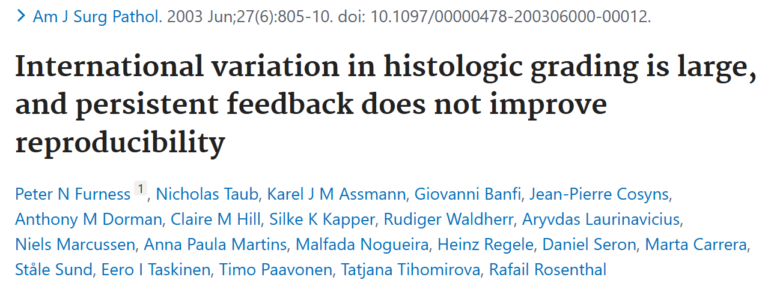
.
UNDER-RECOGNIZED, LARGE,
Almost Certainly of MAJOR clinical consequence, and
In URGENT need of improvement (2003 publication!)
.
Notes:
Another study frequently quoted to criticize histopath .this publication by Peter Furness in 2003, .
The title of the paper reads that international variation in histologic grading is large and persistent feedback does not improve reproducibility
One important observation made in the discussion of the data is that this variation is Under-recognized, large, and quote “almost certainly” of major importance, in urgent need of improvement.
Xxxxxxxxxxxxxxxxxxxxxxxxxxxxxxxxxxxx
Another study frequently quoted to criticize histopath How good is histopatholgy at diagnosing TCMR. I feel that I must comment on this publication by Peter Furness in 2003, which is frequently MISquoted to sell the virtues of Molecular diagnosis USING A STRAW MAN APPROACH.
My rebuttal is that :
Variation in mmdx assessment is also UNDER-RECOGNIZED; and I gave you several examples of that; WHICH IS A BIT OF A DEPARTURE FROM STANDARD TALKS AT INTERNATIONAL MEETINGS WHERE IT IS sometimes presented as AS A PERFECT TEST WITH NO ERRONEOUS DIAGNOSES
-I PREDICT mdx variation would be LARGER than assumed if measured by a comparable method
That would require TCMR biopsies to be measured in multiple laboratories (UNFORTUNATELY, AT THE TISSUE PROCESSING LEVEL THE MMDX STUDY IS STILL AT THE SINGLE CENTER STAGE, NOT MULTICENTER)
simply choosing multiple mmdx experts in 1 laboratory can not capture all the variation
For comparable calculation we should then divide TCMR molecular diagnosis scores INTO TERTILES corresponding on Banff grades 1, 2 and 3,
-and then Perform kappa statistics on those 3 ordinal categories.
Factors contributing to variability: would included sampling error, Bx processing, transport, RNA extraction, chip hybridization, data normalization, choice bioinformatics analytic methods, rules used for Machine Learning., & acceptance of arbitrary diagnostic thresholds

Slide 25
.
Misconceptions About Furness Reproducibility Study
Focused on histologic grading of lesions ≠ Dx accuracy of biopsy
Bx Dx can be accurate based on clincopathologic correlation
--even though gradng of rejection associated pathology is imperfect
Grades can determine intensity Rx, all Histo TCMR gets steroids
Bx guided Rx has played a critical role in evolution of TxMed .
Better methods to refine Dx & quantify kidney injury are needed
Notes:
There some misconceptions about the Furness Reproducibility Study that need to be brought out clearly
It focused on variation in histologic Grading and not Diagnostic Accuracy;
Bx Dx can be accurate if based on clincopathologic correlation even though the grading of rejection associated pathology is imperfect (imperfections could not have been of MAJOR clinical consequence; if biopsy readings were as bad claimed, clinicians would have stopped using biopsies long ago; The proclamation about MAJOR clinical significance and URGENCY is also debatable: THOUGH I AM ALL IN FOR MORE IMPROVEMENTS in this area;
We should clearly recognize that Histologic examination of biopsies has played a critical role in the evolution of txMed over the past 40 yrs: and has helped bring the field to ITS PRESENT STATE OF impressive graft survival; I DO NOT KNOW OF ANY TRANSPLANT
CENTER –either before or after the publication of thse Furness article in 2003---WHERE SURGEONS PUT ORGANS IN AND THEN NOT BIOPSY THEM BECAUSE THEY THINK BIOPSY DIAGNOSIS ARE NOT LARGELY RELIABLE
Bx guided Rx has played a critical role in evolution of TxMed helped bring the field to its present state of impressive G.S
Better methods to refine Dx & quantify kidney injury are needed but must be validated by CLINICAL OUTCOMES before being adopted—I will mention this need for validation at several other points during this talk

Slide 26
.
Applicability Kappa Statistics to Kidney Pathology
Pathology lesions with kappa scores comparable to Banff lesions have value in managing SLE, IgA, ANCA
Problem is with the biologic relevance as opposed to statistical relevance of the Kappa values
Many Kappa calculation penalize clinically insignificant differences eg ci0 vs ci1, or t2 vs t3
Notes:
I want to also make some general comments on the applicability of Kappa Stats to Kidney Pathology
In particular I want to note that Pathology lesions with kappa scores comparable to Banff lesions have unquestioned value in managing SLE, IgA, ANCA
Problem is with the biologic relevance as opposed to statistical relevance of Kappas as calculated by investigators; insufficient attention to making a distinction between differences that are not clinically significant versus those which are.
Many Kappa calculation penalize clinically insignificant differences eg ci0 vs ci1, or t2 vs t3
xxxxxxxxxxxxxxxxxxxxxxxxxxx
Tools shown to be clinically useful should not be trashed because a statistician tells you that a mathematical quantity calculated by him is not as good as he thinks it should be
xxxxxxxxxxxxxxxxxxxxxxxxxxxxxxxxxxx
I should not question accuracy of diagnosis in BFC 403 etc BUT Experienced patholgists do not start scoring lesions and then add up the scores to come to a diagnosis. Most path lesions have multiple cause and this mindless process will lead to inaccurate diagnoses 20-30% of the time. As in all other medical specialties Diagnosis should made based on the totality of clinical, laboratory and histologic information. Grading of disease should be done after the disease has been identified. (laura barisoni calls biopsy diagnosis a holistic process integrating data from multiple sources)
Grading is important for prognosis but perhaps less so for diagnosis (though it can lead to treatment/no treatment at lower end of the spectrum of rejection; BL/TCMR interface) treatment/non-treatment of these lesions is not likely to have a major effect on graft outcome, certainly not anything you are likely to see in terms of graft survival with short and intermediate term follow ups. Of course, the goal should still be to produce incremental improvements wherever possible
There are also Diagnostic interface areas where we need better diagnosis tools eg BL TCMR/early ABMR; pure TCMR/subtle mixed TCMR; TCMR/BKV nephropathy (therapies appropriate for these interfaces may appear in the future(. Again new tools should be validated before being commercialized

Slide 27
Clinical Implications DxTCMR 1A or Higher
Nankivell = 55 = 2.6% of 2055 consecutive bxs
80% performed for rising creatinine
Overall 1 & 5 yr graft survivals 97.7% and 87.4%
97.0 & 76.0% for Banff 1A and higher)
Notes:
I will now make a few comments on the Clinical implications of a diagnosis of TCMR 1A or Higher
The data is from Nankivell BASED ON 55 TCMR biopsies which represented 2.6% of 2055 consecutive specimens in that series
80% performed for rising creatinine
Overall 1 & 5 yr graft survivals 97.7% and 87.4%
97.0 & 76.0% for Banff 1A and higher)
xxxxxxxxxxxxxxxxxxxxxx
None had moderate/severe IFTA

Slide 28
Rx TCMR 1A or Higher
96% treated as acute rejection
38% had >25% recovery, 58% stable, 2% worse
Inflammation better in 84% paired biopsies
51% had subsequent acute rejection
Notes:
Data from the same paper on the Rx of TCMR, grade 1A or Higher
96% treated as acute rejection
38% had >25% recovery, 58% stable, 2% worse
Inflammation better in 84% paired biopsies
51% had subsequent acute rejection
xxxxxxxxxxxxxxxxxxxxxxxxxxxxxxxxxxxxxxxxx
None had moderate/severe IFTA

Slide 29
Performance of Molecular Classifier for TCMR
Sensitivity just 50% even after including Mixed
PPV only 62%
NPV 92% similar to a pathologist read of no TCMR
Overall accuracy 89% driven largely by high NPV
Notes:
Now let us examine the performance of the Molecular Classifer for TCMR as published by the alberta group-----
Sensitivity is just 50%, ..PPV is only 62%.
The NPV is 92% (which is similar to a pathologist being able to correctly call absence of TCMR in 90% of cases.
Overall accuracy is 89%,..but this is driven largely by the HIGH NPV ….ie the ability of the test to correctly identify biopsies with NO REJECTION
xxxxxxxxxxxxxxx
classfier built on pure cases can’t assumed to work and always be better in difficult cases; (arguably the cases were not all pure TCMR since some contributing centers likely called TCMR in ifta and some did not
Scarred cases need more work and correlations with histology may improve if 2017 and 2019 criteria caTCMR are used
Guiding improvements in TCMR: specificity 90% was targeted during classifier development ie 10% error allowed; later forgotten and called guiding improvements
REEVE STUDY # 2 is TCMR INTERCOM ajt 20`3; 13 2352
TCMR score versus histology correlations:I 0.79, t 0.83, v, 0.85, ptc 0.28, cg – 0.58 (not abmr),
ci -0.05, ct -0.06 (same explanation for negative correlation, i.e IFTA led to non-call of TCMR )
TCMR score (and histologic dx) did not associate with graft loss (but mixed TCMR with parallel ABMR score did so associate; however p-value was close 0.15 and hazard ration graft loss 1.79 confidence interval 0.8-4.0)
Xxxxxxxxxxxxxxxxxxxxxxxxxxxxxxxxxxxxxxxxxxx
Sensitivity just 50% (despite including mixed rejection that was not used in building the classifer)
PPV only 62% (histo disagreement similar 45-56%),
NPV 92% (similar to pathogist read of no TCMR =90%)
Overall accuracy 89% driven largely by the HIGH NPV ie the ability of the test to correctly identify biopsies with NO REJECTION (takes into account performance both in biopsies which have TCMR and those which do not)

Slide 30
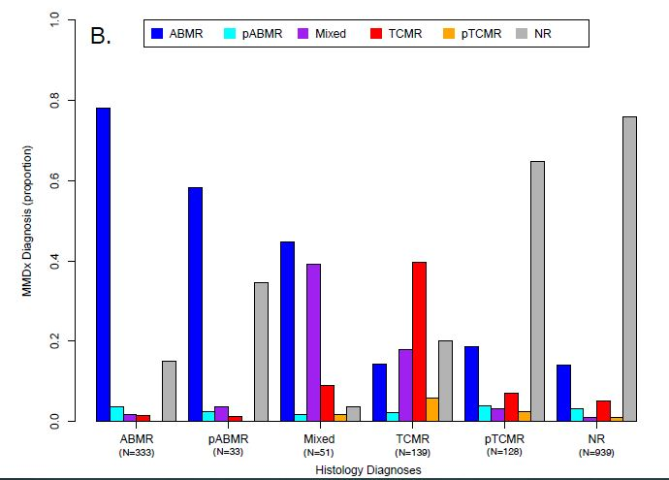
DISCREPANCIES RELATED TO HISTO. DX OF TCMR (Relative proportions of molecular calls on 1679 Bxs)
Notes:
There were MANY discrepancies between histologic and molec diagnosis in a series of 1679 biopsies published by the Halloran lab
The bars show the Relative proportions of molecular calls on 1679 biopsies with histology labels (note the color codes: red represents molecular TCMR, blue is molecular ABMR-----)
---Different histology categories such as ABMR, TCMR and BL are mentioned on the x-axis.
---The proportion of biopsies showing discrepancies is shown on the y-axis.
---This is a complicated slide, so I sliced this section called TCMR which has 130 biopsies . and I copy pasted it in the next slide
xxxxxxxxxxxxxxxxxxxxxxxxxxxxxxxxxx

Slide 31

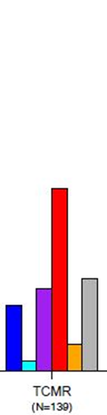
Molecular Confirmation of Histologic TCMR (n=130)
~ 40% H-TCMRs = recognized as M-TCMR
- sampling issues = MMDx® False Negative
- threshold for TCMR set too high
- ignoring i & t in IFTA explains others
Historically, biopsies with IFTA have NOT been graded for acute rejection lesions by many pathologists
Area where mRNA profiling has improved histologic interpretation
Madill-Thomsen et al 2020: 20: 1341
Notes:
Only ~ 40% of 130 histologic TCMRs were confirmed to be TCMR by MMDx® (red bar)
-I consider it very unlikely that most of the biopsies histo false +
-I think many are MMdx false negatives due to sampling issues, as I will show you in the next slide. .
- a 2nd problem is that the threshold for diagnosis of TCMR was set too high during the development of the classifier; Not relevant for this x-axis: eg ALL BL biopsies were labeled as no rejection; At least in our practice, -- and in some other major transplant centers---many BLs respond to treatment
Historically, biopsies with IFTA have NOT been graded for acute rejection lesions by many pathologists
Area where mRNA profiling has improved histologic interpretation
.
XXXXXXXXXXXXXXXXXXXXXXXXXXXXXXXXXXXXXXXXXXXXXXXXXXXXXXXXXXXXXXXX
Conversely, ~ 40% of biopsies called TCMR by mmdx were not called TCMR by Histo (many likely had IFTA lesions AND THIS IS AN AREA WHERE mRNA PROFILING HAS IMPROVED THE HISTOLOGIC INTERPRETATION OF BIOPSIES )
XXXXXXXXXXXXXXXXXXXXXXXXXXXXXXXXXXXXXXXX
(yes, false negative could also be C4d-ve mixed ABMR-TCMRs (classifed as ABMR by MMDx®), and v-lesions)
we have to continue diagnosing TCMR by standard histopath, as we have been doing for the past 40 years. Histology based diagnosis & treatment of rejection has certainly been very successful, & have helped reduce the incidence of TCMR from 50% and above to about 10% in the modern era
C4d negative mixed ABMR-TCMRs seem to be labeled just as ABMR by MMDX ---likely another training problem---that is why incidence mixed in MMDX series is <10%
Figures are estimated by me using a ruler with 1mm markings (Tabular data was not organized in a way that would let me translate histology data into molecular diagnosis; it forced me to do the reverse—BUT THAT ALSO MEANS I CAN NOT SHOW HOW MDX+HISTOL- MAY BE A REALLY BELIEVABLE COMBO: MANY CENTERS DO NOT DIAGNOSE TCMR IF THERE IS IFTA)
~ 20% H+ MDx “NO REJECTION” (archetype-based)
- NR archetype biopsy can have i & ci lesions
20% of biopsies that were histologic rejection were called NO REJECTION on MMDx® (archetype based analysis)(a biopsy in the NR archetype is not necessarily a biopsy free of inflammatory and fibrotic lesions)
xxxxxxxxxxxxxxxxxxxxxxxxxxxxxxxxxxxxxxxxxxxxxxx
--
15% of histologic TCMRs were ABMR or probable ABMR (added up together);
15% H + were mixed ABMR-TCMR --------WHETHER THE CLINICAL COURSE OF THESE PATIENTS WAS actually what you would expect for ABMR IS NOT STATED IN THE PAPER; - some the discrepancies may be due to isolated V lesions as I will discuss later which the mmdx does not recognize as TCMR; But this lesion is not common & we cannot attribute most of the discrepancies to this issue; I will discuss the subject of isol later in my talk (with emphasis on how correlation with DSA and C4d is important in these cases) (I do not think theresholding issue is relevant here)
xxxxxxxxxxxxxxxxxxxxxxxxxxxxxxxxxxxxxxx
I would not ignore the histologic TCMR call if it fits the clinical 30+ years experience respond to steroids;
A more charitable statement could be that in the 60% of TCMR biopsies which could not be confirmed by MMDX the % true false positive are unknown
Many may be a sampling issue: just the absence of I & t in the piece taken for mmdx
Some may be isol v-lesions which I will discuss later: we should take into account DSA and C4d results while trying to deal with these cases
~15% Mixed = endothelial injury & NK cells in TCMR (admittedly may treat anti-C if C4d or PP if DSA, and if not responding to TCMR treatment) (yes it could also be g>0 of ati, TCMR, membranoproliferative glomerulonephritis with incidental DSA)
~15% ABMR & pABMR (same explanation) It is not clear if these had any clinical manifestation, which the transplant team warranted treatment for ABMR; I suspect these were subclinical rejections similar to ones we call on protocol biopsies; they do not always trigger any specific therapeutic intervention
Here is my pathologist interpretation (principal discrepancies only; minor ones can all be explained by molecular noise such as focality of lesion, size of piece taken for molecular diagnosis, imperfections rules used to train the classifiers, and errors of about 10% allowed while developing some algorthms such as ABMR)
~40 confirmed TCMR on MMDX
xxxxxxxxxxxxxxxx
`Here is a detailed listing of the numerous discrepancies that were related to a histologic diagnosis of tcmr
Considering all the Histologic TCMRs (as the patholgist saw them):-Only ~ 40% confirmed TCMR by MMDX; the remainder fell in other categories, of which the 3 most freq are listed & discussed below
- Conversely, ~ 40% of biopsies called TCMR by mmdx were not called TCMR by Histo (many likely had IFTA lesions)
- 20% of biopsies that were histologic rejection were called NO REJECTION on MMDX—(20% different from the 40% figure above which just means not TCMR—could be any diagnosis other than that; this is not eqvt to no rejection )
-based on my own clinical experience of how often clear cut histol calls of TCMR respond to treatment, I consider it very unlikely that most of the biopsies were histologic false+(this data is from table 2 of manuscript: of 123 biopsies with molecular - -MMdx false negativity due to sampling issues is the most likely explanation for the discrepancyTCMR call, 48/123= 39% - -
15% of histologic TCMRs were ABMR or probable ABMR (added up together);
15% were mixed ABMR-TCMR --------WHETHER THE CLINICAL COURSE OF THESE PATIENTS WAS actually what you would expect for ABMR IS NOT STATED IN THE PAPER;
Xxxxxxxxxxxxxxxxxxxxxxxxxxxxxxxxxx
ANOTHER IMPORTANT FACTOR I HAVE REALIZED NOW IS THE CLASSIFIER TRAINING AND CIRCULAR REASONING PROBLEM—molec classifiers were traied NOT to recognize BL biopsies as TCMR
0.2 CUT OFF chosen for ABMR as it resulted in 90% specificity for diagnosis of histology-DSA ABMR (10% error built in right there) sellares ajt 2013 13 971
xxxxxxxxxxxxxxxxxxxxxxxxxxxxxxxxxxxxxxxxxxxxxxxxxxxxxxxx
Transcriptomics based scores (based on microarrays or RNA-seq) are a potential solution but are technologically complex, and we still have to address if they will be accurate enough, particularly when inflammation is sparse, and most in need of quantitation.
We know that < 2 fold differences can have a high SD and rigorously designed multicenter reproducibility studies will be needed)------(we can’t just have one commercial laboratory claiming they are very reproducible & making a pitch that the whole world send biopsies to them)
They are unlikely to be reliable particularly if small 3 mm or so pieces taken from tissues with focal pathology are sent as described in some publications (20% of biopsies focal)----in this setting Nanostring and RNA-seq on FFPE are expected to perform better than technologies such as mmdx which require fresh frozen tissue
Xxxxxxxxxxxxxxxxx
Total i > 25%, I-IFTA >25% criteria will need to be re-defined and re-validated by molecular diagnosis. Histologic caTCMR covers a wide spectrum of pathology including:
Total i 27 units 1, I-IFTA 27 units (inflammation barely above current threshold & all in scar)
Total i 50 units, I-IFTA 90 (inflammation clearly significant but again mostly in “scar”= not described with respect to severity/density)
Even in biopsies that are histologic grade 0 (recognizing that the several dozen lymphocytes seen here definitely generate a molecular signal and the molecular inflammation score will not be zero but a discrete number; that number will be on a continuous scale & that would be better than an ordinal histology grade; however the variability associated with that measurement will need to be determined; experience with existing molecular methods such as PCR suggests that the same sample being measured twice would generate numbers that would differ ~2-5 fold, particularly at the lower limit of detection (J. for example in patients with low grade BK viremia, many clinicians would not regard 5-10 fold changes between two time points very meaningful).
he An ASTOUNDING OBSERVATION is that this greay bar
Here is my pathologist interpretation
~56% NO REJECTION: would again not throw away 30 years experience;---recall Nankivell experience; attribute to the threshold used by MMDX to call rejection
18+ 5= 23% ABMR or mixed: GIVE HIM CREDIT AND ACKNOWLEDGE POTENTIAL UTILITY BUT SPECIFICITY 90%; RISK 10% FALSE POSITIVE; KEEP CLINICAL PICTURE IN MIND(get DSA tested if not already done, and monitor patients closely, not necessarily give plasmapheresis ritux) (yes it could also be g>0 of ati, TCMR, membranoproliferative glomerulonephritis with incidental DSA)
~ 7+3 = 10% would interpret as MMDX thresholding effect; they will call it histology error but only randomized perspective studies can really answer the question
~15% Mixed = endothelial injury & NK cells in TCMR (admittedly may treat anti-C if C4d or PP if DSA, and if not responding to TCMR treatment)
~15% ABMR & pABMR same explanation
` 20% NO REJECTION: I would not ignore the histologic TCMR call: 30+ years experience respond to steroids; attribute to absence in piece taken for mmdx
or less fall into these categories
Figures are estimated by me using a ruler with 1mm markings (Tabular data was not organized in a way that would let me translate histology data into molecular diagnosis; it forced me to do the reverse)
Figure 2. Clear histology-MMDx discrepancy scenarios where MMDx would provide a useful second opinion.
Panel A shows the overall mapping of all histology diagnoses per MMDx diagnostic category in the 1679
population. Panel B shows the mapping of MMDx diagnostic sign-out comments to histology diagnoses in the
1679 population.

Slide 32
.
Factors Causing Variability in MDx Assays
Histology reading discrepancies often the only mentioned F
Use of pathology reports from multiple centers to capture data without normalizing it by a central read
Tissue fixation, Transport under extreme weather,
RNA extraction, Chip hybridization,
Data normalization, Choice Bioinf tools, Rules used for ML
Use of arbitrary MDx thresholds without clinical validation
Notes:
(for this talk) IN ADDITION TO THRESHOLDING and SAMPLING PROBLEMS… there are a number of other factors that cause variability in molecular assays,… AND THUS CONTRIBUTE TO HISTOLOGY-MMDX DISCREPANCIES………….
Histology reading discrepancies are frequently the only factor mentioned by proponents of mdx,….BUT THIS IS A VERY TUNNEL VISIONED APPROACH.
Other relevant factors include:--
Use of pathology reports from multiple centers to capture data without normalizing it by a central read
Tissue fixation, Transport under extreme weather
RNA extraction, Chip hybridization,
Data normalization, Choice bioinformatics tools
Rules used for M.L.,
AND FINALLY Acceptance of arbitrary or histol based MDx thresholds without clinical validation
Xxxxxxxxxxxxxxxxxxxxxxxxxx
THE YELLOW HIGHLIGHTED ITEMS ARE AREAS WHERE, I think PATHOLOGY AND MOLECULAR DIAGNOSIS EXPERTS SHOULD WORK TOGETHER TO MOVE THE FIELD FORWARD
xxxxxxxxxxxxxxxxxxxxxxxxxxx
Multipe items will give cumulative discrepancy rate of ~20% EVEN IF WE ESTIMATE VERY CONSERVATIVELY and assess the individual contribution of each to be ONLY 1-2% (although we know for a fact that some items like sampling problems & ML rules have a contribution that is much bigger than that)

Slide 33
Mixed TCMR –ABMR
Notes:
I will now discuss the concept of mixed TCMR-ABMR (Next Slide)

Slide 34
Many Biopsies Labeled as ABMR Satisfy Criteria of Mixed TCMR-ABMR
Actual incidence AUTHOR-dependent variable
Lower end estimate ~5% -TRAINING SETS MMDX
Higher end: - 43% early, 48% late ABMR
- 63% & 96% BL
Demographics, I.S., PERSONAL OPINION
i-IFTA not reported by ~50% pathologists leads to undercalling TCMR in late biopsies
Notes:
Our experience at UPMC suggests that MANY Bxs Labeled as ABMR in the literature are actually Mixed TCMR-ABMR.
The reported incidence of mixed TCMR-ABMR is an AUTHOR-DEPENDENT variable
The lower end estimate is about ~5%. ----Training sets labeled as having this THIS LOW INCIDENCE FORMS THE BASIS of all MMDX dx algo, ---& THEREFORE ALL CONCLUSIONS BASED ON THE MMDX SYSTEM REFLECT THIS VIEW OF THE WORLD, ---that ABMR is frequently the cause of graft loss, & that T-cells are not important.
-OTHER CENTERS HAVE A DIFFERENT EXPERIENCE.------E.G. one study quotes a TCMR incidence of 43% in early and 48% in late ABMR; ----These figures rise to 63% & 96% if we include THE BL CATEGORY, ----which does behave clinically as rejection in many studies.
Potential explanations for these marked variations in incidence include …different patient demographics, ..varied immunosuppression protocols, …AND PERSONAL OPINION.
Another important problem is that inflammation in areas of IFTA is not reported by many pathologists… and this leads to undercalling TCMR in late biopsies. ---
XXXXXXXXXXXXXXXXXXXXXXXXXXXXXXXXXXXXXXXXXXXXXXXXXXXXXXXXXXXXXXXX
This is an important issue …as it is now clear that such inflammation is a strong predictor of graft loss, …even after correction for fibrosis, positive C4d staining, and presence of dsa.
xxxxxxxxxxxxxxxxxxxxxxxxxxxxxxxxxxxxxxxxxxxxxxxxxx
MMDX undercalls of mixed rejection reflect the machine learning rules used for diagnosis
Xxxxxx
These figures rise to 63% and 96% if we include BL category, ----which does behave clinically as rejection in many studies (not unreasonable since in some studies even subclinical inflammation is a risk factor for CAMR and late graft loss)
Yes mmdx recognizes TCMR in i-IFTA, but if antibody is present they choose to label these cases simply as ABMR rather than mixed
xxxxxxxxxxx
less than 10% of ABMR at UAB are called mixed ; BECAUSE THEY BELIEVE T CELL INFILTRATES IN THESE BIOPSIES ARE THE RESULT OF SECONDARY INFLUX AFTER INITIAL ANTIBODY DAMAGE
xxxxxxxxxxxxxxxxxxxxxxxxxxxxxxx
With respect to the pathogenesis mixed rejection, examination of a single biopsy cannot determine whether (a) ABMR occurred first with a secondary influx of T-cells, or (b) whether TCMR exposed epitopes which then elicited antibody formation (27). Clinically, it has been observed that ABMR can be preceded by one or more episodes of TCMR (11, 28), some of which may be subclinical (29, 30). Conversely, the presence of DSA at implantation is associated with subsequent TCMR (31), which affects graft outcome (32). There is not enough hard data available at this time to determine how often antibodies precede T-cell influx and vice versa. It is likely that both scenarios exist but their relative frequency is unknown. Molecular studies show that the burden of cytotoxic T lymphocytes in TCMR can be comparable to ABMR (33).
It is important to recognize that TCMR and ABMR are not mutually exclusive diagnoses. ------------Indeed, the classical paper by Feucht, which heralded much of the current literature on ABMR, was a demonstration of C4d staining in biopsies with TCMR (6) . ----------The actual incidence of mixed TCMR-ABMR appears to be a center-specific variable with low end estimates approximating 6% (10, 17). ----------Hopkins acute rejection <3 m 28/38 or 74% mixed KID INT 2014:87:409)----Lefaucheur lancet 2013: 381: 313 interstitial inflammation in 72% ABMR-v and 45% actually misclassified as TCMR initially----they did give steorids, plasmapheresis, ritux but not ATG which may have helped---At the other extreme, in a series of 67 ABMR biopsies from Norway, 63% of early and 96% of late ABMRs biopsies had concurrent TCMR, if borderline changes were included in the analysis. If only TCMR Banff grade 1A or higher was analyzed, 43% of early and 48% of late biopsies satisfied the criteria of mixed rejection (22).----------- Likewise, in a recent study of antibody mediated vascular rejection, approximately two thirds had an inflammation + tubulitis sum score >3 and could be construed as mixed rejection (13). This is not just a semantic point because this series of patients had an ~40% graft survival after ABMR treatment. Arguably, this clinical outcome could have been improved if T-cell depleting therapy had also been administered consistently.
Potential explanations for the apparently marked variations in incidence of mixed rejection include different patient demographics, varied immunosuppression protocols, and lack of uniform diagnostic criteria. Some investigators ignore T-cell infiltrates that fall in the Banff borderline category. ----This may not be necessarily correct in all cases, since even subclinical inflammation is a risk factor for CAMR and late graft loss (19, 23).----------- Another confounding element in determining the true incidence of mixed TCMR-ABMR is the presence of inflammation and tubulitis in areas with scarring. Literal application of the Banff Schema in this setting can results in under-diagnosis of TCMR in at least 33% of such biopsies (24). This is problematic as it is now clear that T-cell inflammation in areas of tubular atrophy is a strong predictor of graft loss, even after correction for fibrosis, positive C4d staining, and presence of donor specific antibodies (25). Molecular studies have confirmed that patients with progressive chronic diseases express high levels of acute kidney injury transcripts (25, 26).-------------------------With respect to the pathogenesis mixed rejection, examination of a single biopsy cannot determine whether (a) ABMR occurred first with a secondary influx of T-cells, or (b) whether TCMR exposed epitopes which then elicited antibody formation (27). Clinically, it has been observed that ABMR can be preceded by one or more episodes of TCMR (11, 28), some of which may be subclinical (29, 30). Conversely, the presence of DSA at implantation is associated with subsequent TCMR (31), which affects graft outcome (32). There is not enough hard data available at this time to determine how often antibodies precede T-cell influx and vice versa. It is likely that both scenarios exist but their relative frequency is unknown. Molecular studies show that the burden of cytotoxic T lymphocytes in TCMR can be comparable to ABMR (33).

Slide 35
Pathogenesis of Mixed TCMR-ABMR
Bidirectional relationship
ABMR→ influx T-cells follows
TCMR→21-32% DSA 4.4m later (Loupy: Tx 2015: 99: 965)
- Also typical in non-Adherent patients & low I.S. regimens
Relative importance of 2 pathways difficult to determine
Actual sequence of events not relevanT
Notes:
With respect to the pathogenesis mixed rejection, …It is really a bidirectional relationship.
In some cases ABMR is documented first and an influx of T-cells follows. …
On the other hand, in study from Paris, ..TCMR was followed by a 21% -32% incidence of DSA, at the time of Biopsies performed at a mean interval of 4.4m later. …..THIS SEQUENCE OF EVENTS IS ALSO TYPICAL IN NON-ADHERENT PATIENTS…. and in patients on LOW IMM.SUPP REGIMENS. (Nankivell was 32%)
The relative FREQUENCY of these different scenarios is Difficult to determine in clinical practice --(human subjects are not mice, --and we can’t biopsy them repeatedly to address this issue in a scientific way------
The actual sequence of events IS NOT EVEN relevant in my opinion. ---CMI & Ab-Imm work together ---and BOTH need to be targeted when we think about IMPROVING THERAPEUTIC OPTIONS-for patients that are carry labels of ABMR.
Xxxxx
There is not enough hard data available at this time to determine how often antibodies precede T-cell influx and vice versa. It is likely that both scenarios exist but their relative frequency is unknown. Molecular studies show that the burden of cytotoxic T lymphocytes in TCMR can be comparable to ABMR (33).
xxxxxxxxxxxxxxxxxxxxxxxxxxxxxxxxxxxxxxxxxxxxxxxxxxxxxxxxxxxxxxxxxxxx
examination of a single biopsy cannot determine whether (a) ABMR occurred first with a secondary influx of T-cells, or (b) whether TCMR exposed epitopes which then elicited antibody formation (27). Clinically, it has been observed that ABMR can be preceded by one or more episodes of TCMR (11, 28), some of which may be subclinical (29, 30). Conversely, the presence of DSA at implantation is associated with subsequent TCMR (31), which affects graft outcome (32). There is not enough hard data available at this time to determine how often antibodies precede T-cell influx and vice versa. It is likely that both scenarios exist but their relative frequency is unknown. Molecular studies show that the burden of cytotoxic T lymphocytes in TCMR can be comparable to ABMR (33).
staining, and presence of donor specific antibodies (25). Molecular studies have confirmed that patients with progressive chronic diseases express high levels of acute kidney injury transcripts (25, 26

Slide 36
Estimates of Mixed Rejection & ABMR Confounded by Non-specificity of MVLs
Glomerulitis
-Sis: 10% BL , 21% TCMR
ALL MY CASES c4d-DSA-g have CD3, CD8
Peritubular capillaritis
- Kozalowski et al (n=1322)
ptc>0, 48% biopsies had TCMR grade ≥1a
- only D-ptc and not focal ptc was risk factor for CABMR (OR4.5)
Notes:
Another point worth making is that ESTIMATES of ABMR & MIXED rej are confounded by the non-specificity of MVLs.
EVEN THOUGH THESE lesions are are a defining histologic feature of ABMR, ---many investigators have noted that they can occur in TCMR.
For glomerulitis I am going to quote Banu Sis, ---from Alberta, at a CENTER THAT CAREFULLY excludes ABMR before labeling a biopsy as TCMR….
She has published a 10% incidence of MVI in BL biopsies, & 21% in TCMR biopsies.
For peritubular capillaritis: I would like to quote a publication by kozalowski from Austria, --based on an evaluation of 1322 biopsies….
In biopsies with peritubular capillary scores >0, -- 48% had a dx of TCMR grade 1a or above.
Only diffuse PTCi was a risk factor for CABMR with an odds ratio of 4.5, but focal PTCi was notOnly a peritubular capillary score of 3 was associated with worse graft survival (though you could argue lesser scores caused dysfunction not yet culminating in loss)
Xxxxxxxxxxxxxxxxxxxxxxxxxxxxxxxxxxxxxxxxxxxxxxxxxxxxxxxxxx
In biopsies with peritubular capillary scores >0, 48% had a diagnosis of TCMR grade 1a or above (at least was mixed TCMR, ABMR for the cases where C4d positive; DSA most not available)
Only diffuse PTCi was a risk factor for CABMR with an odds ratio of 4.5, but focal PTCi was not (CABMR diagnosis based on histology and C4d with DSA mostly na)
xxxxxxxxxxxxxx
you could argue g1 ptc1 still seems a somewhat lax criterion for diagnosis ABMR; it satisfies banff rule of ptc+g>=2 criterion for antibody-endothelial interaction)
(This paper only talks about CABMR; Acute ABMR not presented likely because too few cases without chronicity already set in)
Xxxxxxxxxxxxxxxxxxxxxxxxxxxxxxxxxxxx
Kozakowski: prospective ffpe C4d since 1999; DSA for a smaller subset of 85/1322 with no multivariate analysis; i strongly correlated ptc and can not analyze separately;
Yes no DSA?-----but number is large.
Pittsburgh: 47% TCMR --?incl BL? Had glomerulitis —skip as they will criticize insufficient DSA testing and possibly even my diagnostic criteria
My manuscript discussion: The occurrence of glomerulitis and peritubular capillaritis in this series of biopsies with negative C4d staining and no associated DSA illustrates the point that this lesion/these lesions (particularly if low grade) is/are not pathognomonic of ABMR. High diagnostic specificity of these lesions in only achieved in the in the context of C4d and/or circulating DSA . Some but not all of these studies were performed in the era of C4d staining and DSA testing----
It has been suggested that TCMR associated glomerulitis may be responsive to Tacrolimus therapy (34). Glomerulitis has also been described in 16% of biopsies with glomerulonephritis and 7% of biopsies interpreted as calcineurin inhibitor toxicity (35). Peritubular capillaritis is reported in 24% of biopsies with ‘acute tubular necrosis’ and 16% of biopsies with glomerulonephritis (35, 41). - ---------------------------------------------------------------------
One would expect that expression of adhesion molecules by microvascular endothelium would lead to intra-capillary accumulation of inflammatory cells which would result in glomerulitis and peritubular capillaritis. -------------The potential of these cells to cause tissue damage is highlighted by immunohistochemical studies that show granzyme producing T-cells in biopsies with microvascular inflammation (38). ---------Recurrent episodes of such injury would lead duplication and multi-layering of the endothelial cells. This line of reasoning provides a conceptual basis for how TCMR can result in chronic transplant glomerulopathy and multi-lamellation of peritubular capillary basement membranes. The failure to find C4d deposits or DSA in 30-70% of biopsies with chronic transplant glomerulopathy is consistent with this interpretation (11, 44-46).
Other observations that support this pathway of microvascular injury include the demonstration of cytotoxic T-cell transcripts and proteins in lesions of chronic transplant glomerulopathy T-cells (48) (38, 46, 49), (iii) mRNA levels of interferon-γ, T-bet and granzyme B are higher in biopsies with cg (49), and (iv) microarray analysis of C4d negative biopsies with cg in the absence of DSA showed increased expression of cytotoxic T-cell transcripts compared to C4d-negative, DSA negative biopsies not showing cg (46) -------------------------------------------------------------------------------------------------
Glomerulitis: The Banff 2013 meeting report defines glomerulitis as complete or partial occlusion of one or more glomeruli capillaries by leucocyte infiltration AND endothelial cell enlargement. It should be viewed as a lesion typical but not pathognomonic of ABMR. Therefore, in biopsies with no C4d deposition, and absence of donor specific antibodies, the possibility of TCMR masquerading as glomerulitis deserves consideration. ---------------------Peritubular capillaritis: PTC is defined as the presence of 3 or more inflammatory cells in the peritubular capillary lumen with at least 10% of the capillaries being affected (39). The inflammation may be comprised of mononuclear cells or neutrophils (40).
Microvascular inflammation has been described in DSA negative patients (32). The lesion is pronounced whenever there is severe inflammation and transcapillary migration of mononuclear cells into the interstitial compartment. Therefore, the Banff 2013 meeting report suggested that in the presence of TCMR ptc not be taken as evidence of ABMR unless concurrent glomerulitis is also present (15).

Slide 37
Molecular Dx Does Not Solve the Problem of Limited Specificity
G & ptc are simply assumed to be specific for ABMR 100% of the time when MLs are developed
Other examples of Non-specificity Molecular Signatures
- Tubular injury transcripts present in ATN & TCMR
- GE profiles TCMR/BKVN ~identical in many studies
- Molecular panels predictive of graft loss in late Bxs have no predictive value in 6w protocol Bxs
Notes:
At this juncture, it important to REITERATE that MDx Does Not Solve the Problem of Limited Specificity.
-G & ptc were simplistically assumed to be specific for ABMR 100% of the time--when the ML algos were were developed, but as I have noted this is not true.
THERE ARE OTHER EXAMPLES OF THE NON-SPECIFICTY OF MOLECULAR SIGNATURES---Tubular injury transcripts are present in both acute tubular necrosis and TCMR---Gene expression profiles of TCMR & BKVN nearly identical in many studies.
and likewise, Molecular panels predictive of graft loss in LATE Bxs have no predictive value in 6 WEEK protocol Biopsies
xxxxxxxxxxxxxxxxxxxx
It is not histology error: ENDAT presence in TCMR limits the specificity of the test (which was only 56% in this cohort) and will likely be different in others
Cut off score used to discriminate ABMR from nonABMR will be center-specific, dependent on severity of E vs T injury in case mix used for validation
This means that every center will need to do its own validation
Another issue is that this test is confounded by the presence of mixed rej (70% UPMC-ABMRs)
Indeed the definition of mixed rejection is not stanadardized; less than 10% of ABMR at UAB are called mixed ; BECAUSE THEY BELIEVE T CELL INFILTRATES IN THESE BIOPSIES ARE THE RESULT OF SECONDARY INFLUX AFTER INITIAL ANTIBODY DAMAGE
ENDAT are from Sis 2009 9 2312

Slide 38
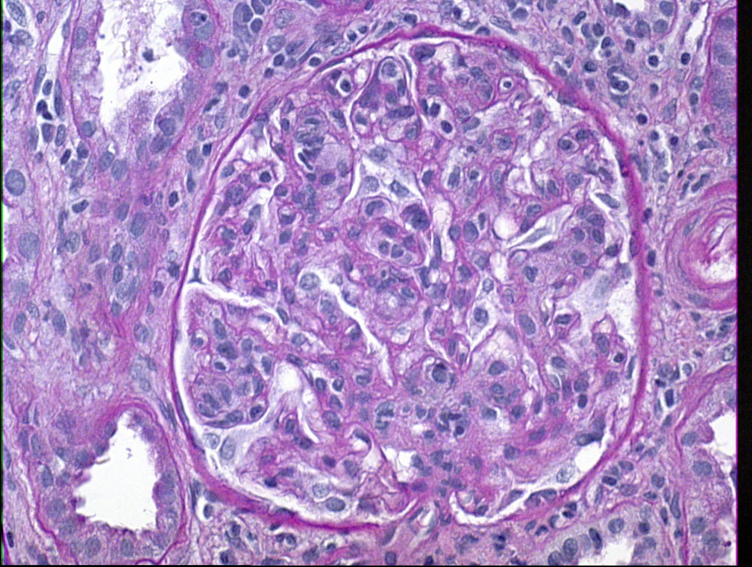
BX CONSISTENT WITH TCMR GLOMERULITIS
C4d -ve, DSA -ve, No HLA, MICA, A2T1R antibody
Responded to steroids
MDx detection ENDATs would not change interpretation
Notes:
HERE IS AN ACTUAL EXAMPLE OF A biopsy consistent with TCMR glomerulitis --------------You can see the intracapillary inflammatory cells with endothelial swelling;-----
C4d was negative, -----No DSA was found-----and no HLA, MICA or Angiotensin-II—type1 Receptor antibody was detectable either.
-The patient responded to steroids.
In my opinion, --molecular diagnostics detection of Endothelium Associated Transcripts, --the so called ENDATs-- or NK cell transcripts--- in this biopsy would NOT change my biopsy interpretation. ---- That finding would still be quite compatible with T-cells –or another antibody-independent mechanism--causing glomerulitis, endothelial injury, and upregulation of ENDATS and DSA-ST
xxxxxxxxxxxxxxxxx
The lesion would be caused by T-cells only in a small proportion of biopsies (yes isol glomerulitis like this is rare, but T-cells in ABMR are common)
and DSA tests negative both before and after the biopsy; MICA and Angiotensin II type 1 receptor antibodies (A-ii-T1R)
xxxxxxxxxxxxxxxxxxxxxxxxxxxxxxxx
Let me first illustrate the lesions. Glomerulitis is defined as intra-capillary inflammation with endothelial swelling and partial or total occlusion of the capillary lumen.
Xxxxxxxxxxxx
Swollen endothelial cells are probably present in many capillarires but it is hard to say so conclusively without immunohistochemistry
g3
Xxxx
Satisfies definition but lowers senstivity
On the other hand reducing threshold less specific g1 seen in TCMR of paris

Slide 39
.
.
Notes:
LIKE ALL MY OTHER CASES OF C4d negative, DSA negative glomerulitis
This biopsy had readily demonstrable T-cells
.
Not showing CD68 CD56

Slide 40
IHC Studies of Glomerulitis
4/5 studies show T-cells ~ 1/4th
CD3 counts 1±2 vs CD68 3+/-2 per glom
(Magil: AJKD 2005:45:1084)
Bob Colvin series T-cells ~2x Mac
CD3 = 11 +/- 2 vs Leu7 mono = 6 +/- 2
(Tuazon/Colvin et al: Am J Pathology 1987: 129: 119 )
Notes:
IHC studies of glomerulitis support the notion that T-cells play a role in the pathogenesis of these lesions.
4/5 studies I have reviewed showed that --- T-cells constituted about ¼ of all the cells present--- with the remaining cells being mostly macrophages.
Eg in one study cd68 MACROPHAGE counts per glomerulus were 3 +/- 2 ---COMPARED TO per glomerulus counts of 1+/-2 for CD3 positive T-cells--(these biopsies were C4d positive)
Another study from bob colvin’s group found T-cells to be twice as frequent as macrophages ---AGAIN SHOWING THAT SOME CASES OF GLOMERULITIS MAY BE PRIMARILY T-CELL MEDIATED
xxxxxxxxxxxxxxxxxxxxxxxxxxxxxxxxxxxxxxxxxxxxxxxxxxx
Many (4) studies I looked at report CD68 as the overall predominant cells dominant when studied).
A well done study from Covin’s group found the reverse suggesting that both kinds of cases exist in routine transplant practice
Even in macrophages predominantly series, with CD3 positive T-cells constitute approximately 1/3 of all cells and that is not a trivial number (mostly CD8 positive T-cells when studied)
(colvin: lack of C4d, DSA not relevant; we can assume 70% were positive or even 100% were positive )
11 G3 Glomerulitis in ist yr biopsies (Papadimitriou et al: Txn 2010:90:1478)
CD68-max = 28+/-17
CD3-max = 9+/-7
produce granzyme and colvin electron microscopy cytoplasmic processes in contact with endothelial cells
Magill: did immunohistochemistry of C4d positive versus negative cases of glomerulitis: it is not the point but yes C4d positive cases had significantly more monocytes per glomerulus than C4d negative cases, whereas the number of t-cells was lower
Papadim: reports on glomerular inflammation in ist year biopsies: n=240; they also say TCMR diagnosis had no correlation with glomerular pathology; they do report intraglomerular cd68 and CD3 positive T-cells cells and note the ratio reversed if DSA or C4d was present concurrent with TCMR

Slide 41
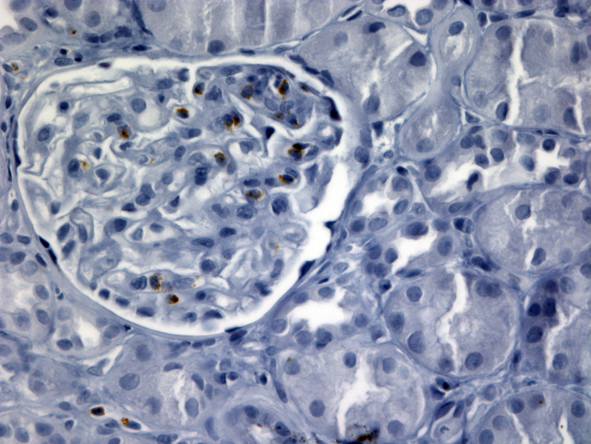
T-cell Infiltrates in ABMR Biopsies with Glomerulitis
4/5 studies Mac ~ 3x T-cells
CD68 counts per glom 3+/-2 vs 1+/-2 CD3
R. Colvin series T-cells ~2x Mac
CD3 = 11 +/- 2 vs Leu7mono = 6 +/- 2
Dr. I. Batal
Notes:
There are many studies –showing the existence of T-cell infiltrates in ABMR biopsies with glomerulitis: .
4/5 studies reviewed by me show macrophages present at a frequency that ~ 3times that of T-cells in these lesions WHICH MEANS THAT ~ 25 OF THE CELLS WERE T-cells ; Macrophages have fc receptors that enable them to link with antigen-antibody complexes. Eg in one study cd68 counts per glomerulus were 3 +/- 2 versus 1+/-2 for CD3 positive T-cells (C4d positive glomerulitis biopsies)
And one study form bob colvin’s group found T-cells to be twice as frequent as monocytes MEANING THAT ABOUT 66% WERE T-cells
THUS LESIONS USED TO DEFINE ABMR have significant # T-cells
Right panel: An IMMUNOHISTOCHEMISTRY prep showing that T-cells in glomerulitis lesions produce granzyme. I take that to mean that these t- cells are not just innocent bystanders but actually contributing to capillary injury. INDEED Bob colvin has found that on electron microscopy CD8 cells throw cytoplasmic processed in direct contact with endothelial cells
xxxxxxxxxxxxxxxxxxxxxxxx
[gawking at (admiring) what antibodies are doing]
participating in ha curious observer/bystander but active participant in what is happening
Not all cases in the literature were shown to be i0 t0: but you can arguably say: THIS IS AN EXTREMENLY IMPORTANT POINT: WHEN WE ARE TOLD THAT a biopsy has pure ABMR with an i-score of 0 and t-score also 0, the glomeruli (&peritubular capillaries) still have a significant component of T-cells in them;
xxxxxxxxxxxxxxxxxxxxxxxxxxxxxxxxxxxxxxxxxxxxxxxxx
A well done study from Covin’s group found the reverse suggesting that both kinds of cases exist in routine transplant practice
(colvin: lack of C4d, DSA not relevant; we can assume 70% were positive or even 100% were positive )
11 G3 Glomerulitis in ist yr biopsies (Papadimitriou et al: Txn 2010:90:1478)
CD68-max = 28+/-17
CD3-max = 9+/-7
Magill: did immunohistochemistry of C4d positive versus negative cases of glomerulitis: it is not the point but yes C4d positive cases had significantly more monocytes per glomerulus than C4d negative cases, whereas the number of t-cells was lower
Papadim: reports on glomerular inflammation in ist year biopsies: n=240; they also say TCMR diagnosis had no correlation with glomerular pathology; they do report intraglomerular cd68 and CD3 positive T-cells cells and note the ratio reversed if DSA or C4d was present concurrent with TCMR

Slide 42
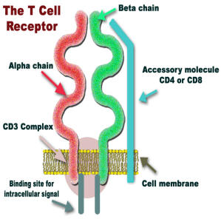
Biologic Plausibilty of T-cell Mediated Glomerulitis or PTC
Ag recognition repertoire of T-cell pool corresponds to 10¹⁶ unique TCRs
It is expected that endothelial cells will bear antigens that can be recognized by T-cells
(presence of ENDATs in these biopsies should not ead to re-classication as ABMR, unless antibody present)
Notes:
I do not believe tht The BIOLOGIC PLAUSIBILITY OF T-CELL MEDIATED glomerulitis or ptc will BE CONTESTED BY ANY TRANSPLANT IMMUNOLOGIST.
-We need to remember that the antigen recognition
It is expected that –
Therefore it stand to reason taht
XXXXXXXXXXXX
As a corollary one can say that The argument that T-cells cannot recognize ANY endothelial allograft-antigen is not logical and hard to defend
xxxxxxxxxxxxxxxxxxxxxxxxxxxxxxxx
Yes agree some can be non-HLA endothelial but current evidence does not suggest it should be a very common phenomenon
xxxxxxxxxxxxxxxxxxxx
There is experiment evidence/Immunologists have clearly shown that
xxxxxxxx
10¹⁶ with 10⁷ unique T-cell receptors in the peripheral blood (36). There is also experimental evidence that endothelial cells can endocytose and phagocytose endogenous as well as exogenous antigens with subsequent presentation to CD4 and CD8 positive T-cells (37). ------------One would expect that expression of adhesion molecules by microvascular endothelium would lead to intra-capillary accumulation of inflammatory cells which would result in glomerulitis and peritubular capillaritis. The potential of these cells to cause tissue damage is highlighted by immunohistochemical studies that show granzyme producing T-cells in biopsies with microvascular inflammation (38). Recurrent episodes of such injury would lead duplication and multi-layering of the endothelial cells. -----------------------------This line of reasoning provides a conceptual basis for how TCMR can result in chronic transplant glomerulopathy and multi-lamellation of peritubular capillary basement membranes.
The idea that T-cells can injure glomerular or peritubular capillary endothelium is biologically quite plausible, if we keep in mind that the antigen recognition repertoire of the human T-cell pool is of the order of 10¹⁶ with 10⁷ unique T-cell receptors in the peripheral blood (36). There is also experimental evidence that endothelial cells can endocytose and phagocytosie endogenous as well as exogenous antigens with subsequent presentation to CD4 and CD8 positive T-cells (37).

Slide 43
V-LESIONS (intimal arteritis)
Notes:
Next I will take up v-lesions-------------v-stands for vessel----and another name for these lesions is intimal arteritis

Slide 44
Classification of V-Lesions
Banff Type IIA Rej: grade v1
- isolated v-lesions if i0-1, t0-1
- i-t-v lesions for higher i or t scores
Banff Type II B Rej: v2
Banff Type III: transmural i or fibrinoid necrosis
Notes:
They are also sometimes called vascular rejection
Diagnosis of Banff Type IIA: rejection requires the presence of --grade v1 intimal arteritis ---with any i or t score
Banff Type II B: rejection requires presence of a grade v2 lesion with more than 25% luminal occlusion by inflammatory cells
Type III: rejection is defined by transmural inflammation/fibrinoid necrosis

Slide 45
IHC Studies of V-lesions
Four Studies ~ 30% are T-cells
Pattern 1: CD3/CD68 ratio >1.0 in 47% Biopsies
Pattern 2: Ratio < 1.0 in 53% Biopsies
(Kozakowski/Regele NDT 2009; 24: 1979)
T-cells virtually all V-lesions, dominant cell in 30-50%
Mediated in part by Tcells (despite DSAs 50-70%)
.
Notes:
IHC studies of v-lesions show findings similar to those reported for glomerulitis:-------4 studies reviewed by me found that ~ 30% of the inflammatory cells in intimal arteritis are t cells with the rest being mostly macrophages.
One study found two patterns of staining -----In pattern 1, the CD3toCD68 ratio was >1; and this was seen in 47% of the biopsies
In pattern 2, the ratio was reversed & this was seen in 53% of biopsies-------------
Thus, T-CELLS ARE PRESENT IN VIRTUALLY ALL v-lesions---A CASE COULD thus be made that these lesions are MEDIATED AT LEAST IN PART BY T-CELLS, ----even though DSAs are present in 50-70% of cases
.
LOOKING AT IT THIS WAY SERVES AS A REMINDER THAT THESE CASES MAY NEED T-CELL THERAPY IF THEY ARE GOING DOWN HILL on treatment for ABMR.
xxxxxxxxxxxxxxxxxxxxxxxxxxxxxxxxxxxxxxxxxxxxxxxxxxxxxxxxxxxxxxxxxxxx
Looked at another way T-cells are the dominant cell type in 30-50% of biopsies with v-lesions,----although there are also studies wherein macrophages are said to be 2-3 times as common as T-cells)
xxxxxxxxxxxxxxxxxxxxxxxxxxxxx
Unpublished data (and photograph) FROM ME and Anthony Chang from University Chicago has shared me indicates that % CD68 and CD3 positive cells does not differ much between v-lesions associated with ABMR or TCMR
Thus, WHILE MOLECULAR STUDIES CLASSIFY ONLY A SMALL % OF V-LESIONS AS TCMR, HISTOLOGY SHOWS THAT T-CELLS ARE PRESENT IN VIRTUALLY ALL BIOPSIES---a case could thus be made from a pathogenetic point of view that all v-lesions are examples of T-cell mediated or Mixed antibody & tell mediated rejection. LOOKING AT IT THIS WAY SERVES AS A REMINDER THAT THESE CASES MAY NEED T-CELL THERAPY IF THEY ARE GOING DOWN HILL
XXXXXXXXXXXXXX
Decided not to get into rare T-cells not being detected due to rarity of transcripts or dilution out by IQR filters that remove all genes with minimum variation across the chip; the fact is that a significant proportion of even 1A and 1B TCMR does not get called TCMR by mmdx
xxxxxxxxxxxxxxxxxxxxxxxxxxxxxxxxxxxxxxxxxxxxx
Banff bullet point removed: Pre-DSA/C4d interpreted as Cell Mediated Rejection
An important point I want to make at this stage is that in the preDSAc4d era all immunohistochemistry studies on intimal arteritis concluded that this lesion reflected cell mediated rejection. Now that we can find antibodies in –let us say 70% of the cases---we should not flip flop completely and start calling these ABMR.
A more rational approach would be to refer to them as mixed TCMR and ABMR.
xxxxxxxxxxxxxxxxxxxxxxxxxxxxxxxxxxxx
Mean cd68 positive cells per vessel
CD45 R0 memory cells already exposed to cognate antigen (CD8 positive T-cells and CD4 positive T-cells)
Mean CD68 9.5 vs CD45RO 4.4
(Matheson et al. Transplantation 2005: 79: 1658) (n=10)
CD68 1.7 vs 0.5 CD8 vs 0 CD4 (Sementilli et al: TxProc 2010: 42: 1671)(n=10)
CD3/CD68 ratio >1.0 in 47% (2 patterns) (Kozakowski/Regele NDT 2009; 24: 1979)
CD68, CD3 no difference (A. Chang)

Slide 46
Overall Clinical Outcome of V-Lesions
In terms of response to Anti-rejection Rx
-Grade 2A: 52-80% complete remission
- Grade 2B: 10%
Death censored graft survival
69% of Grade 2A grafts function at 8yrs
46% of Grade 2B/3 grafts do so
Banff grade 2A Bxs are heterogeneous & remission rates overlap with Grade 1A & 1B (44-73%)
Notes:
This slide shows the overall clinical outcome of v lesions
IN TERMS OF Response to Anti-rejection Rx
-Grade 2A biopsies show: 52-80% C.R.
- For Grade 2B bxs C.R. rate is 10%
In terms of death censored Graft survival
69% of grade 2A grafts function at 8 yrs while only 46% of grade 2B/3 grafts do so
This data emphasize that Banff 2A bxs are heterogeneous, and remission rates overlap with Grade 1A & 1B which are in the 44-73% range
xxxxxxxxxxxxxxxxxxxx
Wu at al are the source of 46%
Lamarche et al. is really a meta review with overall Banff grades and v-grade data summarized; (studies that only included steroid resistant cases excluded)
Wu et al. transplantation 2014: 97 1146 is quoted for death censored graft survival at 8 yrs: BL 87% 1A 73, 1B 65, 2A 69, 2B/3 46%
xxxxxxxxxxxxxxxx
May try to fit in Salazar et al; JASN 2015: 26: 3190
Intimal arteritis with i-t lesions (i≥2 and t≥2)
Intimal arteritis with i-t lesions (i>1 and t>1)
(Intimal arteritis i-t lesions 16% of all Bxs <1yr, 5% 1-5yr
Isolated intimal arteritis 12% of Bxs <1y, 5% at 1-5y
Sis isolated v: death censored graft survival 1 yr 90%, 3 yr 85, 8 yr 81 (mixed types 1, 2, 3 were 91, 87, 79%)
Haas Kid Int 2002 61 1516 median 8 yr graft survival 35-40%; 2B reached 30-35% at median follow up 4.6 yrs
Minervini CR 73% for 1B, 67% for 2A

Slide 47
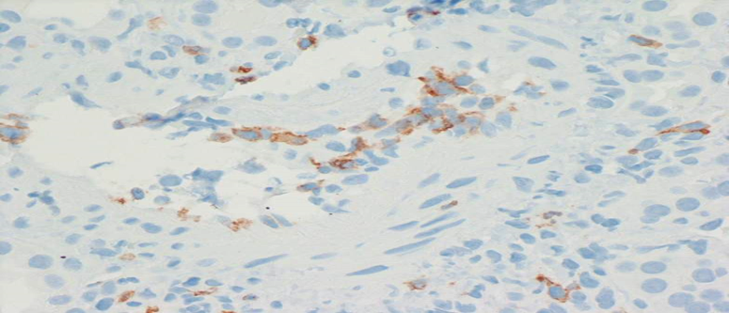
Clinical Outcome By Immunohenotype
TCMR arteritis: --15% graft loss at 6 yrs (2% controls)
---Unspecified % GFR <30 (impending GL)
ABMR arteritis: rate of graft loss is ~60%
- 2/3 Biopsies Paris i+t sum score >3 (mixed Ab-TCMR)
CD3 + Cells Intima
Notes:
Here is the clinical outcome by immunophenotype
TCMR arteritis: in Paris series had 15% graft loss at 6 yrs (2% controls);
An unspecified additional % likely had eGFR <30 ml/min & were just hanging in there (some investigators classify these as impending graft loss and study them separately)
ABMR arteritis: rate of graft loss is 60%
- As I noted earlier, T-cells present in the intima in virtually all cases
- 2/3 of biopsies in Paris experience had an i+t sum score >3 (mixed Ab-TCMR)
Here is a an actual example of a biopsy with intimal arteritis showing abundance of CD3 positive T-cells in the intima
xxxxxxxxxxxxxxxxxxxxxxxxxxxxxxxxxx
Hanging in there: Chemouny et al. Transplantation 2015: 99: 965
Lamarche et al. is really a meta review with overall Banff grades and v-grade data summarized; (studies that only included steroid resistant cases excluded)
Wu et al. transplantation 2014: 97 1146 is quoted for death censored graft survival at 8 yrs: BL 87% 1A 73, 1B 65, 2A 69, 2B/3 46%
xxxxxxxxxxxxxxxx
May try to fit in Salazar et al; JASN 2015: 26: 3190
Intimal arteritis with i-t lesions (i≥2 and t≥2)
Intimal arteritis with i-t lesions (i>1 and t>1)
(Intimal arteritis i-t lesions 16% of all Bxs <1yr, 5% 1-5yr
Isolated intimal arteritis 12% of Bxs <1y, 5% at 1-5y
Sis isolated v: death censored graft survival 1 yr 90%, 3 yr 85, 8 yr 81 (mixed types 1, 2, 3 were 91, 87, 79%)
Haas Kid Int 2002 61 1516 median 8 yr graft survival 35-40%; 2B reached 30-35% at median follow up 4.6 yrs
Minervini CR 73% for 1B, 67% for 2A

Slide 48
Clinical Outcome of Isolated-V (i & t scores of 0 or1)
Short series benign outcome available (Halloran)
Caveat is that most get treated pre-emptively
Banff Group 101 Bxs, mostly early post-tx, C4d -ve
- worse 3 yr GS 79% vs 91% controls
- GS in ISO-T-V similar to Bxs where if i-t-v lesions present
- adverse effect persisted after removing Bxs g+ptc>1 & DSA+
Graft loss only 21%: most cases not rapidly downhill
Notes:
I FORGOT THIS WAS FOR ISOLATED V; SLIDE 2 PLACES EARLIER WAS ALL KINDS OF V
A few comments on the Clinical Outcome of ISOLATED v-lesions. These are defined as biopsies with I or t scores of 0 or 1 (v-score can be 1, 2, or 3) -------
Short series with benign outcome are available; -----The Caveat is that most of these cases get treated pre-emptively as rejection
Banff Group studied 101 biopsies, that were mostly early post-tx, and C4d -ve
- these had a worse 3 yr GS of 79% vs 91% controls
- this GS similar in ISO-V was similar to that seen in biopsies where I & t were lesions present (79% in both groups!!)
- adverse effect persisted after removing biopsies with g+ptc>1 and positive DSA
Graft loss was only 21%; Hence it is safe to conclude that most cases with intimal arteritis do not have a rapidly downhill course
Xxxxxxxxxxxxxxxxxxxxxxxxxxxxxxxxxxxxx
Note Wehmeier/schaub transplant direct 2017 3 e136: one third of all Banff IIA/IIB TCMR were isolated v; possibly current immunosuppression effective against interstitial lesions but not vascular lesions caused in some cases by T-cells, some by antibody, and many by both
SIS ET AL: We retrospectively enrolled recipients of kidney transplant who underwent biopsies between 1999 and 2011 at seven American and Canadian centers. Exclusion criteria were recipients were blood group-incompatible or crossmatch-positive or had C4d-positive biopsy samples. After biopsy confirmation, patients were divided into three groups:
isolated endarteritis (n=103), positive controls (type I acute T cell-mediated rejection with endarteritis; n=101), and negative controls (no diagnostic rejection; n=103). Primary end points were improved kidney function after rejection treatment and transplant failure.
Mean decrease in serum creatinine from biopsy to 1 month after rejection treatment was 132.6 µmol/L (95% confidence interval [95% CI], 78.7 to 186.5) in patients with isolated endarteritis, 96.4 µmol/L (95% CI, 48.6 to 143.2) in positive controls (P=0.32), and 18.6 µmol/L (95% CI, 1.8 to 35.4) in untreated negative controls (P<0.001).
Functional improvement after rejection treatment occurred in 80% of patients with isolated endarteritis and 81% of positive controls (P=0.72). Over the median 3.2-year follow-up period, kidney transplant survival rates were 79% in patients with isolated endarteritis, 79% in positive controls, and 91% in negative controls (P=0.01).
In multivariate analysis, isolated endarteritis was associated with an adjusted 3.51-fold (95% CI, 1.16 to 10.67; P=0.03) risk for transplant failure. These data indicate that isolated endarteritis is an independent risk factor for kidney transplant failure.With respect to the clinical significant

Slide 49

Graft Survival For V-Lesions
Notes:
I am showing you these KM curves from the Paris group ONCE MORE to illustrate the GS associated with v-lesions.
****Black DOTTED LINE*** : patients with no rejection had excellent graft survival of 98% at 6 yrs
***TCMR presenting WITHOUT ARTERITIS (red line) or WITH ARTERITIS (green line)-----WITH NEGATIVE C4d and no DSA ----had a graft survival of ~85% at 6 yrs, with PERHAPS A comparable number showing IMPENDING GRAFT LOSS
For ABMR without arteritis (black line): rate of graft survival was about 80% at 72 months ----BUT with intimal arteritis it rose to about 50%.
Xxxxxxxxxxxxxxxxxxxxxxxxxxxxxxxxxxxxxxx
- T-cells present in intima in all cases
- 2/3 i+t sum score >3 (mixed Ab-TCMR)The graft survival for Arteritis with TCMR in the validation cohort (n=661)s Lancet study was ~85% at 48 m (and at 72 m);
Thus about 15% of grafts had been lost; and perhaps an equal number were chugging along although serum creatinine or gfr is not presented in this study.---so clearly TCMR remains a perceptible element in the long term survival of grafts.Note it is worse than control (but no stats presented); TCMR arteritis apparently somewhat better but probably not a real difference --[HOWEVER, in the main study cohort findings were slightly different: TCMR as a whole did 10-15% worse than no rej; TCMR v- did no worse; TCMR v+ odds ration 1.5 for graft loss but said not to be significant
Intimal arteritis with ABMR had a significantly; worse graft survival of about 50% at 4 yrs; PERHAPS IN PART BECAUSE AS A GROUP THEY DID NOT GET AGGRESSIVE STEROID OR T-cell THERAPY

Slide 50
MMDx Findings V-lesions Labeled HISTOLOGIC TCMR (n=30)
.
Molec. TCMR score>0.1 | 15/30 = 50%
ABMR score > 0.2 | 5/30 = 17% ~ half DSA –ve, C4d status NA
 | ISOL-V: 13/28 = 46% M-ABMR Did not behave as ABMR Mdx score needs validation
NO MOLECULAR REJECTION | Called in 10/30 = 33% v-lesions Iso-V 12/28 = 43% .
Notes:
Here is summary of mmdx findings for v-lesions reported as histologic TCMR; ----this is data on 30 biopsies reported by Dr. Halloran’s group All 30 are pure TCMR =30 but I did sneak in data on 28 isolated V1 lesions)
IST ROW: -Molec TCMR score high in 15/30 or 50% of the biopsies. Although not histologic correlations are presented, I think these were all biopsies with high banff Total-i score scores (so called i-t-v lesions of Halloran, and Haas talk).
SECOND ROW: -ABMR score high in 5/30 = 17% ; Overall about half were said to be DSA NEGATIVE, & C4d status was not given for any patient; The treatment and clinical course of these patients is also not presented.
THIRD ROW:
For IsoV the % called molecular ABMR was even higher, ie 46%
These patients certainly did not behave as ABMR: course of the whole cohort was relatively benign
- I think the meaning of the mdx high ABMR score in this setting needs further validation; whether giving these patients inconvenient, expensive, and potentially toxic therapies such as plasmapheresis & ritux does more good than harm remains to be determined.
FOURTHE ROW: NO Molecular REJECTION was found IN 10/30 = 33% biopsies with v-lesions
-for isol-v the proportion was even higher viz 12/28 OR 43% of cases
xxxxxxxxxxxxxxxxxxxxxxxxxxxxxxxxxxxxxxxxxxxxxxxxxxxxxxxxxxxxxxxxxxxxxxxxxxxxxxxxxxxxxxxxxxxxxxxxxxxxxxxxxxxxxxxxxxx
I would argue that the molec classifer used in this study was not trained on such Biopsies
XXXXXXXXXXXXXXXXXXXXXXXXXXXXXXXXXXXXXXXXXXXXXXXXXXXXXXXXXXXXXXXXXXXXXXXXXXXXXXXXXXXXXXXXXXXXXXXXXXXXXXXXXXX
FIFTH ROW WITH HISTO FIGURES:
Rather it was trained on biopsy with clear cut inflammation & tubulitis as is shown here; IT WAS NOT TRAINED ON ISOL-V BIOPSIES THAT HAVE A VERY DIFFERENT, an example of which is shown here
BOTTOM-MOST TEXT BOX IN BLUE
Hence in my opinion, stating that these cases are not TCMR, because the machine does not say so IS A FORM OF CIRCULAR REASONING
Indeed I think the piece taken for MMDx studies in these biopsies was likely normal SINCE ISOL V-LESIONS ARE EXTREMELY FOCAL
Revisit relative % ABMR-TCMR with spatial profiling
XXXXXXXXXXXXXXXX
THE AFFECTED VESSEL WAS VERY LIKELY NOT EVEN PRESENT IN THE PIECE TAKEN FOR MMDX; & inflammation was none or minimal; SO IT IS NO SURPRISE THAT THESE WERE CALLED NO REJECTION.
Xxxxxxxxx
---no patient was mentioned to have received plasmapheresis or IVIG, ----and even the graft outcome was not demonstrable worse for patients with v-lesions (ABMR diagnosis remains an opinion; no evidence that ABMR diagnosed thus needs treatment )
IXxxxxxxxxxxxxxxxx
V-lesions more common in ist yr (9% of biopsies versus 5% >1 yr)
Timing: <1 yr often DSA –ve and not rejection (he may have a point in saying do not diagnose most as TCMR unless i&t criteria satisfied); 1-5 yr often ABMR scores + & DSA;
Primary discrepancy: MDX does not call rejection on many that were really isolated V
Figures argue it is a purely training problem.
Clinical implications of discrepancy remain unclear; mmdx would argue half not be treated; many clinicians would feel very uncomfortable not treating biopsies with intimal arteritis; trial to resolve this unlikely to be ever done
xxxxxxxxxxxxxx
Most of the numbers are from Table 2 and 3 (total is 30+47 + 1 no rejection = 48 biopsies so TCMR by histology was 30/48=63%; molec 15/48=31% = about the 30% figure I had in mind
The feeling is that most late cases of isolated v have antibody while sis studied early cases mostly without antibody
-------------
Half the table is removed: it had 17 Mixed Rejection by Histology: 2/17 molec TCMR, 9/17 molec ABMR,
xxxxxxxxxxxxxxxxxxxxxxxxxxxxxxxxxxxxxxxxx
Here are some deleted lines that could be reviewed.
Here is summary of mmdx findingscies for v-lesions reported as histologic TCMR; this is data on 30 biopsies reported by Dr. Halloran’s group (49, in all, isolated v= 28, All 30 are pure TCMR =30 but I did sneak in data on 28 isolated V1 lesions)
-ABMR score high in 5/30 = 17% (1+4 =5; 4 of 5 were mixed since TCMR score also high); Overall about half were said to be DSA NEGATIVE, & C4d status was not given for any patient; The treatment and clinical course of these patients is also not presented. SO IT IS NOT CLEAR HOW MANY PATIENTS were clinically behaving as ABMR. REALLY are well UNDISPUTED ABMR—in 2021 he has started arguing very early change, but needs careful study and refrain from using the diagnosis in clinical management---?unnecessary treatment
to these stable patients is really and inconventient paper published 2015, and it will be of interest to see how these patients are doing now—in 2021 he has started arguing very early change, but needs careful study and refrain from using the diagnosis in clinical management---?unnecessary treatment

Slide 51
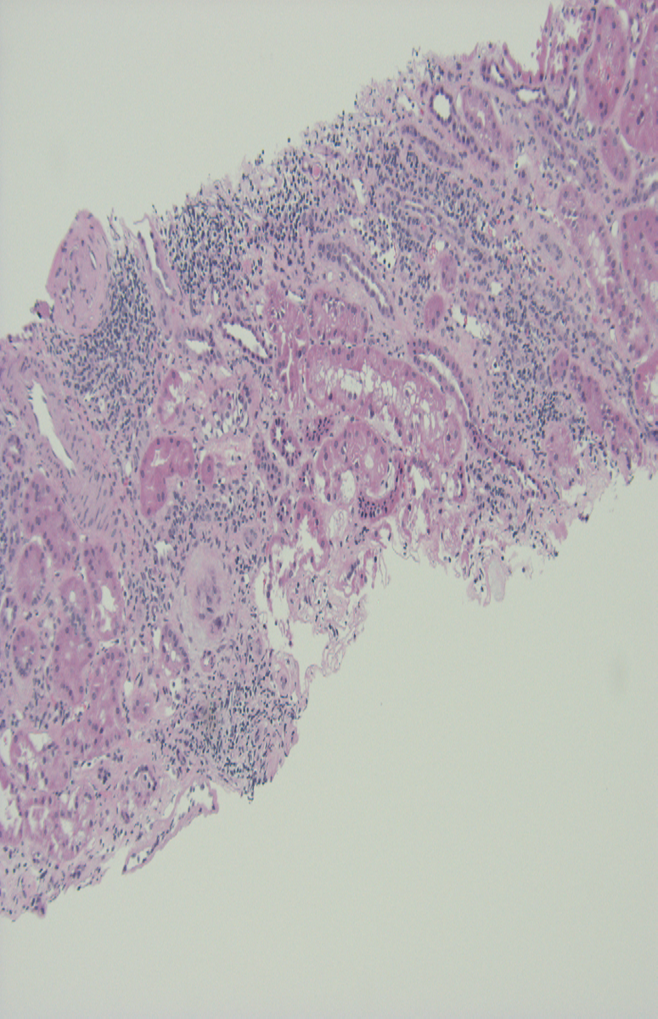
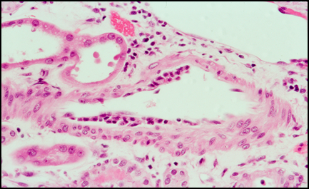
Caveats of Analyzing Isolated V by M-Classifiers
Isol V- lesion biopsies not included in TCMR training sets
Absence of molecular rejection in 43% is a circular argument.
Failure to detect TCMR in most biopsies mirrors its
suboptimal performance for TCMR Dx in ALL BIOPSIES
Negative MMDx® test for TCMR should not preclude rx as Banff
TCMR grade 2A/2B with steroids/ATG, if clinically indicated
Notes:
I WANT TO POINT OUT SOME NOT OFTEN APPRECIATED Caveats of Analyzing Isolated V-lesions by M-Classifiers
--.Isol v lesion biopsies were not included in training sets for either the ABMR or the TCMR classifiers
--Rather it was trained on biopsy with clear cut inflammation & tubulitis as is shown here;
--IT WAS NOT TRAINED ON BIOPSIES THAT ---look very different---because they were essentially free of inflammation & tubulitis, as is shown here
---Therefore, the absence of molec rejection in 43% of these biopsies is A FORM OF CIRCULAR .
-- Failure to detect TCMR in most biopsies mirrors its
suboptimal performance for TCMR Dx in ALL BIOPSIES
---Negative MMDx® test for TCMR should not preclude rx as Banff
TCMR grade 2A/2B with steroids/ATG, if clinically indicated
Xxxxxxxxx
.
IXxxxxxxxxxxxxxxxx
V-lesions more common in ist yr (9% of biopsies versus 5% >1 yr)
Timing: <1 yr often DSA –ve and not rejection (he may have a point in saying do not diagnose most as TCMR unless i&t criteria satisfied); 1-5 yr often ABMR scores + & DSA;
Primary discrepancy: MDX does not call rejection on many that were really isolated V
Figures argue it is a purely training problem.
Clinical implications of discrepancy remain unclear; mmdx would argue half not be treated; many clinicians would feel very uncomfortable not treating biopsies with intimal arteritis; trial to resolve this unlikely to be ever done
xxxxxxxxxxxxxx
Most of the numbers are from Table 2 and 3 (total is 30+47 + 1 no rejection = 48 biopsies so TCMR by histology was 30/48=63%; molec 15/48=31% = about the 30% figure I had in mind
The feeling is that most late cases of isolated v have antibody while sis studied early cases mostly without antibody
-------------
Half the table is removed: it had 17 Mixed Rejection by Histology: 2/17 molec TCMR, 9/17 molec ABMR,
xxxxxxxxxxxxxxxxxxxxxxxxxxxxxxxxxxxxxxxxx
Here are some deleted lines that could be reviewed.
Here is summary of mmdx findingscies for v-lesions reported as histologic TCMR; this is data on 30 biopsies reported by Dr. Halloran’s group (49, in all, isolated v= 28, All 30 are pure TCMR =30 but I did sneak in data on 28 isolated V1 lesions)
-ABMR score high in 5/30 = 17% (1+4 =5; 4 of 5 were mixed since TCMR score also high); Overall about half were said to be DSA NEGATIVE, & C4d status was not given for any patient; The treatment and clinical course of these patients is also not presented. SO IT IS NOT CLEAR HOW MANY PATIENTS were clinically behaving as ABMR. REALLY are well UNDISPUTED ABMR—in 2021 he has started arguing very early change, but needs careful study and refrain from using the diagnosis in clinical management---?unnecessary treatment
to these stable patients is really and inconventient paper published 2015, and it will be of interest to see how these patients are doing now—in 2021 he has started arguing very early change, but needs careful study and refrain from using the diagnosis in clinical management---?unnecessary treatment

Slide 52
Caveats of Analyzing i-t-V-lesions by MDX
Lesions likely not present in frag taken for MDx (3mm)
Findings reflect background lesions of TCMR or ABMR
Understanding T-cell vs Ab contribution: spatial profiling
IHC suggests mixed pathog. most cases (CD3, CD68, C4d)
Notes:
LET ME ALSO MENTION: want some Caveats of Analyzing I-T- V-lesions by MDX
Lesions likely not present in fragment taken for MDx especially if it is a MMDx® study 3mm
Findings reflect background lesions of TCMR or ABMR (and that info IS STILL RELEVANT to the same extent as it is for biopsies without v-lesions
Understanding T-cell vs Ab contribution to the pathogenesis will need spatial profiling focused on ROIs actually containing the lesion
IHC suggests a mixed pathog. most cases (as CD3 + T-cells , CD68 + macrophages &, C4d deposits are usually present
FOURTHE ROW: NO Molecular REJECTION was found IN 10/30 = 33% patients
-for isol-v the proportion was even higher viz 12/28 OR 43% of cases
I would argue that the molec classifer used in this study was not trained on such Biopsies
FIFTH ROW WITH HISTO FIGURES:
Rather it was trained on biopsy with clear cut inflammation & tubulitis as is shown here; IT WAS NOT TRAINED ON ISOL-V BIOPSIES THAT HAVE A VERY DIFFERENT, an example of which is shown here
BOTTOM-MOST TEXT BOX IN BLUE
Hence in my opinion, stating that these cases are not TCMR, because the machine does not say so IS A FORM OF CIRCULAR REASONING
Indeed I think the piece taken for MMDx studies in these biopsies was likely normal SINCE ISOL V-LESIONS ARE EXTREMELY FOCAL
Revisit relative % ABMR-TCMR with spatial profiling
XXXXXXXXXXXXXXXX
THE AFFECTED VESSEL WAS VERY LIKELY NOT EVEN PRESENT IN THE PIECE TAKEN FOR MMDX; & inflammation was none or minimal; SO IT IS NO SURPRISE THAT THESE WERE CALLED NO REJECTION.
Xxxxxxxxx
---no patient was mentioned to have received plasmapheresis or IVIG, ----and even the graft outcome was not demonstrable worse for patients with v-lesions (ABMR diagnosis remains an opinion; no evidence that ABMR diagnosed thus needs treatment )
IXxxxxxxxxxxxxxxxx
V-lesions more common in ist yr (9% of biopsies versus 5% >1 yr)
Timing: <1 yr often DSA –ve and not rejection (he may have a point in saying do not diagnose most as TCMR unless i&t criteria satisfied); 1-5 yr often ABMR scores + & DSA;
Primary discrepancy: MDX does not call rejection on many that were really isolated V
Figures argue it is a purely training problem.
Clinical implications of discrepancy remain unclear; mmdx would argue half not be treated; many clinicians would feel very uncomfortable not treating biopsies with intimal arteritis; trial to resolve this unlikely to be ever done
xxxxxxxxxxxxxx
Most of the numbers are from Table 2 and 3 (total is 30+47 + 1 no rejection = 48 biopsies so TCMR by histology was 30/48=63%; molec 15/48=31% = about the 30% figure I had in mind
The feeling is that most late cases of isolated v have antibody while sis studied early cases mostly without antibody
-------------
Half the table is removed: it had 17 Mixed Rejection by Histology: 2/17 molec TCMR, 9/17 molec ABMR,
xxxxxxxxxxxxxxxxxxxxxxxxxxxxxxxxxxxxxxxxx
Here are some deleted lines that could be reviewed.
Here is summary of mmdx findingscies for v-lesions reported as histologic TCMR; this is data on 30 biopsies reported by Dr. Halloran’s group (49, in all, isolated v= 28, All 30 are pure TCMR =30 but I did sneak in data on 28 isolated V1 lesions)
-ABMR score high in 5/30 = 17% (1+4 =5; 4 of 5 were mixed since TCMR score also high); Overall about half were said to be DSA NEGATIVE, & C4d status was not given for any patient; The treatment and clinical course of these patients is also not presented. SO IT IS NOT CLEAR HOW MANY PATIENTS were clinically behaving as ABMR. REALLY are well UNDISPUTED ABMR—in 2021 he has started arguing very early change, but needs careful study and refrain from using the diagnosis in clinical management---?unnecessary treatment
to these stable patients is really and inconventient paper published 2015, and it will be of interest to see how these patients are doing now—in 2021 he has started arguing very early change, but needs careful study and refrain from using the diagnosis in clinical management---?unnecessary treatment

Slide 53
CHRONIC ACTIVE TMCR (recognized in 2017) Issues Discussed in Banff 2022
Defining tubular atrophy
Defining IFTA
Adjusting the threshold for Dx caTCMR
Notes:
I will now discuss: Chronic Active TCMR:--- which has been finally recognized in the in the Interstitial Compartment -- after many decades of what to me was UNBELIEVABLE denial that this entity could exist --outside of the vascular compartment.
ca-TCMR related issues discussed in the 2022 conference were:
Defining tubular atrophy
Defining IFTA
Adjusting the threshold for Diagnosis of caTCMR

Slide 54
Definition of Tubular Atrophy
Oxford classification IgAN: Thick irregular TBMs USUALLY with decreased tubular diameter
Banff 2015: Thickening/redundancy TBM OR Reduction Tub. Diam >50%
-Diameter <25% severe; 25-50% moderate (>50% variably referred to as no atrophy or mild atrophy)
Notes:
Let us consider the DefInition of tubular atrophy
The Oxford classification IgAN: defines it as Thick irregular TBMs USUALLY with decreased tubular diameter
.
The Banff 2015 definition is: TBM thickening/redundancy ----OR-----Reduction in tubular diameter >50%.
Diameter of <25% compared to non-atrophic tubules is referred to as severe;
25-50% has been defined as being moderate
And >50% variably referred to as mild atrophy or no atrophy
These definitions are from the 2018 reference guide by Dr. Roufosse
xxxxxxxxxxxxxxxxxxxxxxxxxxxxxxxxxxxxxxxxxxxxxxxxxxxxxxxxxxxxxxxxxxxxxxxx
NOT SURE ati meets any criterion of tubular atrophy: the epithelial cell is atrophic= very flat, but diameter per se may not be reduced:
Caution about reduced diameter alone: ATI (reversible)
>50% has not been explicitly defined as mild, although this is the cut off I TRY TO USE IN MY OWN PRACTICE----recognizing that subtle differences in tubular size are not readily seen by the human eye
While assessing % reduction in diameter atrophic PCT must be compared to normal PCT , PST to PST and atrophic DCT to normal DCT
Confounding factors in the assessment include compensatory H & indeterminate morphology: namely that when tubules are diseased it is not always easy to decide whether it is a proximal or a distal tubule, and what reference tubules should be used to judge the % reduction in its diameter
xxxxxxxxxxxxxxxxxxxxxxxxx
THE CAVEAT OF “USUALLY” prevents me from really saying the following:
Personally, I think the Oxford classification provides a more rigorous definition ---and prevents an ACUTE decrease in tubular diameter---from being confused with chronic tubular injury
Oxford: It is scored according to the % of cortical area involvement with 1-5% rounded to 5% & higher values rounded to the closest 10% (Roberts et al. Kid Int 2009: 76: 546)
Going strictly by the language in SOME OF THE OLDER Banff publications, >50% expected diameter should not even be called atrophy
(PST is proximal straight segment, which will be reflect into and become a part of the medullary ray portion of the cortex);
DCT = distal convoluted tubule -- exists but DST – distal straight segment does not exist as a precisely defined entity
The approved terms are : thick ascending limb of Henle (probably same as distal tubule NOS)->macula densa AT THE POINT IT JOINS Distal conv tubule-→ connecting segment→ (cortical) collecting duct)
(the term distal tubule not specified is vague and not imprecisely defined; it should not be used; DCT is an acceptable term even though DST does not exist)
I would personally like to have a single category of non-severe atrophy that I would like to call mild to moderate. However, the Banff 2018 GUIDE (fig.4) suggests the term moderate atrophy if tubular size is between 25-50% of surrounding unaffected or minimally affected cortical tubules”; Presumably, they want to refer to tubular size of 50-100% as mild atrophy, but Banff 1995 does not even formally recognize that as atrophy, possibly because they were not sure it could be reliably diagnosed-- --------- J. yes they do quote Banff 1995 definition of ct as tubule with a thickened tubular basement membranes or reduction of greater than 50% of the diameter”;
They correctly argue that this definition is relevant only to scoring ct in terms of % cortex affected;
ct1 ct2 ct3 scores for EXTENT of atrophy should not be confused with definition of atrophy for individual tubules (do not use the terms ct1, ct2 , ct3 for this)
Xxxxxxxxxxxxxxxxxxxxxx
Banff 2018 refers to tubular atrophy of the conventional type; then illustrates Thyroidization type atrophy and Endocrine-like atrophy (Figure 8; thyroidization is flattening of epithelium to thin layer; endocrine atrophy has greater cytoplasmic mass; both appear to have decreased diameter; neither has prominent thickening or wrinkling of the tubular basement membranes)---but in my figure of thyroidization below I do not see decreased diameter in ALL tubules (though some likely are decreased)
xxxxxxxx
Severe atrophy already excluded from consideration by Banff 2017; This means that any non-severe atrophy will allow tubulitis to be scored in IFTA (No atrophy, severe atrophy and non-severe atrophy)
Mild atrophy is allowed by Banff in ACUTE TCMR
Banff defines atrophy as <50%; I do not think mild, moderate & severe atrophy can be reliably defined; severe atrophy, non-severe atrophy, and no atrophy are the only reasonable categories we can accommodate in our reporting
Strictly speaking Banff T is defined by mild atrophy without regards to its location in or outside a scar (though most likely would think inside scar)
Not all tubules in any area are equally affected eg mildly atrophic tubulitis valid for scoring is mixed with severely atrophic tubules
(Grading the decrease in diameter is very problematic (upto 50% is normal; beyond that estimating 49% or 24% will be problematic as size is different for proximal and distal tubules and proximal-distal distinction may be difficult when tubules are diseased, not to mention compensatory hypertrophy; also not all tubules equally affected ie mildly atrophic tubulitis valid for scoring is mixed with severely atrophic tubules
Xxxxxxxxxxxxxxxxxxx
Severe atrophy already excluded from consideration by Banff 2017; This means that any non-severe atrophy will allow tubulitis to be scored in IFTA (No atrophy, severe atrophy and non-severe atrophy)
Mild atrophy is allowed by Banff in ACUTE TCMR
Banff defines atrophy as <50%; I do not think mild, moderate & severe atrophy can be reliably defined; severe atrophy, non-severe atrophy, and no atrophy are the only reasonable categories we can accommodate in our reporting
Strictly speaking Banff T is defined by mild atrophy without regards to its location in or outside a scar (though most likely would think inside scar)
Not all tubules in any area are equally affected eg mildly atrophic tubulitis valid for scoring is mixed with severely atrophic tubules
Xxxxxxxxxxxxxxxx
Most of the periglomerular area is proximal tubules and convoluted or not does not seem relevant with respect to morphology; you can use it judge 50% decrease diameter simply by not including the small numbers of distal tubules expected to be present here (but arguably distal tubulitis is also important)------
(% area occupied by nucleus has definition issues too: it will be further affected by plane of sectioning and regenerative nuclear pleomorphism)----
Grading of tbm thickening: binary system of <3 and >3 times normal tubules was once considered by me (reproducibility will need to be assessed)(practical value also an issue)

Slide 55

IFTA Banff 2015: IFTA = IF AND TA Common Practice: TA using only PAS taken as surrogate for IFTA Banff 2018 Reference guide: i-IFTA should be scored in scarred areas Scarred area: “characterized by tubular atrophy, usually, (but not always) accompanied by IF IF assessment needs correlation with HE & Trichrome
Notes:
What are we referring to when we use the term IFTA
Banff 2015 defines it as inflammation in areas with IF AND TA
However, I frequently find that TA is used as surrogate for IFTA An example of this is seen in the Banff 2018 Reference guide: ---which states that inflammation in IFTA or i-IFTA should be scored in scarred areas Then it goes on to define a Scarred area as:----- “characterized by tubular atrophy, ---, usually but not always accompanied by IF
THE TEXT IN THE PARENTHESIS IS mine,-- and not directly from the guide
xxxxxxxxxxxxxxxxxxxxxxxxxxxxxxxxxxxxxxxxxxxxxx
This is not the same as IF OR TA
UNFORTUNATELY, NOT ALL STUDIES recognize this subtle difference.
The 2018 Reference Guide to the Banff Classification states that i-IFTA should be scored in scarred areas, WHICH IS ACCEPTABLE, BUT--It then goes on to define a scarred area as one : “characterized by tubular atrophy, usually, but not always accompanied by interstitial fibrosis
One imp CAVEAT OF PAS IS THAT WHILE IT IS GOOD FOR DIAGNOSIS ATROPHY, It MAY NOT BE THE BEST STAIN FOR FIBROSIS---HENCE SEVERE ATROPHY ON PAS MAY BE RELIABLE FOR THE MOST PART

Slide 56
DISSOCIATION OF IF FROM TA
Acute injury:
- ATN
-TCMR
Atrophy defined by Dec tubular D & H of lining epithelium occurs w/o fibrosis
Chronic injury:
- ct>>ci: BKVN, pyelo, RA stenosis
- ci>> ct compensatory hypertrophy of tubules
Notes:
1
Although usually they go hand in hand, dissociation of IF from TA can be seen in 10-20% of biopsies in my practice
This can happen in Acute Tubular Injury, wherein tubules can look atrophic ---if defined by a decrease in the tubular diameter and height of the tubular epithelium--- without ACCOMPANYING FIBROSIS
.
The same thing may be visualized in some CHRONIC KIDNEY DISEASES
eg we might see tubular atrophy scores EXCEEDING/outpacing THE SCORES for interstitial fibrosis--- in diseases like BKVN,-- pyelonephritis, …and RA stenosis
- conversely interstitial fibrosis may look more severe than tubular atrophy---- if there is there is compensatory H of the tubules
Xxxxxxxxxxxxxxxxxxxxxxxxxxxxxxxxxxxxxxxxxxxxxxxx
Making these distinctions may be imp----- eg biopsies with primarily atrophic tubules may have better prognosis ---or rx-response ----since dense scarring is absent
In passing, let me also mention BIOPSIES with what I could call VANISHING IFTA:
these biopsy have a high density of sclerotic or patent & presumably atubular glomeruli--- without proportional fibrosis or tubular atrophy (due to dissolution of the intervening matrix)
Xxxxxx
I am no longer sure of how loss of nephrons will cause ci>ct; ---------ct score will be unevaluable if there is a large section with tubules missing—I think that is vanishing IFTA vide supra

Slide 57
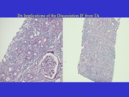
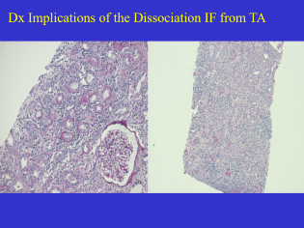
Dx Implications of the Dissociation IF from TA
TA without Fibrosis
TA with Fibrosis
Notes:
There are diagnostic implications of the dissociation of IF from TA. .
Left panel: shows tubular atrophy with thick TBMs but no OBVIOUS fibrosis; IF WE ACCEPT the inflamed area as IFTA we might make a diagnosis of chronic active TCMR; ----but if WE DO NOT, then areas of t2 tubulitis in this area would qualify for a diagnosis of acute TCMR
RIGHT PANEL: THIS BIOPSY IS A MORE CLEAR CUT EXAMPLE of CHRONIC ACTIVE TCMR ----since inflammation is readily recognized in areas with both IF & TA .
PUTTING ACADEMIC DEBATE ASIDE, --this discrepancy is not as big a deal as it might appear at first sight-------------Experienced clinicians ---who come and look at biopsies instead of treating entirely on the basis of a written pathology report---would give steroids to both biopsies—no matter whether they are categorized as acute or chronic active------------UNLESS THE DEGREE OF CHRONICITY IS SUCH THAT RX DOES NOT SEEM PRUDENT
xxxxxxxxxxxxxxxxxxxxxxxxxxxxxxxxxxxxxxxxxxxxxxxxxx
FORTUNATELY IT DOES NOT MATTER MAY BE AN IMPORTANT CONCEPT EVEN FOR THE Working Group; THE ACTUAL SCORES TELL THE REAL THING
POSSIBLE OBJECTION to my photo: these are only mildly atrophic tubules = allowed by Banff 1997; Response: you could have a similar biopsy with a little more reduction in diameter that even you would accept as moderate atrophy
Left panel: shows a biopsy with tubular atrophy with thick TBMs but no OBVIOUS fibrosis; IF WE ACCEPT the inflamed area as IFTA we would make a diagnosis of chronic active TCMR; but if WE DO NOT, then areas of t2 tubulitis (AT LEAST) in areas with non-atrophic or mildly atrophic tubules would qualify for a diagnosis of acute TCMR
IF and TAusually do go together, but this is not always the case)(BOTH BEING PRESENT WILL BE IMPORTANT; otherwise many acute TCMRs with some atrophy but no significant fibrosis will become eligible for i-IFTA criterion of CTCMR).
The inflammation & tubulitis here qualify for Banff ca-TCMR, THOUGH IN OUR EXPERIENCE these cases often present as ACUTE TCMR and we think they can be so classified from a CLINICAL PERSPECTIVE
Xxxxxxxxxxx
May come back to this as making the case that TCMR diagnosed by inflammation without regard to the compartment in which it is present.
The chronicity in the case can be communicated by the ci and ct scores without necessarily labeling it as chronic active if there is no clinical documentation that it is indeed a persistent smoldering TCMR

Slide 58
Terminology for Grading Inflam Banff Schema
Total cortex (denominator for Ti score):
includes subcapsular region
excludes nodular lymphoid aggregates & p/v col
Total inflammation (numerator for Ti score):
excludes subcapsular region
excludes nodular lymphoid aggregates & p/v col
i-Score non-IFTA in numerator & denominator: excludes s/cap
i-IFTA IFTA in numerator & denominator
Notes:
Let me now make some observations about the terminology used in the grading of inflammation in the Banff Schema
. The term Total cortex (which is the denominator for Ti score):
includes subcapsular region
excludes nodular lymphoid aggregates & perivascular collagen (inflammation)
The term Total inflammation (which is the numerator for Ti score):
excludes subcapsular region
excludes nodular lymphoid aggregates & p/v col
i-Score non-IFTA in numerator & denominator: excludes s/cap
i-IFTA IFTA in numerator & denominator

Slide 59
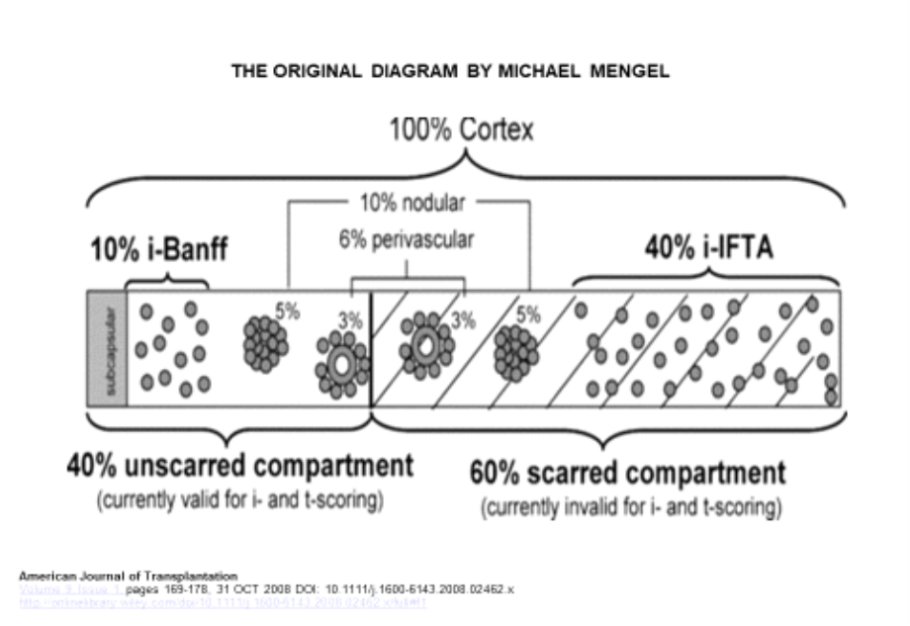
Grading of Inflammation
- 40% not IFTA (left), 60% IFTA (right)
- I-Banff = 10% = i-Banff/Total cortex
- i-IFTA = 40% i-IFTA area/ IFTA area
Notes:
Here is a diagrammatic representation of the Grading of Inflammation IN A HYPOTHETICAL BIOPSY CORE
- 40% of the biopsy is not IFTA (left side of the core), and 60% of the biopsy has IFTA (right side of the core)
- The term I-Banff—is stimated to be 10%--by finding the ratio of I to total cortex--- .
- The term i-IFTA estimated to be 40% --has a different denominator; it is calculated by ratio of i-IFTA area divided by IFTA area
Xxxxxxxxxxxxxxxxxxxxxxxxxxxxxxxxxxxxxxxxxxxxx
Total I includes s/caps area
i-Banff does not excludes s/caps area
Both exclude lymphoid aggregate and p/v inflammation

Slide 60
REFINING THE DX CHRONIC ACTIVE TCMR (Review of Banff 2019 Criteria)
Total i > 1
Inflamed scar or I-IFTA >1 and t or t-IFTA >1
- t-scoring should not include severely atrophic tubules
- reasonable exclusion other causes t & i-IFTA
caTCMR Grade 1A if t/t-IFTA =2, Grade 1B if t/t-IFTA =3
Grade II if we can demonstrate chronic allograft arteriopathy
Score t and t-IFTA separately to allow dx of concurrent BL or acute
Notes:
Discussions also took place in Banff about Refining the Dx Chronic Active TCMR
To put those in perspective let me quickly review the (Banff 2019 Criteria) for this entity
Basically, a diagnosis of ca-TCMR requires a total inflammation score of more than 1, an inflamed scar or i-IFTA score of >1, and a t or t-IFTA score of >1
- t-scoring should not include severely atrophic tubules
- Also, these criteria must be applied ONLY After reasonable exclusion of other causes of t and i-IFTA
Once we have done that, that we can grade the ca-TCMR as, 1A if the or t-ifta score is 2 and as 1B if the t or t-ifta score is 3
Grade II is assigned if we can demonstrate chronic allograft arteriopathy
Another stipulation is that --We should Score t and t-IFTA separately to allow a dx of concurrent BL or acute TCMR as appropriate
xxxxxxxxxxxxxxxxxxxxxxxxxxxxxxxxxxxxxxxxxxxxxxxxxxxxxxx
Banff 2019 does not change the criteria but does advise separate scoring of t-Banff and t-IFTA. Moreover, footnote e: suggests that a 2nd diagnosis of BL or Acute TCMR be made when the corresponding criteria are satisfied. In other words, it now allows simultaneous reporting of BL and acute TCMR using conventional criteria
xxxxxxxxxxxxxxxxx
Let me begin by summarizing the Banff criteria for ca-TCMR. These require that the tubulitis score be >1,
-the location of tubulitis is not clearly stated to be within the area of IFTA,
-his creates ambiguities since non-atrophic tubules can be found within ifta (you can have 2 i-Banff scores in a biopsy)
-it is clearly stated that we must not score severely atrophic tubules
We need reasonable exclusion of other causes of t and iifta
Having done that we grade the ca-TCMR as grade 1A if t =2, Grade 1B if t =3
BRIAN WAS CONCERNED 20% SCARRED AND 80% SCARRED BIOPSIES BOTH GET A CHRONIC SCORE OF 1A—BUT IF THE BIOPSY REPORT IS READ IN CONJUNCTION WITH CI, CT AND i-IFTA SCORES---------AND REMEMBERING THE CICT2 MINIMUM THRESHOLD FOR DX
xxxxxxxxxxxx
Grade II: note that new onset is not required for chronic ACTIVE TCMR, though in my proposal for chronic INACTIVE TCMR I must propose it)
Xxxxxxxxxxxxxxxx
(artery intimal fibrosis with mononuclear cell inflammation in fibrosis & formation neointima)
Do not want to restrict it to chronic scores of >=2 but not doing so means confusing the issue with BL change and mild ifta from donor in a 3 month protocol biopsy– plus the BL infiltrate should prompt upward adjustment of immunosuppression anyway if clinically indicated

Slide 61
Shift in Degree Tubular Atrophy Allowed to Score T
Banff 1997 rules for Acute TCMR:
Normal or mildly atrophic tubules
-t not graded in moderately/severely atrophic tubules - reduction in caliber ≥ 50%
Banff 2017: All but severely atrophic tubules----in areas with or without IFTA (normal, mild, mod)
Banff 2019 rules: can score tubulitis independently both in:
- areas of “preserved” cortex (Banff-t score) AND
- areas of cortical IFTA (Banff t-IFTA score)
- providing that severely atrophic tubules are excluded
Banff 2022 made no changes to the Banff 2019 rules
Notes:
I want to note that OVER THE YEARS, a significant shift in the degree of tubular atrophy allowed for scoring of tubulitis has occurred
The Banff 1997 rules for acute TCMR (which were never changed again till 2017) state that :
We should use mildly atrophic tubules in areas without IFTA------(Thus ifta of mild degree allowed even in 1997) IFTA (1997 was effectively also w/wo IFTA, if mild atrophy counted as IFTA )
-tubulitis should not be graded in moderately to severely atrophic tubules, which are defined as having a reduction in caliber ≥ 50%
Banff 2017: All but severely atrophic tubules could be graded ---in areas w/wo IFTA ----(normal, mild or moderately atrophic tubules could all be included)
Banff 2019 rules: state that we can score tubulitis independently both in:
- areas of preserved cortex (to obtain the Banff-t score----J. THIS INCLUDES tubulitis in mildly atrophic tubules= accepted per se as IFTA in 2018 guide
- areas of cortical IFTA to obtain the Banff t-IFTA score
- providing that severely atrophic tubules are not scored
DECISION IN PUBLISHED MANUSCRIPT IS NOT TO CHANGE ANYTHING FROM 2019
Xxxxxxxxxxxxxxxxxxxxxxxxxxxxxxxxxxxxxxxxxxxxxxxxxxxxxxxxxxxxxxxxxxxxxxxxxxxxxxxxxxxxxxxxxxxxxxx
NOTE: Banff 1997 ACCEPTANCE OF MILD ATROPHY MEANS TUBULITIS CAN BE SCORED in areas without IFTA but also in areas WITH IFTA AS LONG AS IT IS MILD. IT CAN
A Corollary of these rules is that moderately atrophic tubules can be scored for acute TCMR, and that is a departure from the Banff 1997 rules
Likewise: mild atrophy can be used to obtain a t-IFTA score for dx of chronic active TCMR
I MENTION THIS NOT TO CRITICIZE Banff, ---BUT TO POINT OUT HOW DIFFICULT IT IS---FOR A TABULAR REFERENCE TABLE OF THE Banff SCHEMA----TO FULLY ACCOUNT FOR THE WIDE SPECTRUM OF PATHOLOGY SEEN IN ALLOGRAFT BIOPSIES
Xxxxxxxxxxxxxxxxxxxxxxxxxx
Banff 1997: areas without IFTA: yes degree of ifta indirectly specified as that with only mildly atrophic tubules
Banff 2019: introduced the t-IFTA score & suggested scoring it in areas with IFTA . But it did not clarify
? If location of atrophic tubule could be anywhere in the bx?
? If it must be present in an area with IF
.
. xxxxxxxxxxxxxxxxxxxxxxxxxxxxxxxxxxxxxx At this stage it is necessary to comment that Banff 2017 introduced (? Unintended) Changes in Scoring Recommendations for tubulitis

Slide 62
Dx Implications of This Change in Definition
Moderately atrophic tubules in can be scored for acute TCMR (departure from 1997 rules)
Mild atrophy (in area with surrogate IFTA) can give a t-IFTA score of 2 or 3 for dx of chronic active TCMR
WORKING RULE:
--Identify areas w/wo IFTA to generate t & t-IFTA scores --remember to accept even moderately atrophic tubules
Notes:
There are diagnostic implications of this change in definition
First it means that moderately atrophic tubules can be scored for acute TCMR, (if atrophy alone is not considered synonymous with IFTA) and that is a departure from the Banff 1997 rules
Secondly, it means that mild atrophy (with surrogate IFTA area score>1) can be used to obtain a t-IFTA score for dx of chronic active TCMR ----(though historically mild atrophy has been used for the diagnosis of acute TCMR)
WORKING RULE:
Identify areas without IFTA & with IFTA to generate t & t-IFTA scores remembering to accept even the moderately atrophic (even though some of you MAY HAVE BEEN NOT SCORING THIS IN THE PAST)----I have seen colleagues call BL by continuing their old habit of ignoring moderately atrophic tubules
.
xxxxxxxxxxxxxxxxxxxxxxxxxxxxxxxxxxxxxxxxxxxxxxxx
Need to clarify this in Banff Reference Guide if that is what we intend---possibly the survey being analyzed by Maarten in 2023 might have relevant conclusions.t
.
Thus, Banff Schema rules have difficulty in capturing the wide spectrum of pathology seen in allograft biopsies
I think we Need to acknowledge this & revisit scoring process for biopsies with acute TCMR & ca-TCMR
Banff 1997: areas without IFTA: yes degree of ifta indirectly specified as that with only mildly atrophic tubules

Slide 63
What is the Appropriate Morphology Threshold For Dx of Chronic Active TCMR
I-IFTA 2 or 3 is the currently specified threshold
Degree of ci, ct Not Specified
Clearly, a minimum ci threshold must set to avoid trivial scar problem:
? ci1 or ct2: needs discussion
Lowering i-IFTA threshold from 2 to 1: was also debated during the recent Banff meeting
Introducing the term sub-threshold ca-TCMR for further study may be a better option
Notes:
One more question discussed in Banff 2022: ----What is the Appropriate Morphology Threshold for the diagnosis of chronic active TCMR?
I-IFTA 2 or 3 is the currently specified threshold
Degree of ci, ct is Not Specified
Clearly, a minimum ci threshold must be set-----to avoid what I would like to call --the trivial scar problem
Whether that threshold should be ci1 or ct2:----was debated during the Banff Meeting (BUT no minimum ci threshold was incorporated into the defn of ca-TCMR, since they wanted to keep that definition unchanged
Lowering i-IFTA threshold from 2 to 1: was also debated during the recent Banff meeting
Introducing the term sub-threshold ca-TCMR for further study may be a better option
Xxxxxxxxxxxx
TERMINOLOGY FOR NEW TIERS WILL NEED MORE THOUGHT: 1A, 1B, ii ALREADY BEEN DEFINED---create a term Evolving TCMR? Or ci-1-ca-TCMR (there may not be much appetite for the term suspicious or BL)
XXXXXXXXXXXXXXXX
Require ci2 or ci3 to be present concurrently> This Was agreed to in Banff 2019 discussions, but never made it to the final manuscript.
AVOID THIS: one SUGGESTION I WOULD LIKE TO MAKE-- FOR THE NEXT BANFF MEETING REPORT --IS THAT THE FINAL VERSION OF THE MANUSCRIPT—AFTER a gazillion EMAILS HAVE BEEN EXCHANGED---BE PROOF READ BY AT LEAST 3 PATHOLOGISTS,---- BEFORE IT IS FINALLY SUBMITTED FOR PUBLICATION. Not the first time: eg BL changes 2005 not a widely discussed consensus, as far as I can remember
ANOTHER QUESTION THAT CAN BE POSED AT THIS STAGE IS:----Should we LOWER the DxThreshold for caTCMR to include i-IFTA 1, ci1 with the current rider of reasonably excluding other causes IFTA?
CLEARLY THE Banff RULES FOR DIAGNOSIS OF ca-TCMR NEED TO SPECIFY A MINIMUM PERCENTAGE OF FIBROSIS TO BE PRESENT IN THE BIOPSY. ---(NEXT SLIDE)

Slide 64
The Trivial Scar Problem
Biopsy performed 11m post-transplant for rising serum creatinine
Ti3 i3 t3
Acute TCMR 1b
i-IFTA2 t-IFTA2, ci1 ct1
Chronic active TCMR 1A
Notes:
1
Let me illustrate the TRIVIAL SCAR PROBLEM
This biopsy is from a patient evaluated 11 months post-transplant for rising creatinine.
The left panel shows the relevant acute scores: Ti3 i3 t3
The right panel shows the chronic scores i-ifta2, t-ifta2, ci1 and ct2
Application of Banff 2019 rules to the first microscopic field Generated a diagnosis of acute TCMR grade 1B, which makes clinical sense.
But after looking at microscopic field #2 we also got a diagnosis of ca-TCMR, 1A, which DID NOT make sense, because it was based on a trivial scar.
PERIOD. MOVE ON TO NEXT SLIDE
xxxxxxxxxxxxxxxx
Working Group agenda: Protocol biopsy and acute issue; acute retained for BL, and for TCMR; gone for ABMR;
2019 now allows 2nd diagnosis acute TCMR (2017 interdicted)
Chronic active still does not specify location of tubulitis so that same zone can satisfy 2 definitions
A Computerized Intelligent Diagnosis System that we have implemented in our department:
Generated a diagnosis of acute TCMR grade 1B, which makes clinical sense.
But we also got a diagnosis of ca-TCMR, 1A, which DID NOT make sense, because it was based on a trivial scar.
I think we need to specify a minimum threshold of ci2 or moderate interstitial fibrosis to make a diagnosis of ca TCMR
.I DELETED the chronic diagnosis FROM THE AUTOMATED SURGICAL PATHOLOGY REPORT--- and made a note of that in the Comments section.
THIS biopsy IS AN EXAMPLE OF THE NEED FOR CAUTION ----WHEN USING Artificial Intelligence BASED BIOPSY SIGN-OUT TOOLS
XXXXXXXXXXXXXXXXXXXXXXXXXXXXXX
YES IT IS THE SAME CASE AS ACUTE TCMR WITH TUBULAR ATROPHY THAT I HAVE TALKED ABOUT
To indicate the fact that I saw it in the fibrotic area---I AM USING THE TERM t-IFTA
Ci2 ct2 rider never made it thru

Slide 65
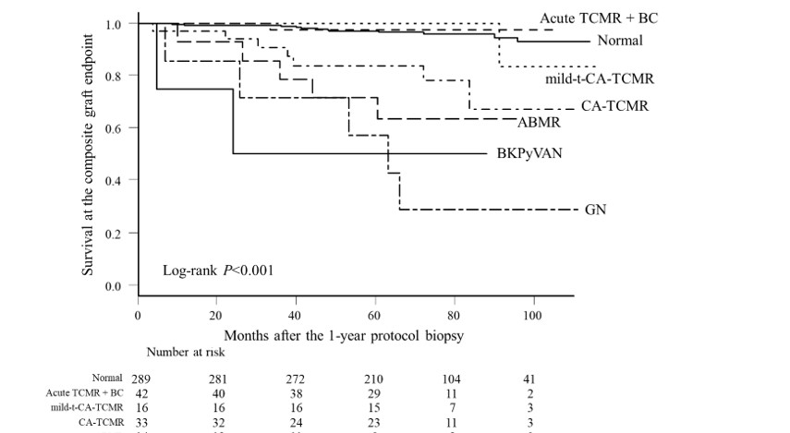
Japanese Study 1 Yr Protocol Biopsies Expanded ca-TCMR: ti ≥1 i-IFTA ≥ 1 (t≥2) Mild-t-ca-TCMR: t lowered to 1
Notes:
Here is some data that supports a change to the current thresholds of Ti, i-IFTA and t-IFTA for a diagnosis caTCMR
This is a Japanese study of 1 year protocol biopsies
They used an expanded definition of ca-TCMR: wherein they LOWERED THE Ti and iFTA thresholds -----from >=2 ----to >=1; The t >= 2 threshold was kept the same.
In addition ---they created a category called ----mild tubulitis chronic active TCMR--- where the tubulitis threshold was also lowered from 2 to 1
Normal patients and acute TCMR or BC = borderline change patients had a 100 MONTH ----COMPOSITE graft SURVIVAL of about 95%.
Mild-tubulitis - ca-TCMR had patients had a composite graft survival of about 85% -----which was lower than normal ----but still better off than--- Banff 2017 ca-TCMR ---which was 70% SURVIVAL AT 100 MONTHS
Expanded Chronic active TCMR, data is not shown here ---but was also intermediate ----between NORMAL and ----BANFF 2017 chronic active TCMR
XXXXXXXXXXXXXXXXXXXXXXXXXXXXXXXXXXXXXXXXXXXXXXXXXX
THE DEKAF PROSPECTIVE AND CROSS SECTIONAL COHORTS ALSO HAVE SOME FINDINGS THAT CAN BE USED TO SUPPORT LOWERING THE THRESHOLD FOR Chronic active TCMR, -----BUT THAT DATA CAN BE LOOKED AT IN MORE THAN ONE WAY
Only t1-tubulitis version shown here--------------But expanded ca-TCMR was similar = 85% survival at the composite graft endpoint = doubling serum creatinine or graft loss (Banff 2017 was ~ 70%, Normal = No Rejection was 95%)-----Overall log rank p-value for whole graph was p<0.001; but I faintly remember hazard ratio for composite graft loss was same for normal and mild ca-TCMR groups
A diagnosis of ca-TCMR predicted a composite graft endpoint defined as doubling serum creatinine or death-censored graft loss with odds exceeded only by a diagnosis of antibody-mediated rejection (ABMR).
Relaxation total 1=1, i-IFTA=1, while retaining ci of 2 or higher (and t of 2 or higher they added in)= MODIFIED CATCMR= # cases 33 rose to 45; grade I rose from 28 to 40; Hazard ratio fell 5.42 to 3.00 (confirm this from final version of manuscript)
They also created a mild-tubulitis-CATCMR with ci of as little as 1 and tubulitis as little as 1 (while retaining Total-i 2 or more and i of 2 or more)= they found 17 cases, better survival AND Hazard Ratio ONLY 0.78=not in informative category
Nakagawa 2021 AJT 21: 174 Supplem Figs 2a 2b: Yes still demonstrable effect but milder (see ppt slides) 70% survival at composite graft endpoint RISES to 85% (no rejection is 95%)

Slide 66
Diagnosing Acute TCMR on top of ca-TCMR
Banff 2017 does not allow you to do so.
Accurately reflects pathology in PBx & Bx smoldering creat
Not satisfactory for Bx acute rise in creat (most late Bxs)
Banff 2019 (in prep): allow separate scores of t & tIFTA
My Opinion: Acute TCMR & IFTA grades based on Total-i & t without separate scores in fibrotic areas
Simple practical rule >30 ys before i-IFTA formally recognized
Location of i t should not determine a call of acute vs chr. active
Notes:
Now I would like to discuss the issue of diagnosing ACUTE TCMR occurring on top of ca-TCMR…..Banff 2017 did not allow you to do so
The term ca-TCMR, as defined in 2017, accurately reflected pathology in Protocol biopsies & in Biopsies done for gradually creeping up serum creatinine
However, it was not a satisfactory term for Bx acute rise in creat (which is actually most late Biopsies in our practice).
The Banff 2019 solution to this problem was to allow separate scores for tubulitis in non-fibrotic and fibrotic areas of the biopsy, --and to use inflammation and tubulitis in THESE NON-SCARRED areas to define ACUTE rejection superimposed on a background of chronicity.
My opinion HAS ALWAYS BEEN that, …IF A Bx IS DONE FOR A RAPID RATHER THAN A GRADUAL RISE IN CREAT,---ACUTE or ACTIVE TCMR can be dx & GRADED ---based on the TOTAL inflamm scores, & the severity of tubulitis ---IRRESPECTIVE of whether it occurs in fibrotic or non-fibrotic areas. ---.
This is a simple rule that we have followed >30 ys, -- beginning long before i-IFTA was formally recognized as a lesion that adversely affects graft outcome.
Location of i t should not determine a call of acute vs chr. active
XXXXXXXXXXXXXXXXXXXXXXXXXX
I do not believe that the Location of i t should not determine a call of acute vs chr. active in any given biopsy; IF THE CREATININE RISES ACUTELY THE REJECTION IS ACUTE; IF SMOLDERING IT IS CHRONIC ACTIVE; IF DURATION NOT KNOWN IT IS JUST ACTIVE
XXXXXXXXXXXXXXX
J. I REGARD THE Banff SCHEMA AS A SYSTEM FOR REPORTING ALLOGRAFT PATHOLOGY IN A UNIFORM WAY, AFTER I HAVE MADE A DIAGNOSIS BASED ON MY OVERALL BIOPSY ASSESSMENT AND REVIEW OF CLINICAL PARAMETERS—Practicing pathology this way is no different from practicing any other subspeciality area of Medicine;
xxxxxxxxxxxxxxxxxxxxxx
If creatinine is rising, these For protocol biopsies we could use the currently recommended terminology viz chronic active-TCMR, Banff grade 1a-II (but glotz had a somewhat valid point about not having separate definitions for different situations)
However of biopsies with rising creatinine, we could use the term acute TCMR Banff 1A-II and specify the grade of IFTA to indicate histologic chronicity without insisting that i & t occur in arbitrarily designated compartment
I WOULD LIKE TO NOTE THAT IN A RECENT BANFF SURVEY CONDUCTED BY MARK HAAS: IT WAS NOTED THAT IF TREATMENT WAS GIVEN TO THESE CASES IT WAS THE SAME TREATMENT THAT IS GIVEN TO PATIENTS WITH ACUTE TCMR
XXXXXXXXXXXXX
(we specify IFTA in this manner anyway for biopsies where fibrosis falls short of the designation CTCMR)
My opinion is that :
For protocol biopsies we could use the currently recommended terminology viz chronic active-TCMR, Banff grade 1a-II (but glotz had a somewhat valid point about not having separate definitions for different situations)
However of biopsies with rising creatinine, we could use the term acute TCMR Banff 1A-II and specify the grade of IFTA to indicate histologic chronicity without insisting that i & t occur in arbitrarily designated compartment
I WOULD LIKE TO NOTE THAT IN A RECENT BANFF SURVEY CONDUCTED BY MARK HAAS: IT WAS NOTED THAT IF TREATMENT WAS GIVEN TO THESE CASES IT WAS THE SAME TREATMENT THAT IS GIVEN TO PATIENTS WITH ACUTE TCMR
XXXXXXXXXXXXX
I believe this reporting system, is consistent with continued use of the term ‘Acute’ to qualify BL change & TCMR without significant IFTA (but no longer in use for early ABMR)(Banff 2017 stills allows acute TCMR)
Calling acute purely on histology has always been a problem: significant one for us as everyweek protocol biopsies show BL & 1A with stable create. We REPLACE the term acute with SUBCLINICAL; and we now need to think for terminology when biopsy triggered by cfDNA or pbf transcriptomics based markers
(need to show that complexity is really more meaningful than a simple read)(my gut feeling for sure but young guys need to prove it to the satisfaction of journal reviewers. if you choose me a referee i will give you a glowing response)
xxxxxxxxxxxxxxxxxxxxxxx
CHS19-2800 with kdpi 85, ci2 ct2 could not be called acute TCMR by Banff ca-TCMR rules even if creatinine shoots up to 4

Slide 67
Treatment of ca-TCMR (steroid pulses &/or optimization CNI MMF)
Banff Survey: 41% routinely, 32% IFTA≠3, 18% Sometimes
Pitt: Complete response (fall to baseline) 5/18 = 28%
Partial response (1-20% above base): 6/18=33%
No response (>20% above baseline): 7/18 = 39%
C/W larger informal clinical experience of >5 yrs
Benefits of Rx for graft longevity need long F/U
Notes:
Here is some data on the RX of ca-TCMR (which is usually steroid pulses &/or adjustment of baseline I.S.)---------
-In aBanff Survey conducted by mark haas: --41% of centers routinely treated caTCMR, ---32% of centers treated it as long as the IFTA score was ≠3, ----& 18% centers Rx ed it sometimes DEPENDING ON THEIR CLINICAL JUDGMENT.
Preliminary analysis of our own data indicates that --Complete response--- (defined by creatinine fall to baseline)--- was seen in 5/18 = 28% of CHRONIC ACTIVE TCMR CASES IDENTIFIED BY A REVIEW OF ~100 CONSECUTIVE BIOPSIES
Partial response ---(with creatinine remaining 1-20% above baseline) was seen in 6/18=33% of patients, and
No response--- (with creatinine remining >20% above baseline)—was seen in 7/18 = 39% of the biopsies.
These small # reflect the low overall incidence ca-TCMR, in the 100 biopsies I analyzed, -- but the results are quiet C/W with a much larger informal clinical experience developed over many years.
Benefits of such Treatment in terms of graft longevity need longer F/U
Xxxxxxxxxxxxxxxx
XIAOMU: The magnitude of the drop of serum creatinine from its peak value was expressed as a percentage of the absolute increase in the serum creatinine from baseline.
Each episode of rejection was characterized as showing complete response, partial response, or no response depending on whether the
Drop in serum creatinine was 60% or greater, 30% to 59%, or 29% or less, respectively.
Patients showing 30% or greater rise in creatinine compared to baseline were classified as having a worse status after treatment.

Slide 68
Pre & Post-Treatment Biopsies
Reduction
i-IFTA& t-IFTA
caTCMR 1A
No Inflammation or tubulitis outside of fibrotic areas
Notes:
1
Here is a comparison of pre & post-transplant biopsies from the patients with grade 1A caTCMR after a steroid recycle had been given.
The original biopsy is on the left and the post treatment biopsy on the right. There was a reduction in inflammation and tubulitis WITHIN THE SCARRED AREA ;
THIS BIOPSY DID NOT HAVE ANY INFLAMMATION IN THE NON-SCARRED AREA AND DID NOT SATISFY Banff CRITERIA FOR ACUTE REJECTION.
That is why I do not believe that the Location of inflammation or tubulitis --should determine whether TCMR in any given biopsy should be called ACUTE or CHRONIC ACTIVE.—
-IF THE CREATININE RISES ACUTELY THE REJECTION IS ACUTE; IF SMOLDERING IT IS CHRONIC ACTIVE; IF the DURATION is NOT KNOWN IT can be just called ACTIVE
have
xxxxxxxxxxxxxxxxxxxx
I do not know if there is any long term effect on graft survival when such rejection episodes are treated; that is a question to be answered by future studies

Slide 69
SUMMARY
TCMR remains an imp issue in KTx
BL change, T-I- rejection, V-lesions, Mixed
T-cells may initiate, perpetuate, worsen Ac/chr-ABMR
MDx has the potential to clarify Dx in difficult Bx
Histo & MMDx (3mm) disagree in many Biopsies
Pathologists, MDx, Clinicians Need to work together to build better molecular tests & move the field forward
Notes:
In summary I would like to make the following points:
T-cell mediated injury remains an imp issue in Kidney transplant
Bxs may show BL change, Tubulo-interstitial rejection, V-lesions, or Mixed TCMR-ABMR.
T-cells may initiate, perpetuate, or worsen Acute as well as chr-ANTIBODY mediated rejection.
MDx has the potential to clarify the Dx in difficult Biopsies. However, it is subject to thresholding, sampling issues & imperfections in performance of MCs.
Histology & Molec Microscope assays performed on ~ 3mm tissue disagree in many Biopsies.
Pathologists, Molecular diagnosticians and Clinicians Need to work together to build better molecular tests & move the field forward
xxxxxxxxxxxxxxxxxxxxxxxxxxxxxxxxxxxxxxxxxxxxxxxxxx
The current incidence ac-TCMR exceeds that of acute/active ABMR------- -T-cells may initiate, perpetuate & worsen BOTH ACUTE AND CHRONIC-ABMR
-MMDx can resolve difficult Bx & help determine prognosis
- However, one must remember that it subject to thresholding, sampling issues & imperfections in performance of MCs
- Histology & MMDx agree in most Bxs but NOT ALL & current data do not allow determination of ground truth IN CASES THAT ARE DISCREPANT
Finally, Pathologists, MDx, Clinicians Need to work together to move the field forward & further optimize patient care .
xxxxxxxxxxxxxxxxxxxxxxxxxxx
Incidence of acute TCMR & mixed rejection is higher than acute ABMR
TCMR can cause MVIs in the absence of AbTCMR can cause MVIs in the absence of Ab & contributes to IFTA more often than is recognized
Cases of refractory TCMR refractory to Rx still cause graft loss
Revise Dx criteria needed to better recognize chronic TCMR
T-cells can assist in the initiation, perpetuation and progression of antibody mediated graft injury –indeed they have been found to be an independent & additional adverse prognostic factor in biopsies classified as ABMR
Appreciate limitations of dichotomous classifications derived from histologic & molecular methods—miss the forest for the trees (for many if not most biopsies in my experience
Work on combined T-cell & B-cells directed therapies to improve long term graft outcome
Novel Rx-regimens targeting innate/cellular/AbI in a concerted fashion are needed to improve long term graft outcome beyond the modest gains of past 10 yrs

Slide 70

Notes:
IT IS TEA TIME AND UNLESS THERE ARE SOME BURNING QUESTIONS THAT MUST BE ADDRESSED NOW,
I think we should adjourn and get some caffeine into our systems
I was feeling a little dopey while preparing for my talk last night; forgot to expand this stolen image and get it to fill up the entire surface area of this slide

Slide 71
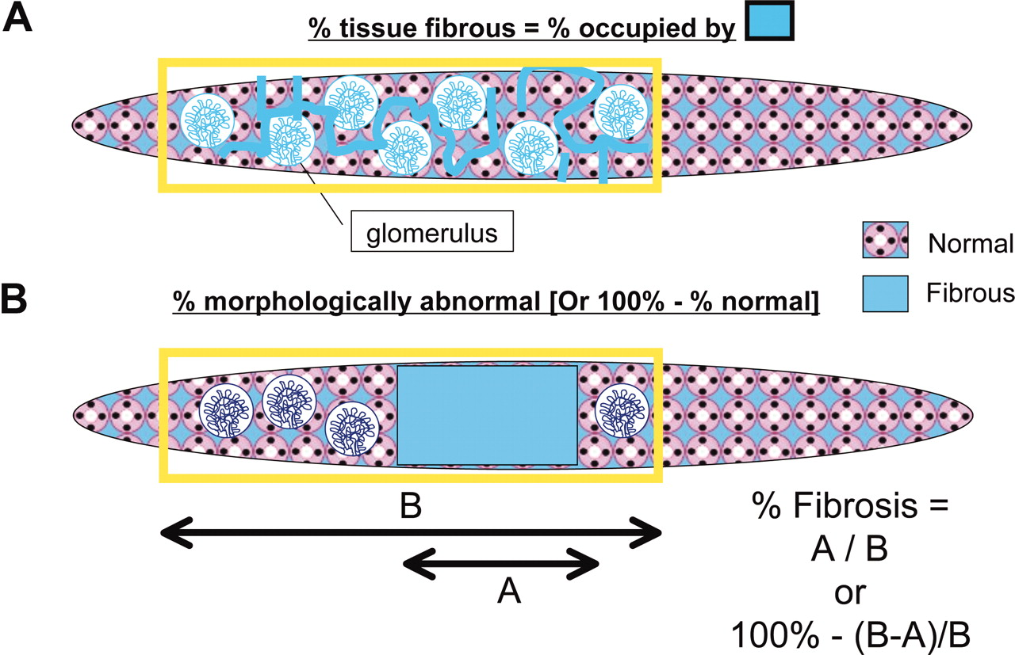

DIFFICULTIES IN GRADING FIBROSIS
% Area Occupied vs % Morphologically Abnormal
©2011 by American Society of Nephrology
Alton B. Farris et al. JASN 2011;22:176-186
Notes:
One of the difficulties in grading fibrosis is that it can be done in two ways, using--
THE PERCENTAGE AREA OCCUPIED by fibrous tissue--- or--- the PERCENT MORPHOLOGICALLY ABNORMAL --because it is fibrotic
This figure explains the difference between these two concepts.
Panel (A) shows The % area occupied paradigm, --which is used in computerized measurements ---and can also be simulated by humans)
Panel (B) shows the second method which seeks to assess the percentage of the tissue that is abnormal.
Xxxxxxxxxxxxxxxxxxxxxxxxxxxxxxxxx
I NEED NOT call Banff rules ambiguous;---- “ci in >50% of CORTICAL AREA”---- by allowing the 50-100% range, one could argue it is it is recommending the % abnormal definition-- (though that is not explicitly stated)
“
Panel A. The fibrosis percentage was taken as the percentage of all tissue occupied by fibrous tissue
The range of possible values will depend on how much RESIDUAL proximal tubular and glomerular mass remains in the diseased bx; it can never go up to 100%.
Panel B. The range of possible values is 0-100%.
This % abnormal is at times is more easily assessed as 100 − % normal
FARRIS 2021 Kid Int Reports 6: 1878: pathologists using method B = % area affected = can call 100% fibrosis (ignoring volume of tubules and glom); ci3 showed very poor correlation visual estimate vs automated image analysis; =13% concordance for severe fibrosis; neither showed strong correlations with eGFR or graft loss which is affected by many factors other than area collagen.
Conversely, pathologist could call low % fibrosis as zero while image analysis will always generate a number
In general visual vs automated r=0.46 (pathologist inter-observer r = better = 0.6)
BANFF 2015 SPECIFIES % CORTICAL AREA AFFECTED BY FIBROSIS—and yes this is what I often do, but when severe it is possible some pathologists just may use the % abnormal
[B-A]/B being the expression for what % is normal).
Survey: method B: 54% expert 86% non expert pathologists
Xxxxxxxxxxxxxxxxxxxxx
It is not necessary for the current discussion but for paradigm A the %age of all tissue was calculated after excluding the tubules and gloms?
Brad Farris studies suggest the incremental value of morphometry on clinicopathologic correlations will be modest, OF THE ORDER OF 0.1 OR LESS
In my opinion this reflects the limitation of USING A SMALL BIOPSY SAMPLE to estimate the inflammation in the WHOLE KIDNEY
Measurements on biopsies can’t be made SUBSTANTIALLY more accurate by using ANY technique that is STILL SUBJECT to SAMPLING ERROR that EXCEEDS THE ACCURACY OF THE MEASUREMENT
Put another way, If 2 measurements are accurate only to 1 decimal place, one can’t divide the numbers, and express the ratio as if it were accurate to 4 decimal places
xxxxxxxx
(it is difficult to describe precisely in words; when i see a biopsy, I try to assign it into four equal quartiles that encompass the best and the worst cases I have seen in my career, and use that in the grading process).

Slide 72
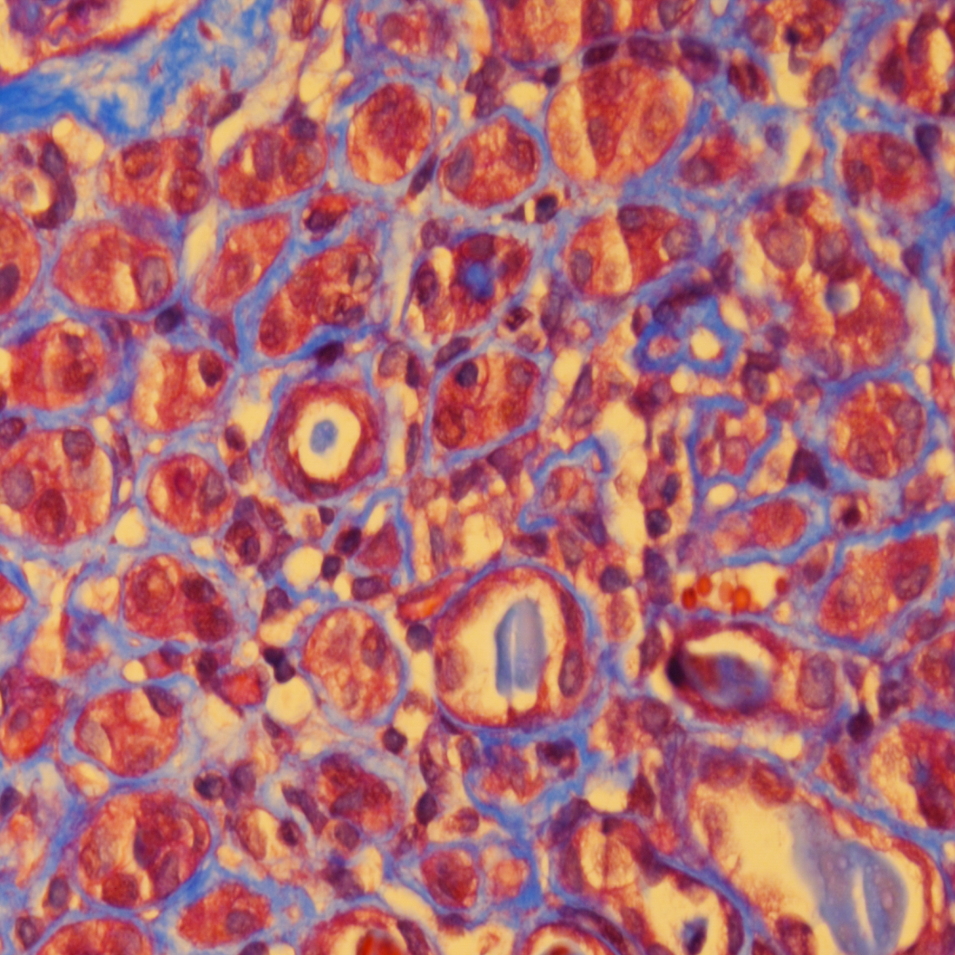
% area occupied by collagen ~20% or less % morphologically abnormal = 100%
Notes:
1
Now let us apply these two methods to this trichrome stained section.
The % area occupied by collagen is perhaps no more than 20%
But arguably,--- the % of biopsy that is morphologically abnormal---- in the sense of having AT LEAST SOME fibrosis---- is 100%
Xxxxxxxxxxxxxxxxxxxxxxxxxxxxxxxxxxxxxxxxxxxxxx
Here is an example of a Biopsy--- in which tubular atrophy was disproportionate to fibrosis.---with only trivial inflammation.
Left panel: The tubular basement membranes were markedly thickened and wrinkled.
Right panel: Trichrome stain confirmed the marked decrease in tubular diameter, ---but there were only fine bands of collagen separating them;---- indeed much of the collagen appeared to be basement membrane matrix
xxxxxxxxxxxxxxxxxxxxx
Bellamy diagram called it diffuse tubular atrophy with replacement fibrosis and yes the blue here can also increase to high %

Slide 73
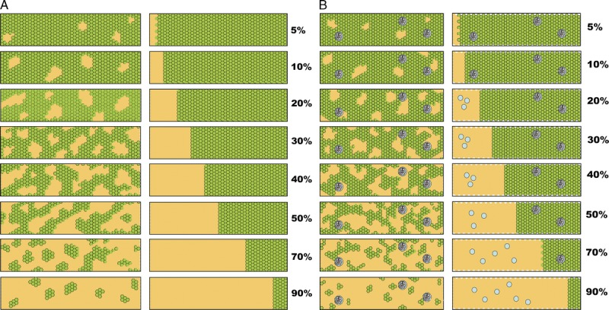
ci Can be Patchy or Confluent
Tubules alone excluded
Glomeruli excluded as well
% Fibrosis assessed as per cent of total area can never be 100%
Upper limit dependent on residual mass PCT & glomeruli
Farris et al. Am J Transplant 2014: 14: 897
Notes:
Another problem with assessing the % area fibrotic ----is that the affected area can be patchy (panels 1 and 3) ----or confluent (as shown in panels 2 and 4).
Also: In assessing fibrosis by digital analysis, --tubules alone can be excluded (use pointer for panels 1 and 2) ---or the glomeruli can be excluded as well (panels 3 and 4)
You will appreciate that the ---% Fibrosis assessed as per cent of total area--- can never be 100%
The Upper limit is dependent on –the residual mass of the Proximal tubules---and the glomeruli---- in that biopsy
XXXXXXXXXXXXXXXXXXXXXXXX
It is obvious that biopsies with pathology that looks quite different can get the same fibrosis score, even if the measurements are made by an accurate morphometric method.
The functional consequences of the same score need not be identical for these different patterns of fibrosis.
xxxxxxxxxxxxxxxxxxxxxxxxxxxxxxxxxxxxxxxxxxxxxxxxxxxxxxxxxx
It is obvious that it is difficult for the human eye to account for all these subtleties, ----especially when the process is variable---- and affects different biopsy cores to different degrees
It should also be apparent that the % fibrosis measured AS % AREA OCCUPIED will never be 100%
The upper limit will depend on the residual PCT and glomerular mass in the diseased biopsy you are looking at.
XXXXXXXXXXXXXXXXXXX
EVEN IF BOTH GLOMERULI AND TUBULES ARE EXCLUDED, BLOOD VESSELS, CAPSULE AND INFLAMMATION WILL PREVENT THE UPPER LIMIT OF 100% FROM BEING REACHED
But again the incremental value of digital analysis may be small due to the numerous clinical variables that can SUPERCEDE the EFFECT of INDIVIDUAL HISTOLOGIC parameters on graft function
acknowledge for fibrosis but equally valid for inflammation
FIGURE 11
More visual analogue scales provided by the Banff Working Group on Fibrosis.¹⁷
A, Scale for the assessment of patchy (left) and confluent (right) interstitial fibrosis without glomeruli.
B, Scale for patchy (left) and confluent (right) fibrosis with glomeruli.¹⁶
Reproduced with kind permission from American Journal of Transplantation.

Slide 74
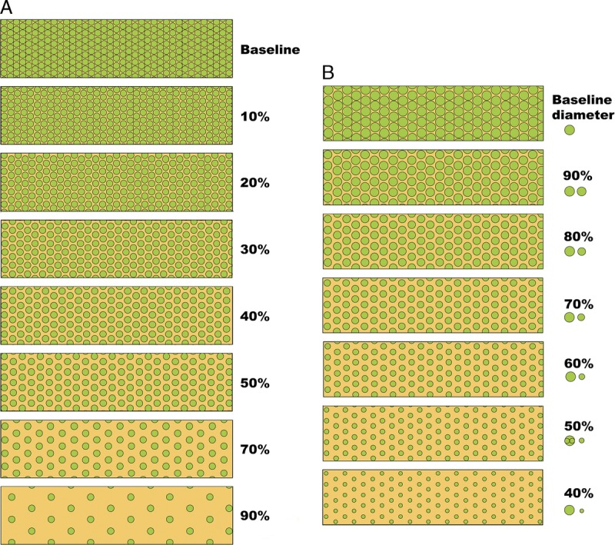
Same % Fibrosis = Different Impact on Outcome without/with Associated Tubular Atrophy
50% fibrosis = Greater volume collagen if tubules atrophic
When diffusely distributed 50% looks quite subtle at 1st glance
Farris et al Am J Transplant 2014: 14: 897
Notes:
This figure illustrates how it is possible for---- the SAME % OF interstitial fibrosis----to have DIFFERENT IMPACT ON RENAL FUNCTION—without and with tubular atrophy
If you look at this box here----The 50% fibrosis accounts for a SMALLER volume of collagen---- if tubules are NOT atrophic (left panel)---compared to when they are atrophic (right panel)
Note that –when it is diffusely distributed--fibrosis as high as 50% looks quite subtle when you first glance at the biopsy
THUS TRYING TO LOOK AT THE DEGREE OF FIBROSIS in a biopsy---- SIMPLY AS AN OVERALL NUMERICAL VALUE----- IS AN OVERSIMPLIFICATION.------It is necessary to make note of its DISTRIBUTION---as well as the ASSSOCIATED tubular pathology
XXXXXXXXXXXXXXXXXXXXXXXXXXXXXXXXXXXXXXXXXXXXXXXX
NOT REALLY SHOWN: In contrast, a patchy fibrosis affecting 50% of bx will be easily recognized at low power examination of the biopsy
Although reproduced in the Banff 2018 guide, this paper is really Farris et al.; it is just a supplementary figure with no great legend.
See this image and copyright information in PMC
FIGURE 10 Visual analogue scales provided by the Banff Working Group on Fibrosis. This working group developed schematic diagrams to facilitate and standardize scoring of Banff Lesion Scores ci and ct.
A, Scale for the assessment of interstitial fibrosis without tubular atrophy.
B, Scale for the assessment of diffuse tubular atrophy with “replacement fibrosis.” .
50% ci

Slide 75
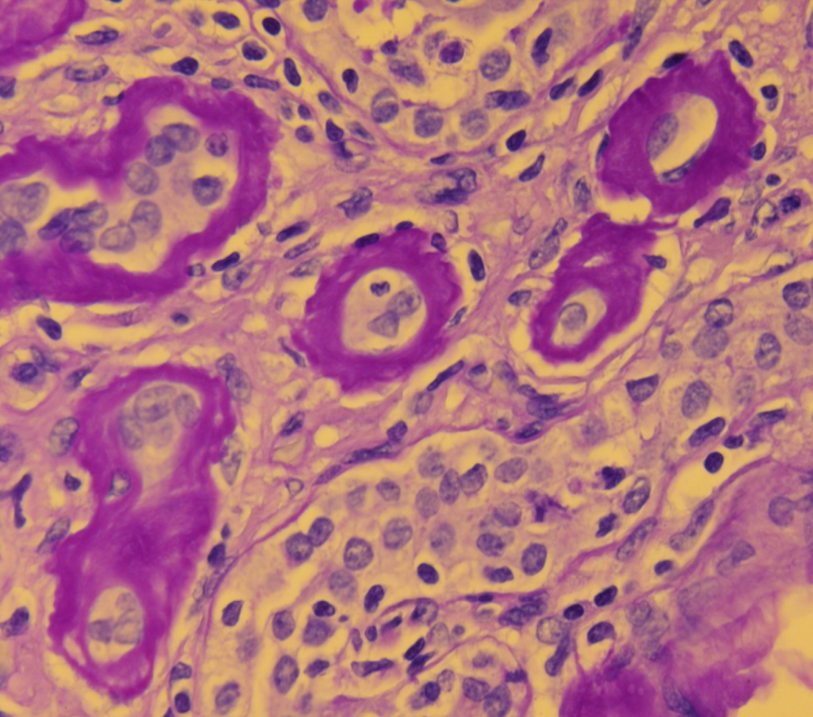
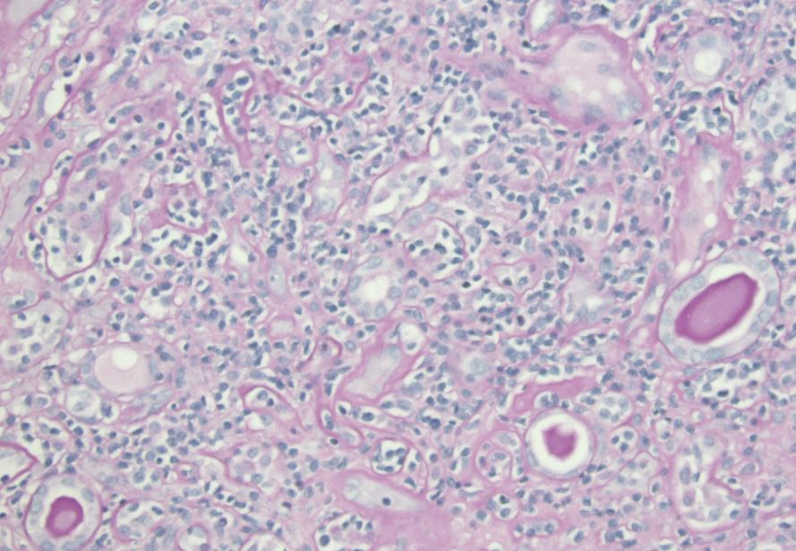
Illustrations of Current Diagnostic Criteria and Grades
IFTA 3+3
i-IFTA 3
C4d –ve
DSA -ve
t-IFTA 2
caTCMR 1A
t-IFTA 3
caTCMR 1B
Notes:
1
Here are illustrations of current diagnostic criteria (panel 1) and grades 1A and 1B (middle and right panels)
-The left panel shows a biopsy with moderate to severe interstitial fibrosis ---ie IFTA score of 3+3 totaling 6,and an an i-IFTA score of 3; ----the C4d was negative, and DSA testing was also negative. -------This would be a generic example of chronic active TCMR, -----and its further grading would require evaluating the grade of tubulitis at hpf.
-This biopsy in the middle panel was called Grade 1a chronic active TCMR, ---since it had t2 tubulitis with 5-10 lymphocytes per cross section.
- The right panel was Graded as 1b chronic active TCMR, -since it showed grade t3 tubulitis, -seen here as disruption of tubular basement membranes
Xxxxxxxx
Here is a recent biopsy in which I made a diagnosis of acute TCMR in the setting of IFTA-
-At lpf inflammation and tubulitis could not be demonstrated in the non-fibrotic areas such as this one. The conventional i & t scores were zero
-C4d stain was negative and there was no DSA
-At hpf I was able to find tubulitis in mildly atrophic tubules even when other tubules nearby were severely atrophic
So I called the biopsy mild acute rejection which is what I have been doing for the past 20 years. I AM PROPOSING THAT THE BANFF SCHEMA OFFICIALLY RECOGNIZE SUCH CASES AS BANFF TYPE 1A superimposed on iIFTA
Transistion mild to moderate silly

Slide 76
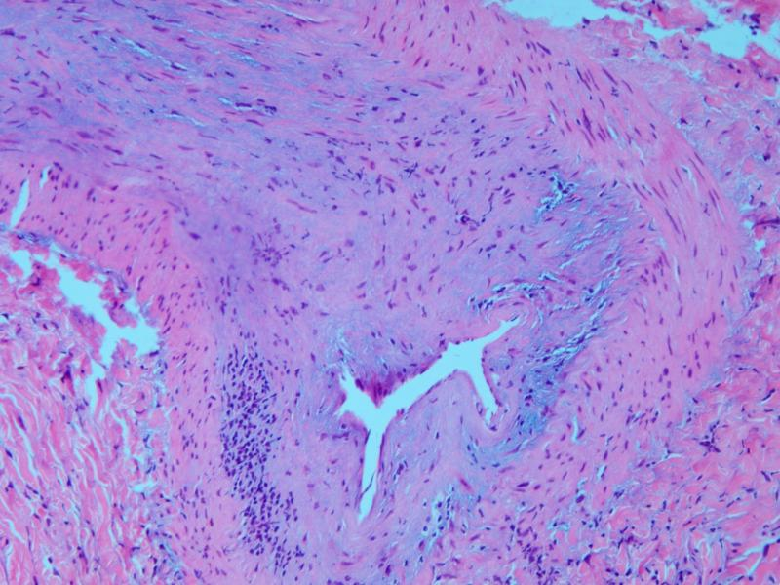
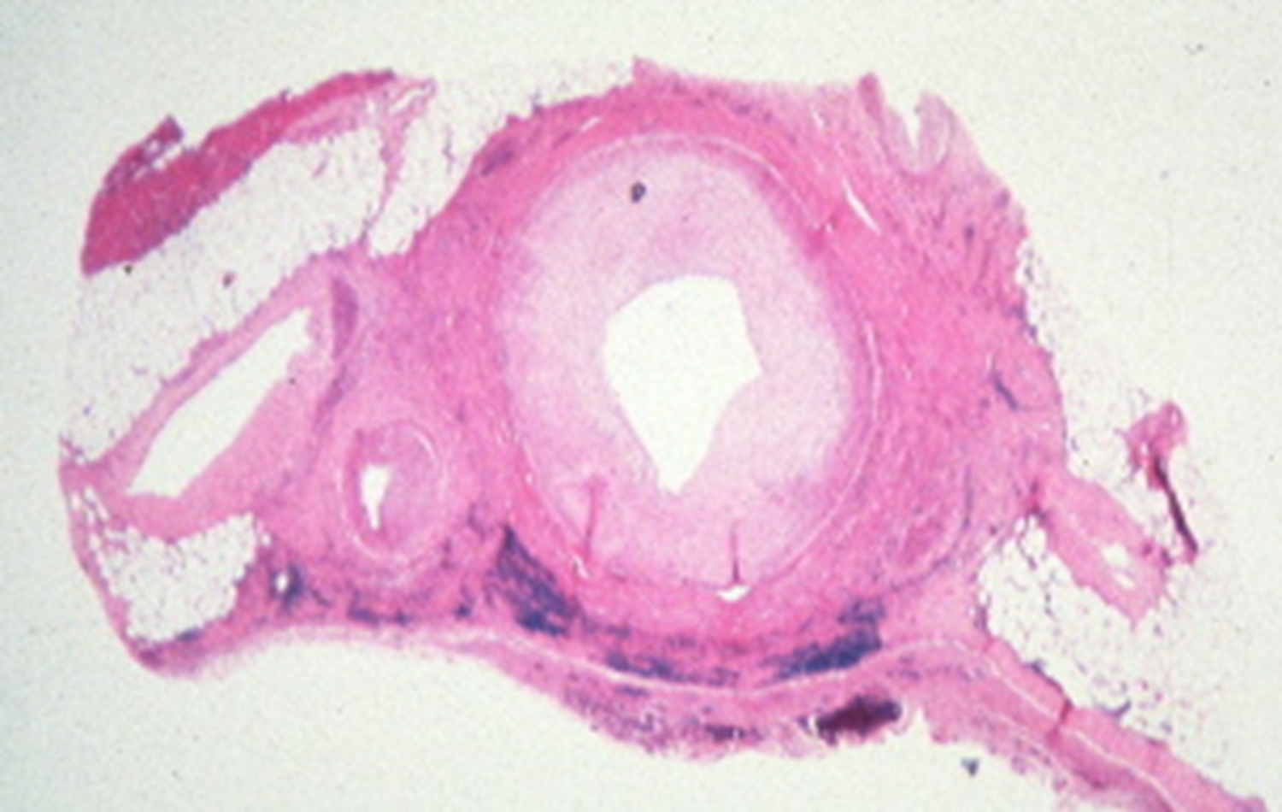
Chronic Active TCMR, Grade II
Bland CV
Notes:
Grade 2 chronic active TCMR requires intimal fibrosis with inflammation as shown in the left and middle panels.
However, in my experience, --More often-- LATE BIOPSIES SHOW a bland form of arteriosclerosis with no intimal inflammation, --as is shown in the right panel. –
Intimal inflammation is not required when graft arteriosclerosis IS USED AS A CRITERION for chronic ABMR,. ----A case could be made that the same rule should apply to chronic TCMR., ----AT LEAST WE COULD CALL biopsies like this CHRONIC INACTIVE TCMR
Xxxxxxxxxxxxxxxxx
Banff 2018 guide; cv1 upto 13% reduction luminal radius; Cv2 29% reduction radius is 50% reduction area

Slide 78
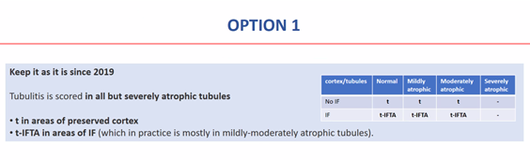
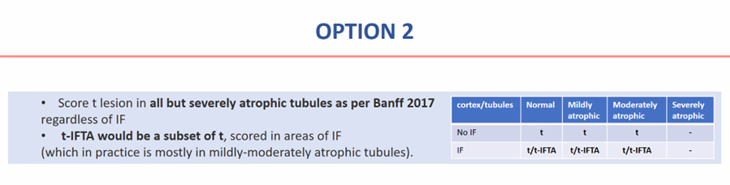
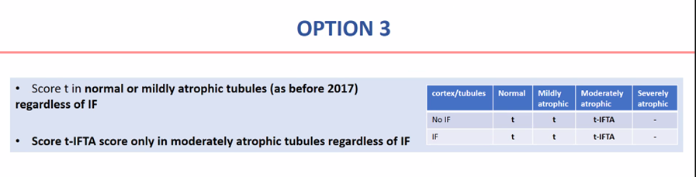
Votes
No
No
No
Notes:
IN FINAL MANUSCRIPT DECISION WAS MADE TO KEEP THE Banff 2019 RULES AND NOT CHANGE IT AGAIN -
In this survey:
Banff attendees were asked to vote on 3 options to get a feel for where they stood on this issue.
Preliminary analysis during the conference suggested that opinions were almost equally split between continuing to follow the Banff 2019 and 2017 rules.
Not many people wanted to turn the clock back to 2013 and before.
xxxxxxxxxxxxxxxxxxxxxxxxxxxxxxxxxxxxxxxxxxxxxxxxxxxxxxxxxxxxxxxxxxxxxxxxxxx
Option 1 was ---to keep Banff 2019 rules--- and keep scoring all but the most severely atrophic tubules ---. There was some but not unanimous …… support for this, and I voted this way as well, ---as we are already being criticized for changing the rules too often. Call it acute or chronic active depending on whether it is t2-no IFTA or t2-IFTA ------(J. Requiring IF to score t-IFTA is more intuitive & prevents confusion between acute and chronic atrophy)
The practical implication is that areas without IF would generate a score of t, while areas with IF will generate a score of t-IFTA---and that makes good sense
_____________________________________________________________________________
Option 2 ---Banff 2017agrees with scoring tubulitis in all but severely atrophic tubules—but suggests this be done REGARDLESS OF interstitial fibrosis BEING PRESENT.
In other words areas with IF can potentially generate a t-SCORE as well as a T-IFTA SCORE.
I think this introduces needless complexity but a significant # of people voted for it PRESUMABLY BECAUSE IT CONTINUES TO ENDORSE THE Banff 2017 RULES- but does need to modify or at least clarify the 2019 rules.
TO KEEP AN AUDITABLE TRAIL OF THIS ALGORITHM IN RESEARCH STUDIES -----WE WILL NEED TO RECORD (AT LEAST) 3 TUBULITIS SCORES PER BIOPSY: -----------(AT LEAST) ONE IN AREAS WITHOUT IF---- AND UPTO 2 IN AREAS WITH IF.
---------------------------------------------------------------------------------
Option 3 was to return to the pre-2017 era and score only mildly atrophic tubules. Only a minority of attendees favored that. .
Xxxxxxxxxxxxxxxxxxxxxxxxxxxxxxxxxxxxxxxxxxxxxxxxxxxxxxxxxxxxxxxxx
Working Group CALL AGENDA: For option 2: I suggest we send out another poll that also targets colleagues who could not attend the Banff conference---maintaining so called “integrity” of existing data is not compatible with exploring a new concept---indeed changing the data recording system is the only way you will be able to determine—the right path forward
.

